Slide 1

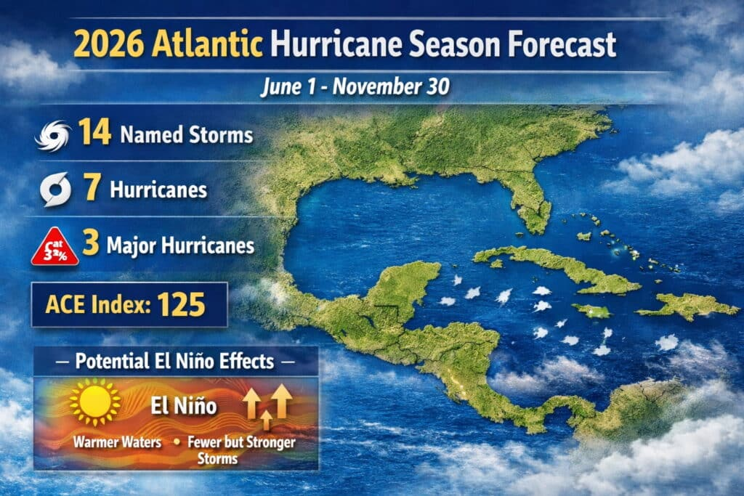


Contents
Introduction – NEMO
Introduction to Disaster Management System of St Lucia
NEMO Documents and Procedures
SLHTA Crisis response Protocols
Disaster preparedness
Health and Wellness Contact numbers
Emergency Shelters by District
Emergency contact information
Disaster Committee Contacts per Community
Embassy Contact details
Honorary Consuls contact information

Slide 2
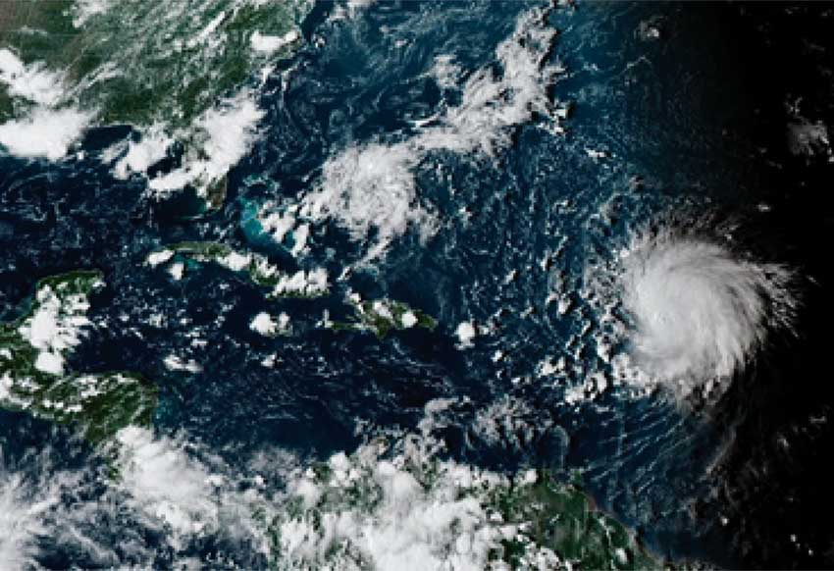

Introduction to NEMO
The role of the National Emergency Management Organization [NEMO] is to develop, test and implement adequate measures to protect the population of Saint Lucia from the physical, social, environmental and economic effects of both natural and man-made disasters.
Its responsibility is to ensure the efficient functioning of preparedness, prevention, mitigation and response actions.
Ms Kenisha Jeffrey-Isembert – Director of NEMO - +1 758 452 3802, Email: director@nemo.gov.lc
Mrs Princess Khodra– Deputy Director of NEMO - +1 758 452 3802, Email: princess.khodra@govt.lc

Slide 3
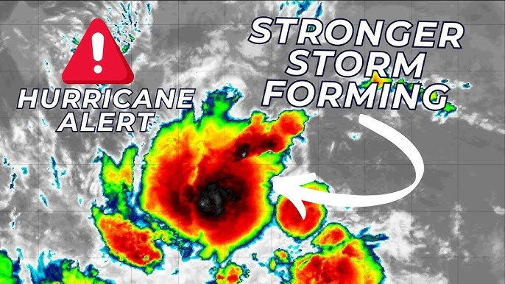
Introduction to the disaster management system
The Disaster Management System of Saint Lucia is a three tiered one
NATIONAL – NEMAC - National Emergency Management Advisory Committee
COMMITTEES - National and District Disaster Committees.
COORDINATING UNIT – NEMO Secretariat

Slide 4
NEMO documents and procedures
Standard Operating Procedures for disaster management at NEMO:
http://nemo.gov.lc/Disaster-Management/National-Emergency-Management-Plan/Standard-Operating-Procedures
General disaster documents for download:
http://nemo.gov.lc/Disaster-Management/National-Emergency-Management-Plan/General-Info
Disaster Management Policy Documents:
http://nemo.gov.lc/Disaster-Management/National-Emergency-Management-Plan/Policy-Documents
National Emergency Plans:
http://nemo.gov.lc/Disaster-Management/National-Emergency-Management-Plan/National-Plans

Slide 5


SLHTA Crisis response Protocols
The SLHTA along with other pertinent stakeholders play a pivotal role in disaster preparedness
SLHTA are part of the NEMAC Committee
We work in conjunction with:
NEMO
GOVT. OF ST LUCIA
DEPT. OF HEALTH AND WELLNESS
MINISTRY OF TOURISM
METEOROLOGICAL OFFICE
SLASPA / HIA
LUCELEC
WASCO
FLOW
DIGICEL
SLTA

Slide 6
Disaster preparedness
Once a Pre-strike meeting is called by NEMO the SLHTA will implement a series of actions immediately following the announcement which is determined by the relevant authorities.
The SLHTA will provide members with updates throughout the duration of the event. This will be disseminated via the What’s App platforms.
These updates will come from various agencies – as outlined previously.
Members with guests in-house must ensure a list of guest details is easily accessible to share in the event of evacuation or accountability measures. This would include name, country of origin, arrival and departure dates.
The SLHTA have compiled a list of emergency contacts for each member company including maintenance managers where relevant. If you have not submitted your emergency contacts please do so to bdo@slhta.info
The following pages will give you relevant emergency contact information which would be helpful.

Slide 7
Health and Wellness Centre contacts
INSTITUTIONS TELEPHONE NUMBERS
Castries Wellness Centre
Sexual & Reproductive Health Clinic
468-8880/ 468-8882
468-8886/ 468-8887
La Clery Wellness Centre
468-8531/ 468-8533
Mobile 723-0712
Entrepot Wellness Centre
468-7935/468-7936
Ciceron Wellness Centre
468-7704
Ti Rocher (Castries) Wellness Centre
468-7746/468-7747
Bexon Wellness Centre
468-7781/468-7783

Slide 8
Health and Wellness Centre contacts
INSTITUTIONS TELEPHONE NUMBERS
Dennery Hospital
Respiratory Clinic
468-7650/ 468-7651/ 468-7657
468-7661/ 468-7662
Soufriere Hospital
Respiratory Clinic
468-7601/ 468-7602/ 468-7603
518-1905/ 468-7617
Gros- Islet Polyclinic
Respiratory Clinic
468 7630/ 468 7637
723-0663
Grand Riviere Wellness Centre 468-7700/ 468-7701
Monchy Wellness Centre 468-8542/ 468- 8541/ 468- 8543
Babonneau Wellness Centre 468-7720
Fond Assau Wellness Centre 4687980/ 4687981 /Mobile 285-3594
La Guerre Wellness Centre 468-7741/ 468-7742
Richfond Wellness Centre 468-7929
Micoud Wellness Centre 468-7957/ 468-7958
Ti Rocher (Micoud) Wellness Centre 468-7713/ 468-7714
Desruisseaux Wellness Centre 468-7716/ 468-7719/ 468-7717
INSTITUTIONS TELEPHONE NUMBERS
Mon Repos Wellness Centre 468-7706/ 468-7708
Vieux Fort Wellness Centre
Respiratory Clinic
468-7995/ Mobile 384-7344/
518-5881
Laborie Wellness Centre 461-6590
Saltibus Wellness Centre 468-7776/ 468-7779
Belle-Vue Wellness Centre 468-7975/ 468-7976
Grace Wellness Centre 468-7751/ 468-7752
Etangs Wellness Centre 468-7766
Fond St. Jacques Wellness Centre 468-7771/ 468-7772
Mongouge Wellness Centre 468-7786/ 468-7787
La-Fargue Wellness Centre 468-7791/ 468-7793
Delcer Wellness Centre 468-7756/ 468-7757
Jacmel Wellness Centre 468-7727/ 468-7728
La Croix Maingot Wellness Centre 468-7736/ 468-7738/ 4687737
Vanard Wellness Centre 468-7733/ 468-7734
Canaries Wellness Centre 468-7761/ 468-7762
Anse La Raye Wellness Centre 451-4225/ 4687800

Slide 9
Emergency Shelters by District
As Inspected and Certified by the Department of Infrastructure, Ports and Transport,
The Public is hereby informed that under Part IV Section 13 of the Disaster Management, Act No. 30 of 2006 the following are designated as Emergency Shelters. NEMO advises that persons take steps to make their homes their emergency shelter. If this is not possible then make advance arrangements to be with family or friends during a storm.
REMEMBER that shelters are not normally opened before a storm. If a shelter is to be opened BEFORE a storm, NEMO will announce such in advance.
Gros- Islet
1.Gros Islet Roman Catholic Church
2.Gros Islet Church of the Nazarene
3.Gros Islet Infant School
4.Gros Islet Primary School
5. Corinth Secondary School
Monchy
6.Monchy Roman Catholic Church
7.Monchy Combined School
8.Monchy Human Resource Development Centre
La Feuille
9.La Feuille Mothers’ & Fathers’ Hall
10.La Feuille Pentecostal Church
Grand Riviere (Gros Islet)
11.Grand Riviere Primary School
12.Full Gospel Deliverance Tabernacle Church
Marisule
13. Marisule Seventh Day Adventist Church – The Lighthouse on the Hill
Degazon
14. Degazon SDA Church Mount Olives
Union
15. Dame Pearlette Louisy Primary School
Balata
16.Balata Combined School
17.Balata SDA Church
18.Fundamental Baptist Church
Ti Morne
19.New Testament Church of God
Babonneau
20.Babonneau Resource Centre
21.Babonneau Secondary School
22.Babonneau Combined School
23.Babonneau Roman Catholic Church

Slide 10
Emergency Shelters by District
Cacoa
24.Gospel Baptist Church
25.Bethany SDA Church and Children’s Division
Fond Assau
26.Fond Assau Primary School
La Guerre
27.La Guerre Combined School
28.La Guerre Gospel Hall
Garrand
29.Garrand Mothers’ & Fathers’ Hall
Boguis
30. Boguis Combined School
Des Barras
31.Des Barras Combined School
32.Des Barras Mother’s and Father’s Hall
Plateau
33.Plateau Seaview SDA Church
34.Plateau Mothers’ & Fathers’ Hall
La Croix
35. La Croix Evangelical Church
Castries North
Lanse Road
36. Camille Henry Memorial School
La Clery
37. La Clery Roman Catholic Church
38. Maranatha Seventh-Day Adventist Church
Vide Boutielle
39. Vide Boutielle Combined School
40. Patricia D. James Secondary School
41. Sir Ira Simmons Secondary School
Morne Du Don
42. Morne Du Don Combined School
Chase Gardens
43. Chase Gardens HRDC

Slide 11
Emergency Shelters by District
Castries Central
44.Carmen René Memorial School
45.St. Aloysius RC Boy Infant School
46.St. Aloysius RC Boy Primary School
47.Ave Maria Girls Infant School
48.Ave Maria Girls Primary School
49.Anglican Infant School
50.Cannon Laurie Primary School
51.Holy Trinity Anglican Church
52.Castries SDA Church
53.Castries City Hall
54.Castries Methodist Church
55.Salvation Army Church
Castries East
Bocage
56.Bocage Combined School
57.Bocage Secondary School
58.Bocage Pentecostal Church
Marchand
59. Marchand Community Centre
60. Marchand Parish Hall
61. Marchand Combined School
62. Marchand RC Church
Entrepot
63. Entrepot Secondary School
64. Entrepot Human Resource Centre
Ti Rocher
65. Ti Rocher Combined School
Castries South
Ciceron
66.Ciceron R.C. Combined School
67.Deliverance Baptist Church
68.Ciceron Secondary School
75.Ciceron Methodist Church
69.Ciceron SDA Church
70.Lady Gordon Opportunity Centre
Faux A Chaux
71. Faux A Chaux Community Centre
Marigot
72.Stanley Jon Odlum Secondary School
La. Croix Maingot
73.La. Croix Maingot Combined School
74. La Croix SDA Church
Tapion
75. Tapion Private School

Slide 12
Emergency Shelters by District
Castries South East
Bexon
76.Bexon Infant School
77.Bexon Roman Catholic Church
78.Grace Baptist/Bexon Baptist Church
Marc
79.Marc SDA Church
Cul De Sac
80.Cul De Sac Early Childhood Development Centre
Goodlands
81.Goodlands Full Gospel Worship Centre
Ravine Poison
82.Zion SDA Church
83.Zion SDA Primary School
Sarrot
84.Sarrot Community Centre
Forestiere
85.Forestiere Methodist Church
86.Forestiere Methodist Combined School
87.Forestiere SDA Church
Ti Rocher (Castries)
88.Ti Rocher RC Primary School
Dierre Fort
89.Dierre Fort Seventh Day Adventist Church
Odsan
90.Odsan Combined School
91.Odsan Pentecostal Church
Trois Piton
92.Trois Piton SDA Church
93. Temple of Faith
Barre De Chaussee
94. Barre De Chausee Multi Purpose Court
Anse Le Raye
95.Anse La Raye Primary School
96.Anse La Raye SDA Church
97.Anse La Raye RC Church
Jacmel
98.Roseau Combined School
99.Jacmel Roman Catholic Church
Millet
100.Millet Primary School / Millet HRDC
Tete Chemin
101. Tete Chemin Human Resource Centre
102. Tete Chemin SDA Church

Slide 13
Emergency Shelters by District
Canaries
103. Canaries Parish Centre
Flora Villa
104. Delia’s Hideaway
Belvedere
105. Fresh Disco
Fond St. Jacques
106. Fond St. Jacques Roman Catholic Church
107. Fond St. Jacques Parish Centre
108. Fond St. Jacques Pre-School
Soufriere Town
109. Soufriere Roman Catholic Church
110. Soufriere Seventh-Day Adventist Church
111. Soufriere Comprehensive School
112. St. Isidore Hall
Fond Beniere
113. Christ is the Answer Church
Bouton
114. Bouton Combined School
Choiseul
Saltibus
115. Saltibus Roman Catholic Church
116. Darban Mothers’ and Fathers’ Hall
River Doree
117. River Dorée Anglican Church
118. River Dorée Mothers’ and Fathers’ Hall
La Fargue
119. La Fargue Mission Evangelical Church
120. Enrichment Centre (Reunion)
Choiseul Village
121. Choiseul Roman Catholic Church
Reunion
122. Reunion Primary School
123. Enrichment Centre
124. Reunion Pentecostal Church
Victoria
125. Victoria Roman Catholic Church
126. Victoria Seventh Day Adventist Church
La Maze
127. La Maze Community Resource Centre
La Pointe
128. La Pointe Pentecostal Apostalic Church

Slide 14
Emergency Shelters by District
Laborie
Laborie Village
129. Laborie Boys Primary School
130. Laborie Girls Primary School
131. Laborie Roman Catholic Church
132. New Life Pentecostal Church (La Croix Road)
Augier
133. Augier Pre School (St. Francis Xavier)
134. Augier Combined School
135. Augier Roman Catholic Church (St. Francis Xavier)
136. Augier Evangelical Church
Banse/La Grace
137. Banse La Grace Evangelical Church
Vieux Fort South
138. Vieux Fort Seventh Day Adventist Church
139. Victory Pentecostal Church
Vieux Fort North
Pierrot
140. St Martin De Porres RC Church
Belle Vue
141. Belle Vue Human Resource Centre
142. Belle Vue RC Church
Grace
143. Grace Community Centre
144. Grace RC Church
145. Grace Fair Trade Centre

Slide 15
Emergency Shelters by District
Micoud South
Ti Rocher
146. Ti Rocher Multi Purpose Centre
147. Liberty Baptist Church
148. Seventh Day Adventist Church - Ti Rocher
Micoud North
149. Mon Repo Catholic Church
150. Mon Repose SDA
151. Praslin Community Centre
152. Bible Baptiste Church (Wooden)
Micoud Village
153. Lime Light Disco
154. Faith Tabernacle Church
155. Micoud RC Church
156. Ebenezer Seventh Day Adventist Church
Desruisseaux
157. Fond Desruisseaux Mothers’ and Fathers’ Hall
158. Desruisseaux Seventh-Day Adventist Church
159. Desruisseaux Roman Catholic Church
160. Desruisseaux Multi Purpose Centre
161. Desruisseaux Evangelical Church
Mon Repos
162. Mon Repos RC Church
163. Mon Repos Seventh Day Adventist Church
164. Praslin Community Centre
165. Bible Baptist Church

Slide 16
Emergency Shelters by District
Derniere Riviere
173. Derniere Riviere Apostolic Faith Church
174. Derniere Riviere Combined School
Dennery South
Dennery Village
175. Dennery Infant
176. Dennery Seventh Day Adventist Church
177. Clendon Mason Memorial School
La Caye
178. St. Mary’s Anglican Church
Dennery North
La Resource
163. La Resource Day Care Center
164. La Resource Roman Catholic
165. La Resource Parish Centre
166. La Resource Combined school
Grande Riviere
167. Grande Riviere Secondary School
168. Grande Riviere Seventh Day Adventist Church
169. Grande Riviere Human Resource Center
Gadette
170. Gadette Day Care
Richfond
171. Richfond Combined School
Aux Lyon
172. Aux Lyon Combined school

Slide 17
Emergency contact information
Download the CAP CAP app to your mobile phone:
CAP CAP Google Play:
https://play.google.com/store/apps/details?id=hr.optimit.capcap.mobile&hl=en&gl=US
CAP CAP Apple: https://apps.apple.com/us/app/capcap/id1176568291
NEMO: http://nemo.gov.lc/
Tel: +1 758-452-3802, Ms Kenisha Jeffrey – Director and Mrs Princess Khodra – Deputy Director
Email: admin@nemo.gov.lc
St Lucia Meteorological Services: https://met.gov.lc/
Hewannora Intl Airport Tel: +1 758 454 6550
Fax: +1 758 454 9705
George FL Charles Airport +1 758 452-5860
Hotline: +1 758 454-3452
E-mail: slumet@yahoo.com
Twitter: @stluciaweather
Facebook: StLuciaMet
SLASPA Flight status: https://www.slaspa.com/hia/index.php/en/hia-arrivals
Tel: +1 758 457 6100
Email: info@slaspa.com

Slide 18
Emergency contact information
LUCELEC: https://www.lucelec.com/
Tel: +1 758 457‐4761
Mobile: +1 758 519-9613 – Omari Frederick – Corporate Communications Officer, External Communications
Email: Omari Frederick - ofrederick@lucelec.com
Customers can call the following numbers to report localized faults: 452-2165 for the north of the island and 454-6617 for the south of the island (from Praslin to Bouton).
Send fault reports via WhatsApp: 285-6796, 285-7859, 285-3593, 285-3329, 728-9754, 728-9755, 728-9756. Please provide your name, a contact number, the location of the fault and the type of fault.
Email: customersupport@lucelec.com
WASCO: https://wascosaintlucia.com/
Control Room North Tel: +1 758 457 3958/60
Control Room South Tel: +1 758 457 3984
Vieux Fort Tel: +1 758 457 3980
Soufriere Tel: +1 758 457 3987
Email: wasco@candw.lc
Email: wascocontrol@gmail.com / control@wascosaintlucia.com

Slide 19
Emergency contact information
MINISTRY OF TOURISM: https://slutourism.govt.lc/
DIGICEL: https://www.digicelgroup.com/lc/en/
Tel: +1 758 728 3400
Roaming Tel: +1 758 716 7626
Email: customercarestlucia@digicelgroup.com
Twitter: @digicelStLucia
Instagram: @digicelstlucia
SLHTA – Noorani Azeez: +1 758 721 4444 ceo@slhta.info / Juliet Sutherland: +1 758 726 4680 bdo@slhta.info
Saint Lucia Tourism Authority: https://www.stlucia.org/en/
Tel: +1 758 458 7101
Email: information@stlucia.org

Slide 20
Disaster Committee Chairpersons
1. Silas Wilsom
Micoud North
520-4466/286-9367
anthonysilaswilson@gmail.com
2. Paul Francis
Micoud South
730-2506
levispaulfrancis@gmail.com
3. Allister Phillip
Castries East
730-2694/285-2033
ceddmcslu@gmail.com
4. Phillip Leon
Castries South-East
730-2711/714-8033
phillipleon@gmail.com
17. Jim Willims
Babonneau
730 2685 / 730 5969
sjules0024@gmail.com
18. Claudine Louison
Dennery North
730-2508
claudine_louison@
outlook.com
5. Denis Hunte
Laborie
489-9856
myshan7@hotmail.com
6. Ian Frederick
Canaries
730-2689
schoolsafetyofficer@
learning.edu.lc
7. Jeny Gillard
Choiseul
730-2491
Jenygaillard28@gmail.com
8. Lindy Eristhee
Vieux Fort South
730-2699
Lindyeristheesmith@gmail.com
9. Ausbert Regis
Dennery South
730-2501
ausbertregis69@gmail.com
10. Elisha Clarke-Malaykhan
Castries North
730-2740/286-9133
11.Mervin S Joseph
Castries South
730-2503/519 6270
mervinsj@hotmail.com
12. Placide Lascaris
Soufriere
730-2493
Lascarisplacide100@
hotmail.com
13. Davis Paul
Castries Central
730-2517
davispaul758@gmail.com
14. Linnell Williams
Anse-la-Raye
287-6387
linnellwilliams7@gmail.com
15. Petra Mitchell
Vieux Fort North
716-5382
Petty65@hotmail.com
16. Vance Pilgrim
Gros Islet
730-2514
Vance1291@gmail.com

Slide 21
Embassy Contact Details
Ambassador of Cuba
Yenielys Vilma Regueiferos Linares
Tel: 758 285 3383
Email: embajador@lc.embacubs.cu
Ambassador of the Republic of China (Taiwan) Her Excellency Nicole Su
Tel: 758 452 8105
Email: taiwanembassyslu@gmail.com
Ambassador Leiff Escalona
Ambassador of Venezuela to Saint Lucia
Tel: 758 452 4033
Email: embavenezslu@gmail.com / vembassy@candw.lc
H.E. Marie-Noëlle Duris
Ambassador of France to Saint Lucia
Tel: 758 455 6060
Email: embassy@ambafrance-lc.org
Ambassador Younes Dirhoussi
Ambassador to the Embassy of the Kingdom of Morocco
Tel: 758 452 0925 / 758 458 4924
Email: embmorslu@candw.lc
Ms. Karla Tatiana Ornelas Loera
Charge D’Affaires of Mexico
Tel: 758 451-4254
Email: mexicanembassy@candw.lc / llopezm@embmexslu.com

Slide 22
Embassy Contact Details
British High Commission
Tel: 758 452 2484 / Zinna Zimbanni 520 1969
Email: zinna.zimbanni@fco.gov.uk
Charge D’Affaires Fouzi Almadani
Ambassador of Libya to St Lucia
Tel: 758 452-0196 / 458-0152 / 488 0108
Email: libyanembassy.saintlucia@yahoo.com
Ambassador Colbert Soares Pinto Junior
Ambassador of Brazil to St Lucia
Tel: +1 758 450 1671
Email: brasemb.castries@itamaraty.gov.br

Slide 23
HONORARY CONSULAR REPRESENTATIVES IN SAINT LUCIA
AUSTRIA
Mr. Konrad Wagner
C/o Calabash Cove
Tel: (758) (C) 484-9813/ 456-3500
Email: konradinstlucia@hotmail.com
BARBADOS
Mr. Timothy Chaderton
Tel: (758) 452-8219 / Cell: (758) 485-3058
Email: chadertont@gmail.com
CANADA
Ms. Paule Turmel-John
Tel: (758) 453 6431 (H) / Cell: (758) 484-6610
Email: stlucia-stelucie@international.gc.ca
CHILE
Mrs. Brenda Floissac-Flemming
Tel: (758) 452-2887 / 452-3250
Email: brenda.floissac@floissaclawyers.com
DENMARK
Ms. Jasmine Kouly
Tel: (758) 285-2112
E-mail: royalknight@candw.lc/ Jasminekouly@gmail.com
FINLAND
Ms Berthia Parle (Ag retired)
Tel:(758) 452-0700 (h) / (758) 716-1301 (c)
Email: bparle@baygardensresorts.com

Slide 24
HONORARY CONSULAR REPRESENTATIVES IN SAINT LUCIA
GERMANY
Ms. Karolin Güler Troubetzkoy
Cell: (758) 727-7002
Email: soufriere@hk-diplo.de
hcgermany@candw.lc
ISRAEL
Dr. Charmaine Gardner
Tel.: (758) 452-2153/484-6004
Email: gardnerc@carascoslu.com
ITALY
Mrs. Maria Thom
Tel: (758) 452 0866/5/ 712-1244
Email: mpt@casalucia.com
THE NETHERLANDS
Mr. Rhory Mc Namara
Tel: (758) 518-1530
Email: rhorymac@gmail.com / stlucia@nlconsulate.com

Slide 25
HONORARY CONSULAR REPRESENTATIVES IN SAINT LUCIA
KINGDOM OF NORWAY
Mr. Albert Daniels
Tel: (758) 451-8198 / 716-7171
Email: albert@daniel.lc / norway@consulate.lc
SOUTH KOREA
Mr. Randall Bain
Tel: (758) 452-7742 / Cell: (758) 720-5491
Email: bain61@gmail.com
SWITZERLAND
Mr. Konrad Wagner
Tel: (758) 484-9813
Email: saintlucia@honrep.ch
SWEDEN
Ms. Michel Anthony-Desir
Tel: (758) 452-5111/5112
Cell: (758) 484-6305
E-mail: mdesir@athenalawslu.com info@athenalawslu.com
TURKEY
Mr. Victor Poyotte
Tel: (758) 450-5347 / Cell: (758) 485-1638
Email: victor.poyotte@gmail.com

