Slide 1

Mpox Sensitization for the Tourism Sector and Ports of Entry
Ministry of Health, Wellness and Elderly Affairs
August 26, 2024
Virtual Session

Slide 2
Outline
Situation Update
Clinical presentation
Surveillance, Case Investigation, Contact tracing
Recommendations for the Accommodation Sector
  Surveillance
  Case Management
  Infection control & prevention practices
Protocols for the Surveillance and Management of Mpox at the ports of entry
Q&A

Slide 3
Situation Update
Dr. Dana DaCosta Gomez, Medical Surveillance Officer

Slide 4
On 14th of August 2024, the World Health Organization (WHO), declares the outbreak of mpox a Public Health Emergency of International Concern (PHEIC)
This is the second declaration in two years of a PHEIC relating to mpox.
The emergence and rapid spread of a new virus strain in the Democratic Republic of the Congo (DRC) in September 2023, and its detection in neighboring countries of the DRC led to the declaration.
The current outbreak of mpox is caused by a new strain, clade Ib , which is different from the 2022 global mpox outbreak caused by clade IIb.
Clade Ib is more transmissible and causes more severe illness.
Clade I is known to affect vulnerable children disproportionately, with a reported 5.5% death rate in the Republic of the Congo (ROC).
Notes:
First declaration in July 2022

Slide 5
The Democratic Republic of the Congo accounts for more than 90% of the cases reported in the African Region
Between 1 January 2024 and 31 May 2024, the highest number of reported cases of mpox is in the African Region.
Since the beginning of 2024, as of the last report on 26 July 2024, 14,479 cases cases of mpox and 455 deaths (case fatality rate: 3.1%) reported by the DRC.
Children under 15 years of age accounted for 66% of cases and 82% of deaths.
73% of the confirmed cases were males.

Slide 6
Rwanda, Uganda and Kenya have reported cases of the new variant. Testing is underway in Burundi to determine whether reported cases are due to the new variant.
The clade I variant contains mutations, indicating an adaptation of the virus due to intense circulation in humans.
Person-to-person transmission has been continuous since its detection.
This is the first time that sustained community transmission of the virus has been described in the country.

Slide 7
In the European Region as of 8 August 2024, 22 662 confirmed mpox cases have been reported by 29 countries in the EU/EEA.
. Most cases (93%) were reported during an intense period of circulation in 2022
In 2024, 685 cases have been reported by 20 EU/EEA countries. All cases reported as of 8 August 2024 were from clade II.
One mpox case clade Ib, of a European man with travel history to the Democratic Republic of the Congo, was confirmed in Thailand on 22 August 2024.
Overall, two cases of MPXV clade Ib have been reported outside outbreak-affected areas in Africa, one by Sweden and one by Thailand.
More imported mpox clade I cases are likely to be reported by EU/EEA and other countries.

Slide 8
In the Region of the Americas, between 2022 and as of 17 August 2024, 63,270 confirmed cases of Mpox, including 141 deaths, were reported in 32 countries.
Most of the cases reported were identified through human immunodeficiency virus (HIV) care services, sexual health services, or primary and/or secondary health care facilities, involving mainly but not exclusively, men who have sex with men (MSM).
Clade II was identified in all cases tested and remains the only one detected to date in the Region.

Slide 9
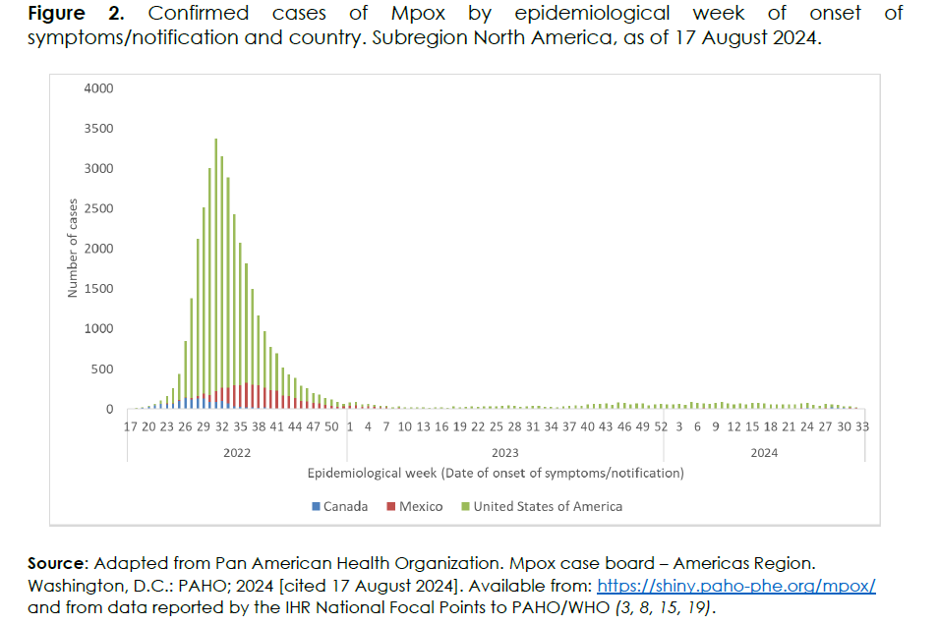
In the North American subregion, between 2022 and as of 17 August 2024, 39,149 cases of Mpox were reported, including 94 deaths.
The highest proportion of cases was recorded in the United States of America with 85% of cases

Slide 10
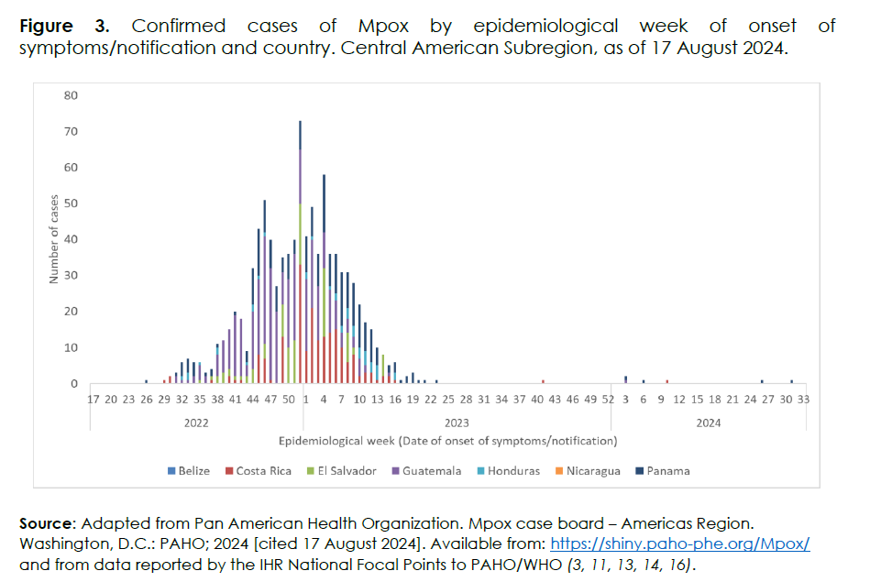
In the Central American subregion, between 2022 and as of 17 August 2024, 1,024 cases of Mpox were reported, including three deaths.
The highest proportion of cases was recorded in Guatemala, with 40% of the cases.
Costa Rica, Guatemala, and Panama have reported cases in 2024 (Figure 3)

Slide 11
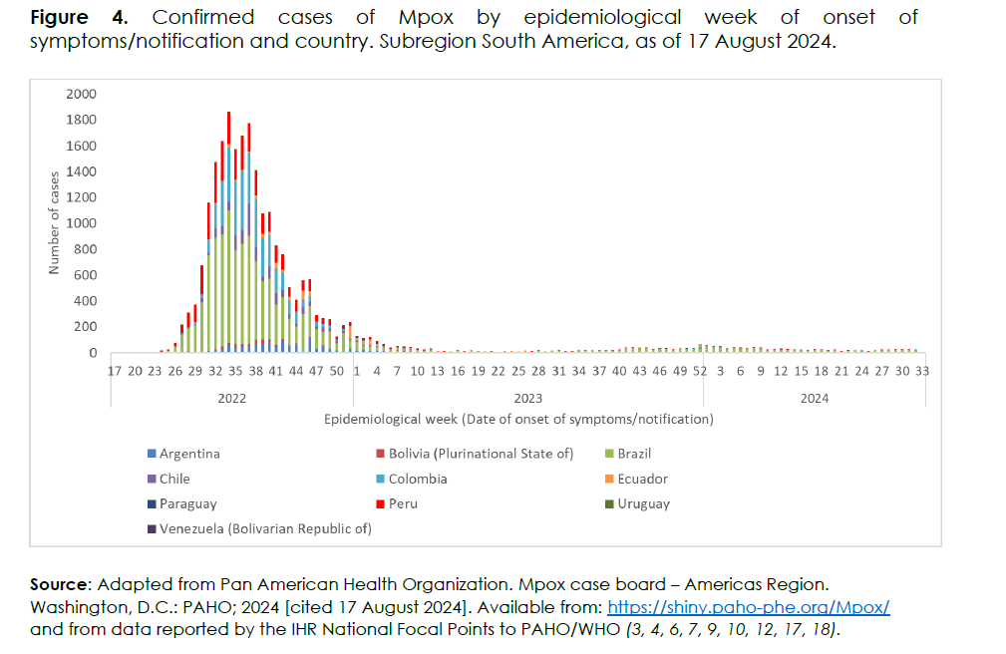
In the South American subregion between 2022 and as of 17 August 2024, 22,990 cases of Mpox were reported, including 44 deaths.
Brazil reported 49% of the cases
Seven countries reported cases in 2024: Argentina, Bolivia, Brazil, Chile, Colombia, and Peru (Figure 4)

Slide 12
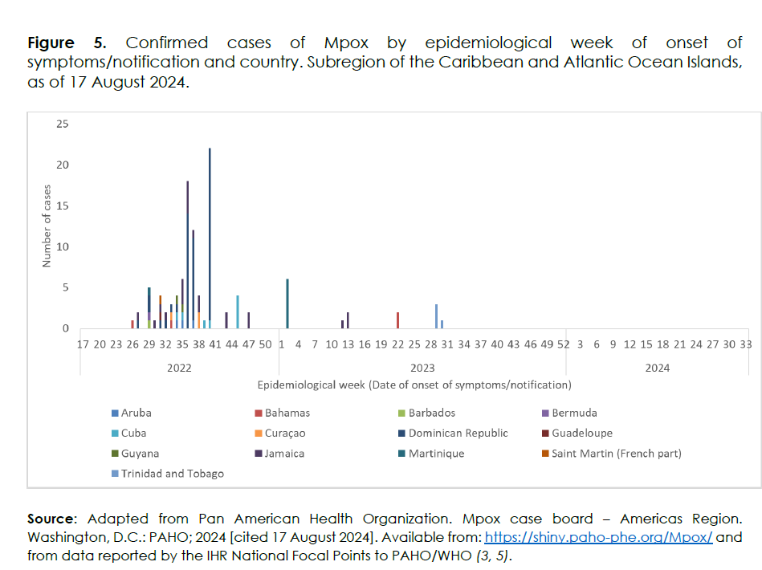
In the Caribbean and Atlantic Ocean Islands subregion, between 2022 and as of 17 August 2024, 107 cases of Mpox reported from 13 countries including 1 death
The Dominican Republic reported 49% of cases
No reported cases during 2024

Slide 13
The current risk to the Caribbean population from mpox clade 1b is low to moderate.
Current and Historical Cases:
  None of the countries and territories from this subregion have reported cases during 2024
  No cases of clade Ib mpox have been reported in the Caribbean and its neighboring countries including the United States .
Travel and Migration Patterns:
  There is also a limited number of travelers and no direct commercial flights from the Democratic Republic of the Congo (DRC), or its neighboring countries to the Caribbean

Slide 14
The current risk to the Caribbean population from mpox clade 1b is low to moderate.
Other factors to consider:
  Naïve and unexposed Population
  Health infrastructure
  Therapeutics – vaccines availability and procurement
  Tourism dependent Economy
  Visitor arrivals
    2022 OVER 729,000
    2023 OVER 1,036,00
  Average length of stay
    2022 9 DAYS
    2023 8 DAYS
  Markets – US and UK

Slide 15
Clinical presentation of Mpox
Dr. Shana Cyr, SMO CNDC’s

Slide 16
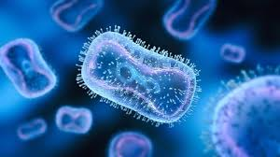
Incubation and Infectious Period
The incubation period
  From 5 to 21 days, generally 6-13 days post exposure.
Infectious period
  May between 2 to 4 weeks
  From the onset of initial symptoms until skin lesions have crusted, the scabs have fallen off and a fresh layer of skin has formed underneath, healed.
May be contagious during this period.

Slide 17
Transmission
Infected animals to humans via indirect or direct contact –
  bites or scratches, or
  Contact with bodily fluids or waste(hunting, trapping etc.)
Human-to-human transmission through direct contact with infectious skin or mucocutaneous lesions,
  face-to-face,
  skin-to-skin,
  mouth-to-mouth or mouth-to-skin contact and
  respiratory droplets (cough & sneeze), prolonged close contact required
  close physical contact, including sexual contact (oral, vaginal and anal)

Slide 18
Transmission
Environment to humans
Persistence of surrogate pox virus in the environment and on different types of surfaces has been found to last between 1–56 days depending upon the temperature and room humidity
contaminated clothing or linens that have infectious skin particles (also described as fomite transmission)
  -If shaken, these particles can disperse into the air and be inhaled, land on broken skin or mucosal membranes and lead to transmission and infection; one documented health worker infection has been published suggesting MPX virus transmitted through contact with contaminated bedding
During pregnancy, virus can cross the placenta, causing intrauterine exposure of the fetus, complications such as fetal loss or stillbirth, and congenital infection of the infant.

Slide 19
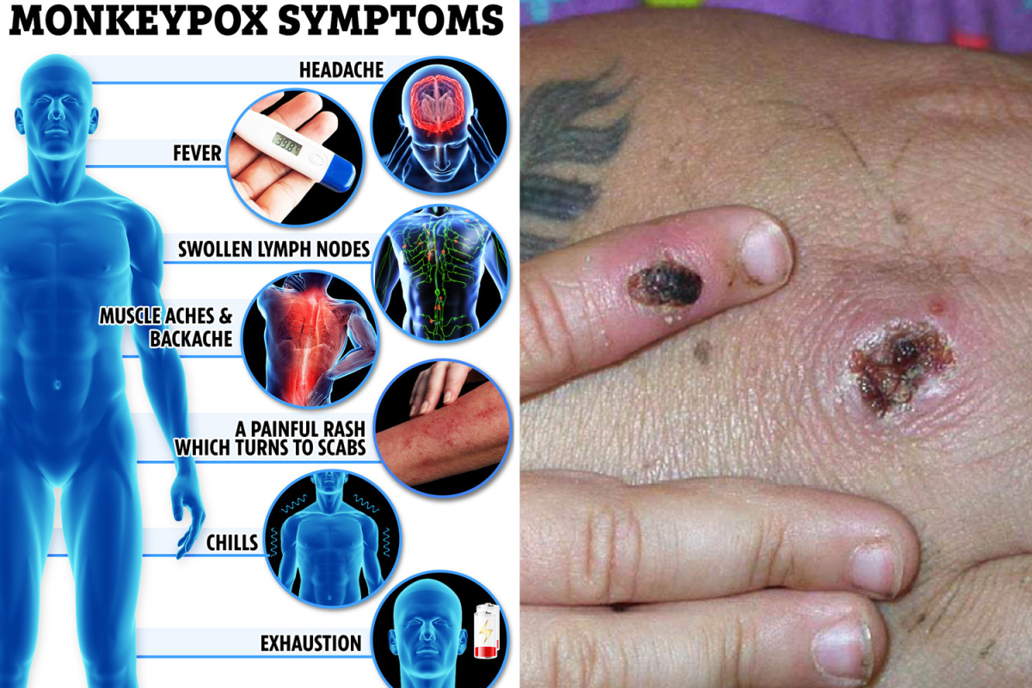
Signs & Symptoms
Phases of Mpox disease
  Prodromal phase(general symptoms)
  Skin Eruption phase(Rash appears 1 – 5 days after initial symptoms)

Slide 20
Prodromal period
Lasts between 1–5 days & characterized by
  Fever
  intense headache, back pain, muscle aches
  Intense lack of energy
  sore throat and cough(sometimes)
  Lymph nodes* generalized or localized (e.g., neck {submandibular & cervical}, axillary, inguinal)
    *Distinctive feature from other diseases like chickenpox, measles, smallpox)
May be contagious during this period.

Slide 21
Skin eruption phase: signs and symptoms
Typically occurs 1 to 3 days after fever subsides
The lesions range in size from 0.5 to 1 cm in diameter and from a few to several thousand in number
Contagious from the onset of the enanthem /exanthem through the scab stage (Up to complete healing)of the lesions & new skin
The rash generally, starts in face
  Affects the face (95% of cases)
  Palms of the hands and soles of the feet (in 75% of cases).
  Also affected
    Oral mucous membranes (70% of cases),
    Genitalia (30%), particularly seen in the outbreaks in European and North American countries
    Conjunctivae (20%), as well as the cornea.
The rash tends to be more concentrated on the face and extremities rather than on the trunk

Slide 22
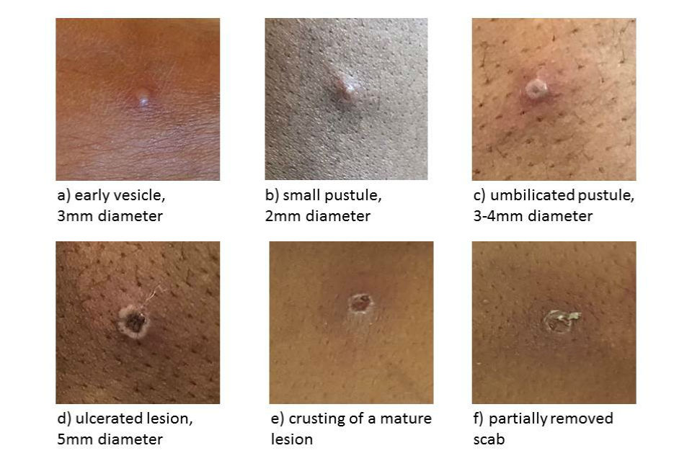
Rash evolves sequentially through stages
First lesions appear on tongue and mouth - enanthem
Pustular rash
  Lasts 5 to 7 days
  Often painful until the healing phase when they become itchy (crusts)
Scabs last about 7 days

Slide 23
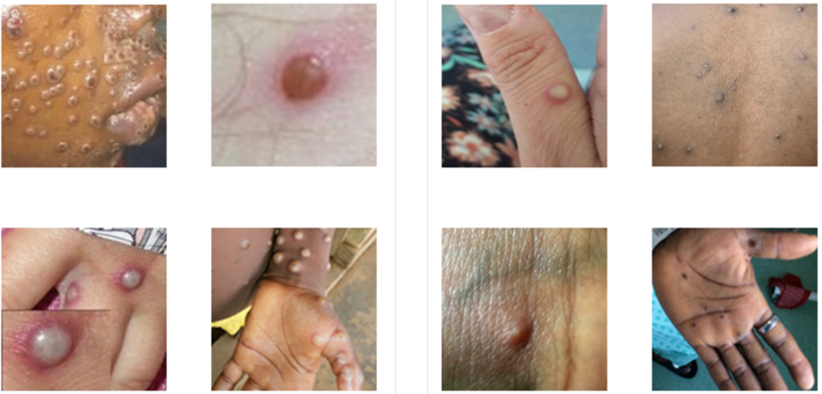
Number of lesions: Few to several thousands

Slide 24
Prognosis
Usually, a self-limiting disease without specific treatment
with symptoms lasting 2 to 4 weeks
Severity of illness dependent on:
  Initial health of the individual
  Route of exposure (sexual vs. fomite)
  Strain of the infecting virus
    West African (associated with milder disease, fewer deaths, and limited human-to-human transmission ) vs.
    Central African clade-more infectious, more serious

Slide 25
Higher risk for Severe disease
Complications:
Secondary infections
Oral ulcers are common and may affect a patient’s ability to eat and drink leading to dehydration and malnutrition.
Skin lesions(abscess or exfoliation)
Retro pharyngeal abscess
Bronchopneumonia
Corneal ulcerations
Sepsis and sepsis shock
Encephalitis
  Children
  Pregnant women
  Immunosuppressed (from other conditions)
  Case Fatality 1-10%

Slide 26
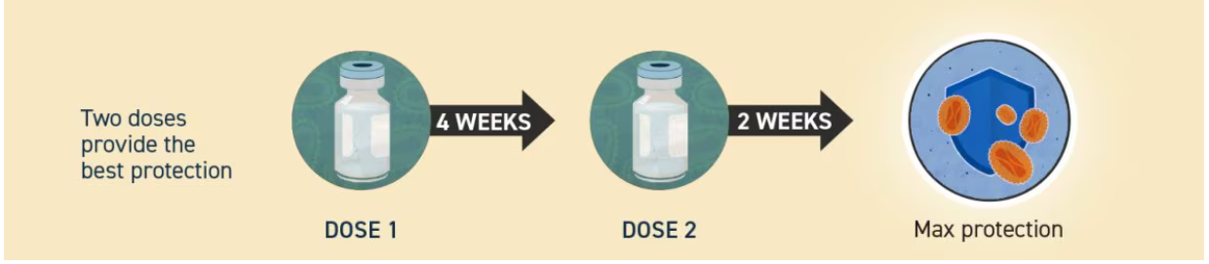
Vaccination - two mpox vaccines have been approved by the WHO-listed national regulatory authorities
JYNNEOS or Imvamune or Imvanex has been approved for vaccination against Mpox
Live attenuated vaccine administered intradermally
Smallpox vaccination is 85% effective against the disease
Mass vaccination is not recommended at this time
Vaccination is recommended for:
  Post exposure prophylaxis for close contacts
  Persons travelling to the affected African regions

Slide 27
Surveillance, Case Investigation and Contact tracing

Slide 28
Case Detection-
Case Definitions - ensures early case identification
Suspected Case
A person who is a contact of a probable or confirmed mpox case in the 21 days before the onset of signs or symptoms, and who presents with any of the following:
acute onset of fever (>38.5°C),
headache,
myalgia (muscle pain/body aches),
back pain,
profound weakness,
fatigue.

Slide 29
Management of a suspected case
Immediate isolation If a guest reports symptoms or is suspected of having mpox. Isolation in designated areas.
Do not allow them to use shared facilities or interact with other guests or staff.
Medical Assistance: Contact the designated doctor on call to assess and test the affected individual.
Registration on the THiS
Contact the Epidemiology Unit within 24 hours of case detection to facilitate case investigation
      Medical Surveillance Officers
      Dr Dana Gomez 285 7522
      Dr Harini Vemula 285 3041
m

Slide 30
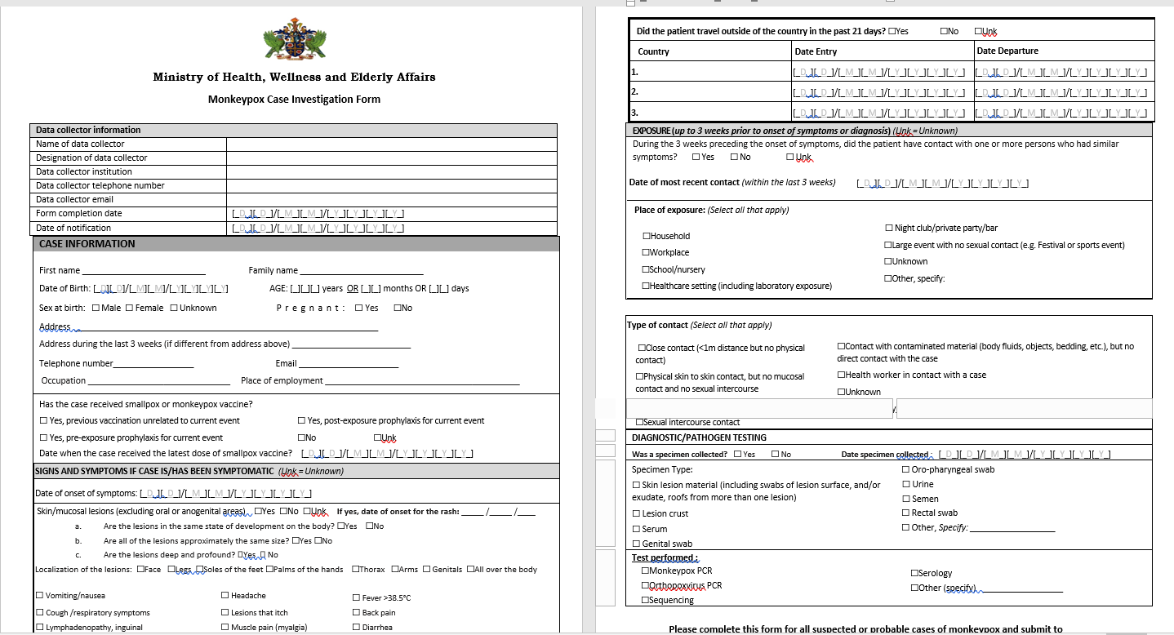
Reporting – completion of a case reporting form for every suspected case of Mpox for submission to the Epidemiology Unit of the MOHWEA

Slide 31
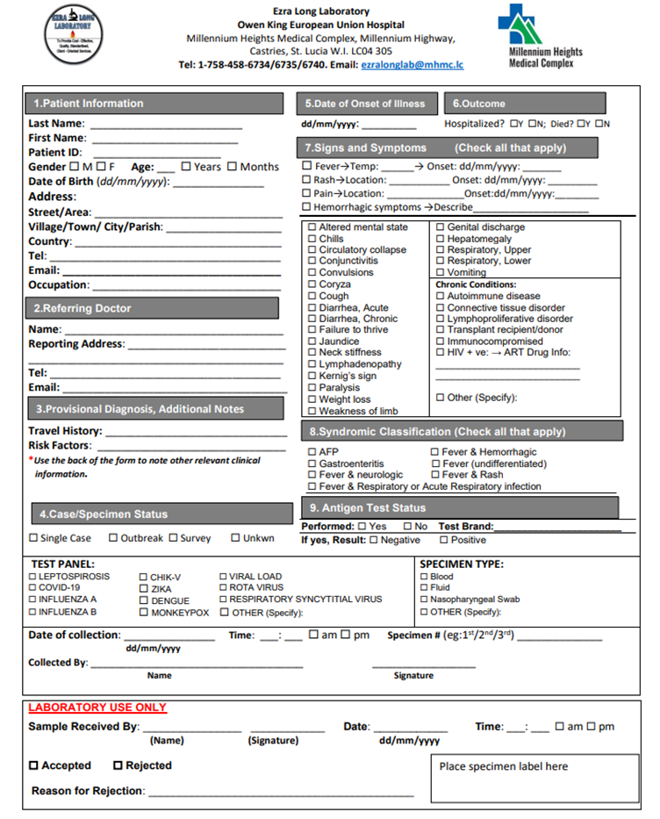
Completion of the Laboratory requisition form
In country capacity testing for Mpox at the Ezra Long Lab at OKEU

Slide 32
Management of a confirmed case
The Epidemiology Unit will inform the designated person at the facility of the positive test result upon receipt of results
Continued Isolation of the case in the designated room
Use of appropriate PPE by the persons attending to the isolated confirmed case to include contact and respiratory precautions
Isolation is for a period of 2 to 4 weeks until the lesions have scabbed over
m

Slide 33
Management of the Contacts
  Identify contacts of the confirmed case
  Contacts are monitored for a period of 21 days from the last contact with the probable or confirmed case or their contaminated materials
  No quarantine is necessary, persons can continue routine daily activities.
  Monitor for signs and symptoms of concern including headache, fever, chills, sore throat, myalgia, malaise, fatigue, rash, and lymphadenopathy.
  During the 21-day monitoring period, contacts should regularly practice hand hygiene and respiratory etiquette.
  Vacconation is only recommended for very close contacts
m

Slide 34
Recommendations for the Accommodation Sector

Slide 35
Recommendations for the Accommodation Sector
1. Sensitization of Staff Members on Monkeypox
Training sessions for all staff members on monkeypox, focusing on recognizing symptoms, transmission routes, and preventive measures.
Regular Updates: Keep staff informed of the latest public health guidelines and protocols related to monkeypox, including any changes in local or national health regulations.
2. Chain of Communication Ensure an established Internal Reporting Mechanism for Management
Ensure an established internal reporting mechanism within the management team for reporting suspected cases to ensure that all reports are handled promptly and discreetly.
Identify a focal point for reporting of suspected cases to the MOHWEA
Encourage guest self reporting if they experiencing any symptoms suggestive of Mpox to managment. Ensure that guests can report symptoms confidentially and without stigma,
m

Slide 36
Recommendations for the Accommodation Sector
3. Infection Prevention and Control
  Isolation of a suspected guest
  Identify and designate Isolation Rooms:
    If possible, have specific rooms designated for isolation that are well-ventilated and located away from high-traffic areas
  Immediate isolation If a guest reports symptoms or is suspected of having mpox.
  Medical Assistance: Ensure that your facility has a doctor on call
m

Slide 37
Recommendations for the Accommodation Sector
3. Infection Prevention and Control
  Contacts of a suspected case
  Contacts are monitored for a period of 21 days from the last contact with the probable or confirmed case or their contaminated materials
  No quarantine is necessary, persons can continue routine daily activities such as going to work and attending school.
  Vaccine recommendations for very close contacts or persons travelling to affected areas.
m

Slide 38
Recommendations for the Accommodation Sector
3. Infection Prevention and Control
  Cleaning and Disinfection/Housekeeping
  • PPE Requirements: Housekeeping staff should wear appropriate PPE, including gloves, masks, gowns, and eye protection, when cleaning rooms occupied by suspected or confirmed monkeypox cases.
  • PPE Training: Ensure that staff are trained on the correct use and disposal of PPE, including how to don and doff PPE safely to prevent contamination.
  • Regular Replacement: Ensure a sufficient supply of PPE and encourage regular replacement to maintain effectiveness, especially after cleaning rooms or handling potentially contaminated materials.
m

Slide 39
Protocol for Management and Surveillance of Mpox at Ports of Entry

Slide 40
Surveillance Measures
Screening and Detection
Review of General Health Declaration from aircrafts and Maritime Health Declaration from ships
Travelers to complete health declaration forms upon arrival from affected countries, including recent symptoms, travel history, and exposure risk.
Temperature Checks: Implement thermal scanners or manual temperature checks to identify febrile individuals.
Visual Inspection: port health staff to identify signs of Mpox such as rash, and swollen lymph nodes.

Slide 41
Surveillance Measures- con’t
Symptom Monitoring: Review health questionnaires to screen for symptoms of Mpox, including rash, fever, headache, and muscle aches.
Detection and Reporting
Identification of suspected cases: traveler exhibiting symptoms such as fever, rash or swollen lymph nodes will be assessed for Mpox.
Immediate Reporting: Report suspected case(s) to Port Health Manager who will coordinate with CEHO, Epi Unit and CMO.

Slide 42
Case Management
Quarantine and Isolation
Isolate Suspected Cases: If a traveler presents with symptoms suggestive of Mpox, they will be isolated in a designated quarantine room at the port of entry for further medical evaluation.
Contacts of suspected or confirmed cases will be submitted to Community Nursing for further monitoring.

Slide 43
Diagnostic and Referral Procedures
Sample collection
Collect specimen for laboratory testing of Mpox.
Send specimens to designated laboratory for diagnosis.

Slide 44
Coordination
Port Health: Engage with CEHO, CMO and Epi Unit for guidance and support in managing cases and outbreaks.

Slide 45
Infection Control
Personal Protective Equipment (PPE)
Port health staff must use appropriate PPE, including masks, gloves, and gowns, when dealing with suspected cases.
Training: Provide regular training on the use of PPE and infection control procedures
Hand Hygiene: Promote frequent hand washing and use of hand sanitizers.
Surface Disinfection: Regularly disinfect high-touch surfaces and areas where suspected cases are isolated.

Slide 46
Communication and Reporting
Internal Communication
Staff Briefing: Regularly update port health staff on Mpox status, protocols, and any new developments.
Incident Reporting: Document and report all cases of suspected or confirmed Mpox to Port Health Manager, CEHO, Epi Unit and CMO
Conduct frequent meetings with Border Control Agencies
Public Information

Slide 47
Communication and Reporting- con’t
Awareness Campaigns: Provide travelers with information on Mpox symptoms, prevention measures, and contacts for accessing further health services.
Signage: Display clear signage throughout the point of entry regarding Mpox and health procedures.

Slide 48
Training and Drills
Conduct regular training sessions for port health staff on Mpox detection, response protocols, and PPE usage.
Simulations: Implement periodic drills to test the effectiveness of the response plan among staff.
Conduct training with airline and ship agents, Ports Police, Customs Officers, Immigration Officers and other SLASPA officials at the Ports.

Slide 49
References
https://journals.plos.org/plosntds/article?id=10.1371/journal.pntd.0010141
https://reader.elsevier.com/reader/sd/pii/S1473309922002286?token=3A77282A29631CDFEBDD737831F234F3DA3D0E2B3AF8136497BDCEDA7A0F3A2D0A10E9EEC76410B8E24967FC46127141&originRegion=us-east-1&originCreation=20220626165803
https://www.nejm.org/doi/full/10.1056/NEJMcpc2201244?query=recirc_mostViewed_railB_article
https://www.who.int/publications/i/item/WHO-MPX-Clinical-and-IPC-2022.1
https://www.who.int/publications/i/item/WHO-MPX-Surveillance-2024.

Slide 50

Questions

