Slide 1
SAINT LUCIA TOURISM AUTHORITY
Half Year Update to Chef’s Table
Fostering meaningful connections and alliances to achieve mutual success.

Slide 2
VISION
MISSION
To be the world-renowned leader in the promotion of Saint Lucia globally.
To create a strong demand for Saint Lucia as the most inspiring and authentic destination, highlighting her beauty, natural resources, culture, and cuisine through visionary and collaborative initiatives by a highly motivated and dedicated team that stimulates overall economic growth and sustainable development.

Slide 3
Executive Summary
To follow the Strategic direction provided by the Ministry of Tourism, the Saint Lucia Tourism Authority continues to ensure that the organisation is operated based on concrete goals and objectives aligned with legislation governing it while adapting to market forces to achieve the most significant returns as a Tourism Destination.
Having assessed its Strengths, Weaknesses, Opportunities and Threats considering the ever-changing landscape, the Authority is presenting the top-line elements for each department for FY 2024-2025. As the year progresses, detailed quarterly plans will be offered, constantly reviewing activations and incorporating those that provide the highest return on investment.
As a marketing organisation of the Government of Saint Lucia, the primary purpose of the organisation is the following:
Increase Air Capacity.
Create Brand Awareness.
Increase visitor arrivals.
Administration of the Tourism Levy.
This plan is guided by research and data that provide intelligence in planning for market activations and development, with key performance indicators used to measure effectiveness.
While the marketing strategy is central to the Saint Lucia Tourism Authority’s Strategic Plan, the supporting departments such as Administration, Human Resources, Finance, Research and Planning and Tourism Levy are included as these areas are foundational for the achievement of the Authority’s mandate.

Slide 4
Goals and Objectives
for FISCAL 2024-2025
Increase airlift seat capacity and load factor on all flights to 5% over 2023.
Increase stayover visitor arrival by 5% over the 2023.
Increase visibility and Brand awareness through digital media and public relations
Diversify into new niche markets
Registration of all Tourism Accommodation service providers to maximize revenue collections.
Notes:
Increase airlift seat capacity and load factor on all flights to 5% over 2023.
Increase stayover visitor arrival by 5% over the 2023.
Increase visibility and Brand awareness through digital ads, campaigns, and Public Relations highlighting Saint Lucian’s culinary, culture, and heritage festivals through SLTA’s participation in the destination’s annual calendar of events (measured by increase in arrivals and overall brand awareness, event participation, visitor arrivals, and occupancy levels).
Diversify into new niche markets such as the African-American market while building on products by focusing on Niches such as Romance, Yachting, Diving, Family, Adventure, Luxury, Community & Wellness Tourism, Sports Tourism, Events
Registration of all Tourism Accommodation service providers (pending the enactment of the Tourism Development Act) to maximize revenue collections.

Slide 5
PERFORMANCE UPDATE

Slide 6
Month | 2023 | 2024 | Difference | % Growth
January | 34,066 | 36,863 | 2,797 | 8%
February | 34,638 | 38,837 | 4,199 | 12%
March | 39,318 | 44,561 | 5,243 | 13%
April | 34,539 | 37,588 | 3,049 | 9%
May | 33,339 | 36,375 | 3,036 | 9%
June | 27,028 | 38,394 | 11,366 | 42%
July | 31,496 | 41,476 | 9,980 | 32%
Total | 234,424 | 274,094 | 39,670 | 17%
August | 27,366 | 28,061 | 695 | 3%
September | 21,142 | 21,733 | 591 | 3%
October | 26,475 | 27,609 | 1,134 | 4%
November | 32,887 | 33,889 | 1,002 | 3%
December | 38,497 | 40,336 | 1,839 | 5%
Total | 380,791 | 425,722 | 44,931 | 12%
Stay Over Arrivals by Month​
In July the island recorded a 32% increase over the same period last year, owing to the island’s hosting of Saint Lucia Carnival.
Stay over arrivals for the first seven-month 2024 up 17% from the same period of last year. This also marked a 12% increase projections for Year over Year.​
​Projections for the balance of the year shows continuous month-on-month increases, with year end figures expected to surpass the 420,000 mark.

Slide 7
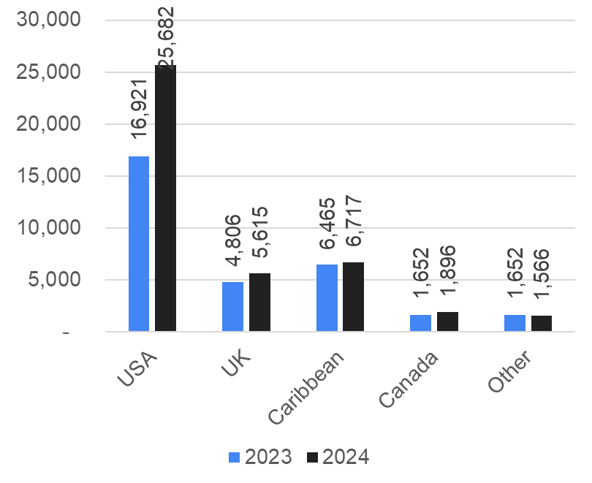
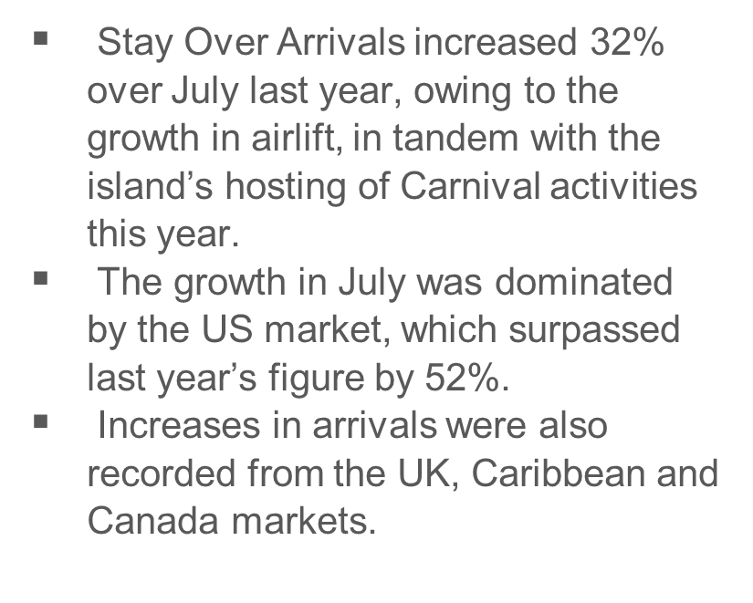
Stay Over Arrivals July

Slide 8
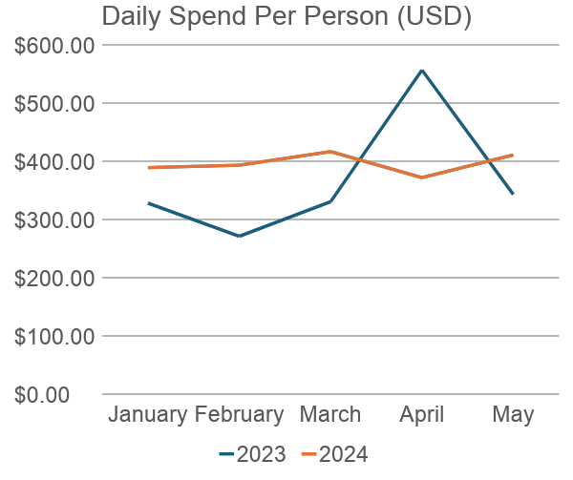
Visitor Expenditure​
Daily spend per person has been higher in 2024 than in 2023.
All months (except April) experienced double digit percentage growth.
The largest areas of spend were:
Accommodation - 64%
Food and Beverage (at the hotel) -15%
Tours/Hotel activities – 12%

Slide 9
Month | 2023 | 2024 | Difference | % Growth
January | 50,582 | 57,060 | 6,478 | 13%
February | 45,380 | 52,637 | 7,257 | 16%
March | 50,894 | 59,990 | 9,096 | 18%
April | 49,628 | 53,707 | 4,079 | 8%
May | 43,626 | 48,414 | 4,788 | 11%
June | 39,300 | 53,657 | 14,357 | 37%
July | 45,072 | 54,058 | 8,986 | 20%
Total | 324,482 | 379,523 | 55,041 | 17%
August | 40,709 | 51,809 | 11,100 | 27%
September | 34,334 | 38,717 | 4,383 | 13%
October | 37,361 | 47,974 | 10,613 | 28%
November | 44,395 | 56,929 | 12,534 | 28%
December | 55,026 | 61,351 | 6,325 | 11%
Total | 536,307 | 636,303 | 99,996 | 19%
Airlift/Seats​
The island recorded month-on-month increases in airlift for the first 7 months of 2024.
This growth pattern is expected to continue for the remaining 5 months as well.

Slide 10
Airlift/Seats​
Market | 2023 | 2024 | Difference | % Growth
US | 155,458 | 197,836 | 42,378 | 27%
UK | 88,338 | 99,876 | 11,538 | 13%
Caribbean | 52,070 | 50,995 | (1,075) | -2%
Canada | 28,616 | 30,816 | 2,200 | 8%
Total | 324,482 | 379,523 | 55,041 | 17%
The growth YTD July was fueled by additional seats from the US UK and Caribbean, resulting in a 17% YTD increase.​

Slide 11
Room Stock Analysis​
Period​ | No. of Rooms​
January Opening Stock​ | 4,685​
December Closing Stock​ | 4,449​
Closed this year​ | 236​
Closed from 2023​ | 334​
Total Rooms Closed​ | 570​
% of Rooms Closed​ | 11%​
Unsold Room Nights/Month​ | 119,700 ​
Levy Lost/month​ | $718,200 ​
The room count in the formal sector at the beginning of the year was 4,685.
Two properties closed for renovations during the year and will be out of commission for some time. This is in addition to the one from last year, resulting in approximately 120,000 unsold rooms nights and a loss of U$718,000 every month.

Slide 12
Accommodation Breakdown (As of May 2024)
Establishment | No. of Properties | % of total | No. of Rooms | % of total
Large Hotels | 18 | 11% | 2,987 | 68%
Small Hotels | 23 | 14% | 551 | 12%
Villas | 78 | 47% | 493 | 11%
Guest Houses | 27 | 16% | 266 | 6%
Apartments | 21 | 13% | 152 | 3%
Total | 167 | 100% | 4,449 | 100%
All Inclusive Properties | 14 | 8% | 2,840 | 64%
Room Stock Analysis​
Informal sector has 5584 rooms.

Slide 13
OVERALL MARKETING PLANS
for 2024-2025

Slide 14
Marketing Strategy
The Saint Lucia Tourism Authority is the premier agency responsible for marketing Saint Lucia, hereby referred to as the destination, to visitors from across the globe. This marketing is executed through a combination of conventional and non-traditional marketing, sales and public relations activities.
THE FOLLOWING COVERS THE MAIN AREAS FOR GLOBAL MARKETING
Advertising
The objective is to increase the profile of Saint Lucia within the global tourism marketplace with a view to maximizing engagement and arrivals. Social Media Marketing
The objective is to improve Saint Lucia’s social media presence on Facebook (“Travel Saint Lucia” and “Caribcation”), Instagram, YouTube, and TikTok. Market Development
The objectives/targets are to expand awareness of “Brand Saint Lucia” globally and take advantage of marketing technologies (artificial intelligence). Giveaways
The objectives are to improve awareness of “Brand Saint Lucia” through the distribution of high-quality branded items in existing and new markets and to identify, produce and distribute a wide range of items.
Sales
The objectives/targets are to improve awareness of “Brand Saint Lucia” to include attendance by senior tourism officials, thereby strengthening Saint Lucia’s position with these audiences and increase attendance by senior officials at meetings, events, trade shows and other activations. Public Relations
The activities includes attendance by senior officials at meetings, events, trade shows and other activations.
Festival & Events
CPL Sponsorship & Support Activities:
ARC Sponsorship & Support Activities
Other Events
Creative
The objectives/targets are to undertake to comprehend photo and video shoots to support website improvement through updating the information, images and video on the site and create a marketing campaign concept development, design or marketing materials (print and digital ads, digital banners, physical banners for events, brochures.
Notes:
Advertising: Target:
Increased and improved engagement with social media
Placement of attractive ads and banners in relevant digital and print publications.
Rollout of niche marketing campaigns (Romance, Wellness, Maritime, Family, Luxury, Adventure, Culture/Cuisine. Delivered on time and within budget.
Rollout of evergreen and event marketing campaigns.
Growth in the SLTA database for improved targeted distribution of campaigns.
Improved metrics for stlucia.org and saintluciajazzandarts.com (more visitors, longer stays)
Social Media Marketing: Activities:
Monthly curated social media calendar on all platforms, including regularly scheduled calendar reviews and plan of action meetings.
Marketing Campaigns including paid advertising on social media: competitions, giveaways, niche focus and generic/evergreen (not niche specific, general Saint Lucia) marketing campaigns to improve the profile of Brand Saint Lucia, to drive traffic to stlucia.org, and ultimately to improve salability of the product.
Stage regular influencer visits to meet social media and other marketing objectives.

Slide 15
Competitive Marketing Presence in Key Markets
The SLTA will seek to sustain a competitive presence in all key markets by implementing a creative integrated marketing campaign using print, connected TV, programmatic video, social media, and digital marketing across all key markets, namely the United States, United Kingdom, Canada, Europe and the Caribbean.
Exploring the power of Artificial Intelligence in Saint Lucia’s Marketing
The SLTA will continue to explore customized tools available in artificial intelligence to understand the behaviour and preferences of visitors to forecast their travel patterns and predict and influence that behaviour.
Connectivity to the Island
Connectivity to the island from all source markets remains a challenge.
The USA market is projected to have 16% more seats than in 2019
UK market 6% less than 2019
Caribbean 32% less than 2019
Canada 2% less than 2019
The SLTA, through its partnership with leading airlines from the key source markets, will provide real-time data analytics in support of marketing activities to those partners to influence schedule increases and sustain connectivity schedules, particularly during the shoulder months of September and October.

Slide 16
International Sports Tourism Partnerships
Through regular assessment of visitor data collection by the SLTA, marketing trends emerge. These are related to the channels and tactics used and technological advances in the industry. This fiscal year, the SLTA will invest in strong international sports partnership marketing with leading sports companies and teams in New York and Florida in the USA to increase destination branding while promoting sports tourism.
Social Media Marketing Dominance
The SLTA has run successful social media campaigns over the past fiscal periods. During this period, the SLTA will prioritise its social media (SM) platforms that allow the authority to reach its correct target and goals. A comprehensive video and photography content driven social media program will aim to seek new customers from Saint Lucia’ preferred niche markets, namely – luxury, adventure, wellness, diving, romance, maritime and special events. A targeted events and experiences influencer marketing campaign will complement the SM program.
Globally increase the profile of the Maritime Sector
Saint Lucia’s maritime sector re-birth has not been on pace with the other fractions of the industry. The SLTA will undertake to push the growth of the cruise, yachting and ferry services by exploring new opportunities, specifically in the USA and the Caribbean.

Slide 17
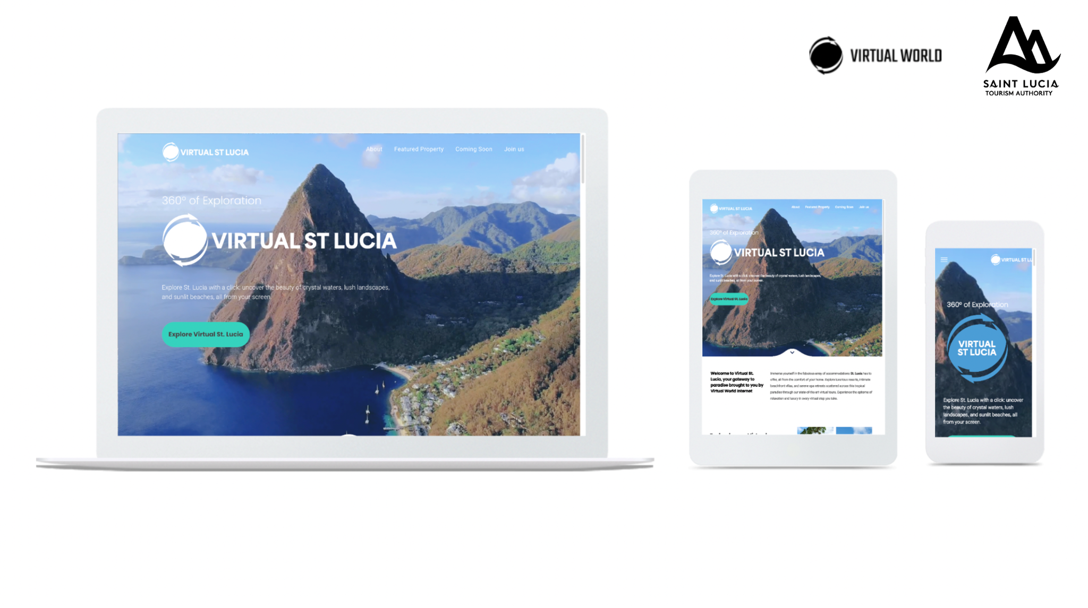
Promote an “Authentic and Customized Saint Luca Experience” program through the CDP
Digital Marketing is not just a trendy marketing tool to reach customers. It is responsive, reactive, innovative and achieves consumer conversion quicker. A strong digital marketing focus will be placed on the certified informal accommodation sector (popularized by the SLTA as the Collection Des Pepites - CDP program) to ensure that the true benefits of tourism derived from international visitors accrue to the community where the accommodations are based.
Launch of Virtual Saint Lucia
The accommodation sector is expected to grow with 1,200 new rooms entering the market by February 2025. A robust marketing education campaign will be launched to inform the consumer, travel trade and the airline industry of these developments, ensuring that those new products are included in the product and marketing portfolios. Saint Lucia will be launched as the first “Virtual Caribbean Island” offering customers an immersive experience using the Virtual Reality technology to search and book their accommodation choices.
Exploring Emerging Markets
Similarly, the SLTA will explore untapped and underserviced markets to sustain the growth of the accommodation sector. The SLTA will explore new airlift routes in emerging markets in South America and aim to regenerate Germany and some islands of the Caribbean with direct service to Saint Lucia. Namely – Saint Lucia to Saint Kitts and Saint Lucia to Antigua.

Slide 18
Launch of Sustainable Tourism - Saint Lucia
Much of the formal sustainable tourism marketing products and services in Saint Lucia have been established by the private sector. “A destination does not have to be dominated by green space to promote itself as sustainable” The SLTA will undertake to develop innovative marketing tools, tactics and distribution services to promote Sustainable Tourism - Saint Lucia promoting its differentiation in sustainable tourism in its key source markets.
Court the Diaspora through the Lucian Links program
The Saint Lucian and Caribbean diaspora continue to support the special events experience on the island by travelling during these periods. The SLTA will work with the private sector (accommodation, transportation and experiences) to provide incentives to the diaspora to grow this sector further.
Increase Revenue Collection through the Tourism Levy
In anticipation of the enactment of the new Tourism Development Bill, the SLTA will seek to encourage increased revenue by increasing the amount of revenue collected from the registered accommodation operators.
Brand Saint Lucia Partnership
The SLTA will continue to work with “Brand Saint Lucia” agencies to strengthen partnerships and networking opportunities for the island

Slide 19
OUTLOOK 2024-2025

Slide 20
Targeting Overview
Demographics
Interests
Markets
Adults 35-65+
Household Income $150K+
Niche Categories
Romance & Honeymoons
Wellness
Adventure Seekers
Luxury Travelers
Collection de Pepites
Families
Caribbean Destinations
Beachbound Travelers
Luxury Destinations
All-Inclusive Vacations
Romantic Getaways
Tropical Island
Boutique Accommodations
Resorts/Destinations
New York
Miami
Charlotte
Atlanta
Philadelphia
Boston
New Jersey
Los Angeles
Dallas
Toronto

Slide 21
WHAT’S
NEW
SLTA Partnership with
ForwardKeys

Slide 22
ForwardKeys
ForwardKeys was set up to create and develop the tools, data sets and knowledge allowing destination marketers to monitor their destination’s performance and anticipate future market trends. The company combines IT, analytical skills, and industry knowledge to provide customers with products, features and services that respond to their specific needs. It has evolved to become a travel intelligence specialist, able to provide insight into not only the flow of international travellers but also their behaviour and preferences at their destination.
Objectives:
• Monitor & measure the destinations tourism performance and evolution year on year
• Increase connectivity and easier access for international markets to Saint Lucia
• Make data-driven decisions and tweak marketing campaigns for better ROI
• Monitor and compare performance against benchmark ‘competing’ destinations in the region
ForwardKeys’s Current Datasets:
• Total Air Market (TAM)
• Actual Air Tickets (AAT)
• Actual Air Reservations
• Seat Capacity
• Fares
• Flight Searches
• Spend
• Beyond the airport / Geo-mobility

Slide 23
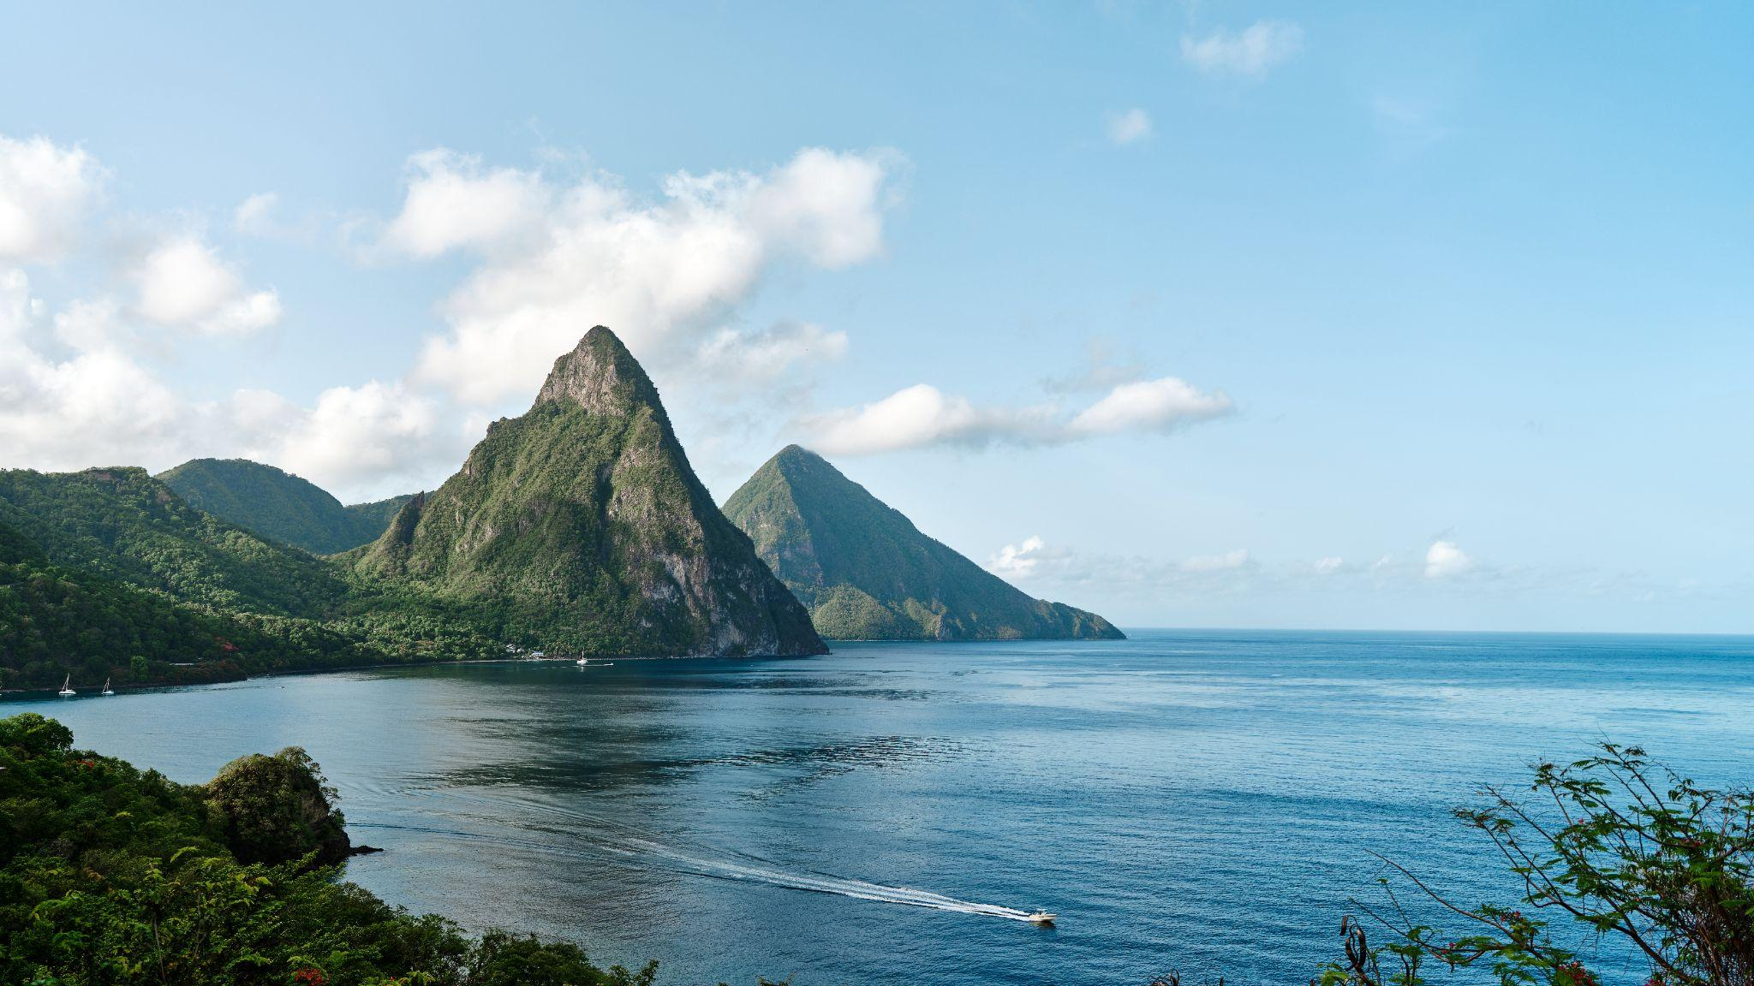
MEDIA
IMPLEMENTATION
STRATEGY
Media Recommendations

Slide 24
Print Publications
Our Strategy
Attract the most readership and site visitors within Saint Lucia's
core destination niches and traveller demographics.
Recommended Publications
Notes:
Recommended Publications
Luxury Travelers: Travel+Leisure Co-op and Co﻿ndé Nast Traveler
Romance: Bridal Guide
Adventure: Scuba Diving Magazine
Travel Trade: AGENTatHOME and Recommend Magazine

Slide 25
Release Date: July 19th 2024
Issue: World’s Best Awards - Aug
Co-op Insertion:
1-Full Page Branding Ad + Advertorial
Properties will have the ability to join the insertion through a co-op opportunity
Circulation:
Print: 962,867
Digital: 11,300,000
Social: 15,700,000
Average HHI: $410,267
Average Age: 48
$39B readership spend on travel annually

Slide 26
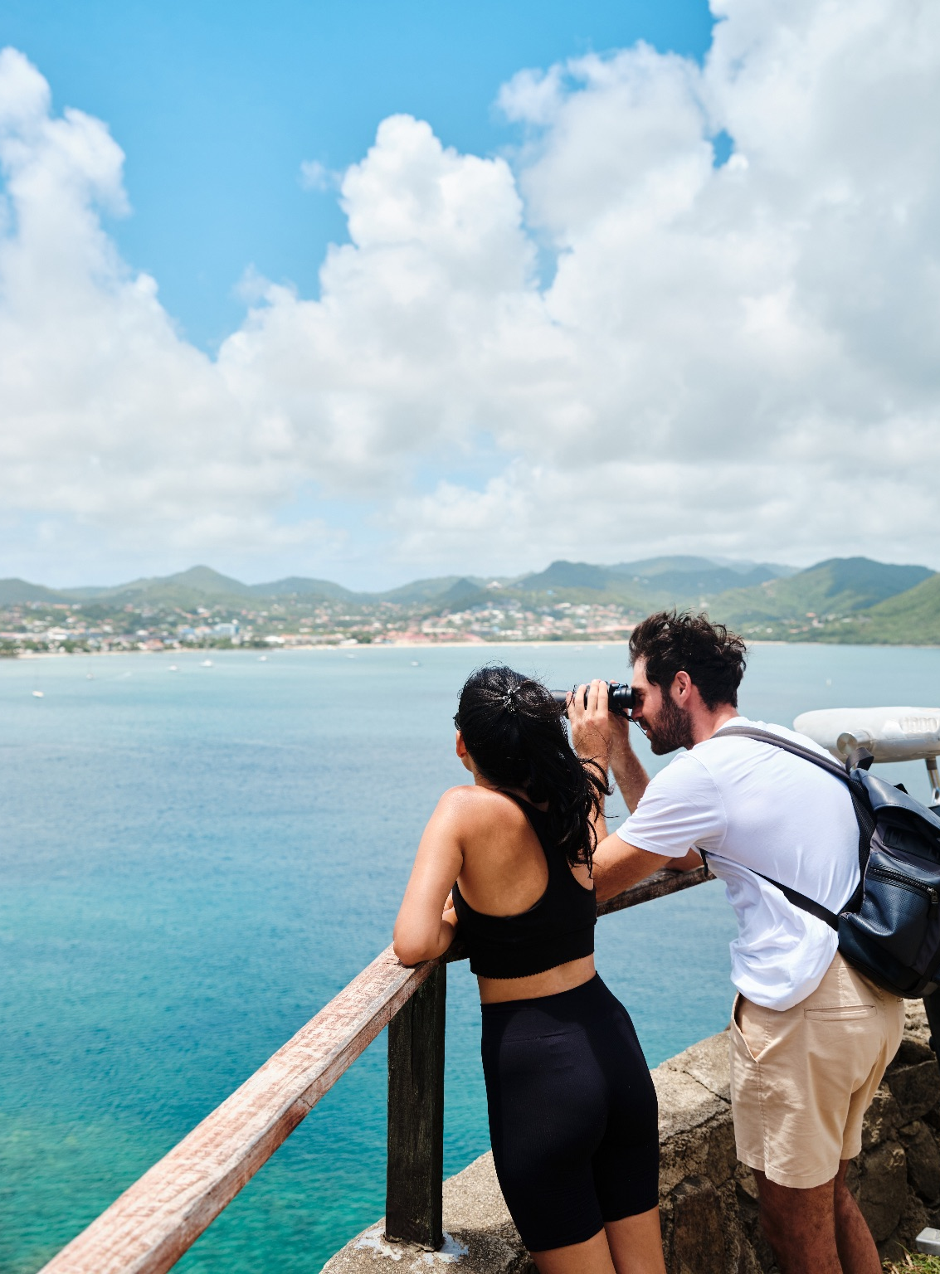
Release Date:
November 5th 2024
Issue: Winter Sun - Dec/Jan
Insertion:
1-Full Page Branding Ad + Advertorial
Circulation:
Print: 723,300
Digital: 18,200,000
Social: 8,923,641
Average HHI: $187,868
Average Age: 50
$7.7B readership spend on travel annually

Slide 27
Insertion 1: Honeymoon & Destination Wedding Guide | Aug/Sept
1-Full Page Branding Ad + Advertorial
Release Date: July 16th 2024
Insertion 2: Romantic Travel Getaways | Oct/Nov
1-Full Page Branding Ad + Advertorial
Release Date: September 17th 2024
Circulation:
Print: 20,181
Digital: 84,207
Social: 1,300,000

Slide 28
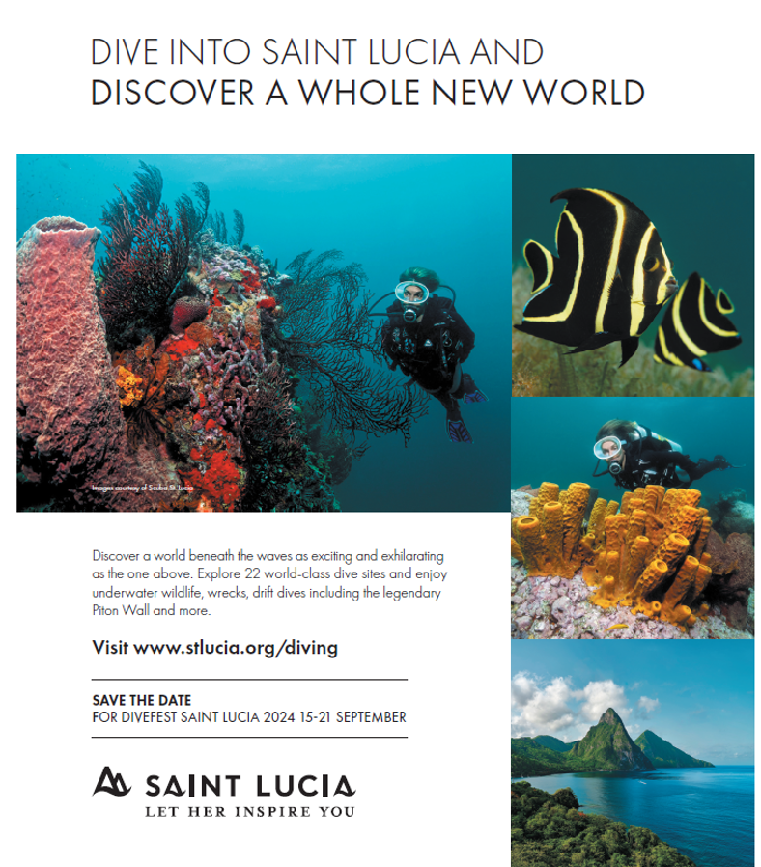
Insertion 1: Annual Photo | Sept/Oct
1-Full Page Branding Ad + Advertorial
Circulation & Highlights:
10 Issues per Year
Print: 20,181
Digital: 84,207
Social: 1,300,000
Monthly Page Views: 278,000
Social Followers: 798,000
Average HHI: $224,000
Average Spent on International Dive Trips: $5,449
Average Dive Trips per Year: 3.3 (7.4 days per)
Booked or Visited a Featured/Advertised Destination: 60%
Release Date: September 2nd 2024
Insertion 2: Reader’s Choice Awards | Nov Issue
1-Full Page Branding Ad + Advertorial
Release Date: November 4th 2024
Insertion 3: Gear of the Year | Dec Issue
1-Full Page Branding Ad + Advertorial
Release Date: December 2nd 2024
Insertion 4: Annual Travel Guide | Jan/Feb
1-Full Page Branding Ad + Advertorial
Release Date: January 6th 2025

Slide 29
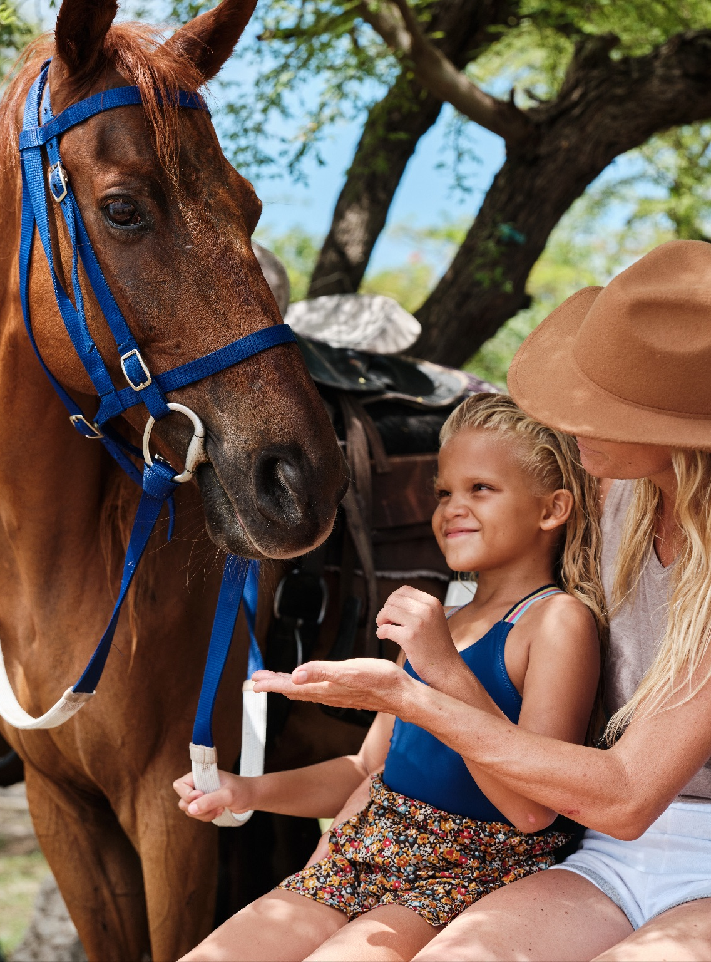
Insertion 1: Selling Groups & Family | June Issue
1-Full Page Ad
Release Date: June 28th 2024
Insertion 2: All About All-Inclusives | July Issue
1-Full Page Ad (Includes Luxury Guide + Vote for Us Travvy Section)
Release Date: July 25th 2024
Insertion 3: Destination Weddings & Honeymoon Guide | Sept Issue
1-Full Page Ad
Release Date: September 16th 2024
Circulation:
Print: 13,250
Digital: 26,804
Social: 37,606

Slide 30
Insertion 1: Wellness & Active Travel | July/Aug Issue
1-Full Page Ad + Advertorial
Release Date: July 1st 2024
Insertion 2: Multi Gen Travel, Hotels & Resorts | Sept Issue
1-Full Page Ad + Advertorial
Release Date: September 1st 2024
Insertion 3: What’s New for 2025 + Reader’s Choice Awards | Nov/Dec
1-Full Page Ad + Advertorial
Release Date: November 1st 2024
Circulation:
Print: 13,250
Digital: 26,804
Social: 37,606

Slide 31
Insertion 1: Romance & Weddings Guide
1-Full Page Branding Ad + Advertorial
Displayed in Travelweek Daily Newsletter for 2 months (1M impressions)
Hosted on Travelweek.ca for 1 year, (2.4M impressions)
Release Date: October 24th 2024
Circulation:
Digital: 31K+
Social: 36,600

Slide 32
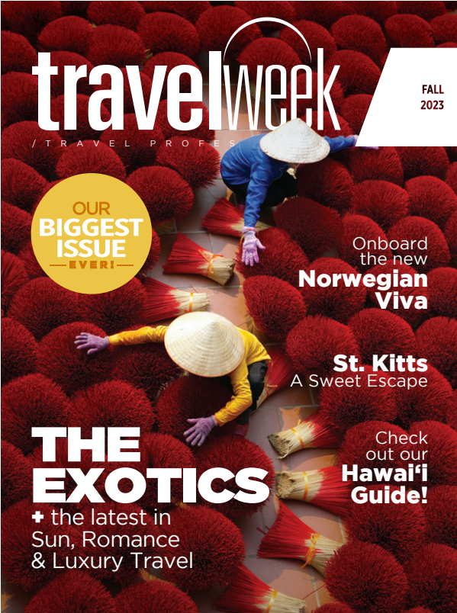
Insertion 1: Sun Destinations, Exotics, Adventure
1-Full Page Branding Ad + Advertorial
Displayed in Travelweek Daily Newsletter for 3 months (1.5M impressions)
Hosted on Travelweek.ca for 1 year, (2.4M impressions)
Release Date: November 7th 2024
Circulation:
Print: 9K
Digital: 31K+
Social: 36,600

Slide 33
Insertion 1: Trending Caribbean, Canada, Luxury Travel & Indigenous Tourism
1-Full Page Branding Ad + Advertorial
Added Value Social Post on Facebook & LinkedIn
Release Date: November 11th 2024
Circulation:
Print: 8,650
Digital: 16,230
Social: 13,500

Slide 34
DIGITAL IMPLEMENTATION
STRATEGY

Slide 35
Digital Channels
Strategy
Create awareness around Saint Lucia by targeting high-intent, in-market audiences using captivating video and images. Re-target users who have previously engaged with Saint Lucia’s online assets to keep Saint Lucia top-of-mind during the buyer’s journey.
Estimated Impressions: 12,500,000

Slide 36
Digital Channels
Strategy
Improve brand perception and recognition by using advanced demographic profiles and on-page keyword targeting to reach in-market travel audiences in real-time using programmatic bidding. This allows us to put Saint Lucia in front of users when they are actively researching travel online.
Estimated Impressions: 3,025,000

Slide 37
Digital Channels
Strategy
Effectively capture the attention of potential visitors by leveraging Expedia’s engaged user base and targeting capabilities to reach a highly targeted audience actively seeking travel options.
Co-Op Marketing for Fall 2024
Campaign Exploration to leverage destination for mutual benefit
Co-Op Marketing for new Full Fiscal 2025/26
Estimated Impressions: PENDING
Notes:
Effectively capture the attention of potential visitors by leveraging Expedia’s engaged user base and targeting capabilities to reach a highly targeted audience actively seeking travel options.

Slide 38
Digital Channels
Strategy
CO-OP Marketing – Support for Fall 2024
Confirmed hosting Classic Vacations Fam in October
Winter Classic Vacations Roadshows – various cities
CO-OP Marketing for 2025 - Exclusive Island of The Month
Romance & Family Themes – Spring Schedule
Estimated Impressions: PENDING

Slide 39
Digital Channels
Strategy
Met with AAV at Showcase and have assessed for opportunities
Co-Op Marketing for Fall 2024
Explore Fam Trip options for AAV preferred agency accounts
Co-Op Marketing for new Full Fiscal 2025/26
Estimated Impressions: PENDING
Notes:
Effectively capture the attention of potential visitors by leveraging Expedia’s engaged user base and targeting capabilities to reach a highly targeted audience actively seeking travel options.

Slide 40
Festivals & Events
Strategy
Leverage geo-targeted paid search campaigns to attract users seeking cultural festivals and events to learn more about Saint Lucia’s offerings.
Focusing on the following events:
Jazz & Art Festival - April 30-May 12
ICC T20 Men's World Cup - June 15 & 16
Carnival - July 1-17
CPL Cricket/Saint Lucia Kings - August 17-September 25
Dive Fest - September 15-21

Slide 41
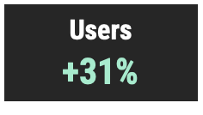
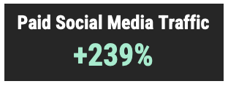
Top Cities (MoM change)
New York | +68%
Toronto | +158%
London | -13%
Dallas | +50%
Atlanta | +19%
Miami | +66%
Los Angeles | +140%
Philadelphia | +108%
Chicago | +5%
Charlotte | +111%
Top Pages (MoM change)
Homepage (US) | +78%
Accommodations (new) | -3%
Accommodations - All-Inclusive | -14%
Festivals & Events | +19%
Homepage [UK] | +2%
Plan Your Trip | -13%
Plan Your Trip - Getting Here | -10%
Nature & Adventure | -8%
Nightlife | -13%
Discover Saint Lucia | -22%
Plan Your Trip - Weather | -47%
Digital Traffic Highlights
July
The large traffic increase in Toronto, Los Angeles and Charlotte is attributed to the paid social media campaign.
Emerging pages that are not indicated on the list:
Festival & Events (French Version)
French Homepage
Wedding Packages
Saint Lucia Carnival

Slide 42
Facebook &
Instagram Ads
July Performance
In July, Charlotte had the highest CTR at 5.44% CTR. Philadelphia is second with a 5.13% CTR.
The remarketing campaign is out performing the prospecting campaign by 149% with a 8.53% CTR. This is to be expected as the remarketing campaign is designed to target users who have previously engaged with awareness ads or Saint Lucia’s website.
Total campaign impressions are up 580% month-over-month. Total clicks are up 373% month-over-month.
Stories Campaign
Impressions | 3,348,409
Clicks | 132,201
Click-Through Rate | 3.95%
CTR Industry Benchmark: 0.90%

Slide 43
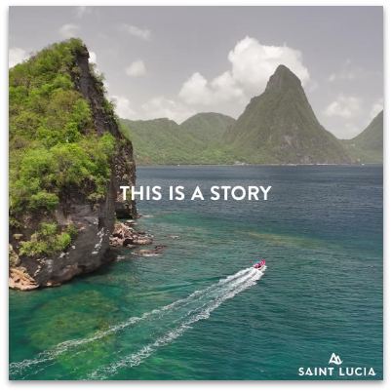
Programmatic Video Ad
July Performance
Impressions are up 65% month-over-month. Clicks are up 45% month-over-month.
Campaign performing about 40% above industry standards.
The addressable geofencing campaign is performing the best with an 86% view completion rate. This campaign uses precise geographic targeting and advanced demographic profiles to reach in-market travel audiences in real time.
The top pages viewed from users entering from the programmatic video campaign in July are:
Homepage
History & Culture
Festival & Events
Accommodations (new)
Discover Saint Lucia
Video Campaign
Impressions | 842,428
Completed Views | 390,584
View Completion Rate | 77.32%

Slide 44
SOCIAL MEDIA
HIGHLIGHTS

Slide 45
Quarter 1 & 2 Highlights
Launched the new “Peak Season for Saint Lucia” Winter Campaign
Ongoing promotions of Collection de Pépites
Highlighted key announcements including increased weekly flights on Air Canada, Sunwing Vacations, and WestJet for the winter and summer schedule.
Announced increased nonstop weekly flights on American Airlines from Miami + afternoon and night flights on JetBlue for Carnival.
Highlighted Saint Lucia’s nominations in the 31st annual World Travel Awards.
Promoted ICC Men’s T20 World Cup at the Daren Sammy Stadium.
Promoted Staycation exclusive deals ongoing
Giveaways
Nobel Laureate
Participants entered for a chance to win a 5-night stay for 2 at Bay Gardens Marina Haven including flight & airport transfers
#LoveSaintLucia
To promote Saint Lucia as a top romance destination for Valentine’s Day, organized an Instagram collaboration giveaway with @Caribcation from February 14th-29th. Participants had a chance to win a romantic dinner for two at Jacques Waterfront Dining.

Slide 46
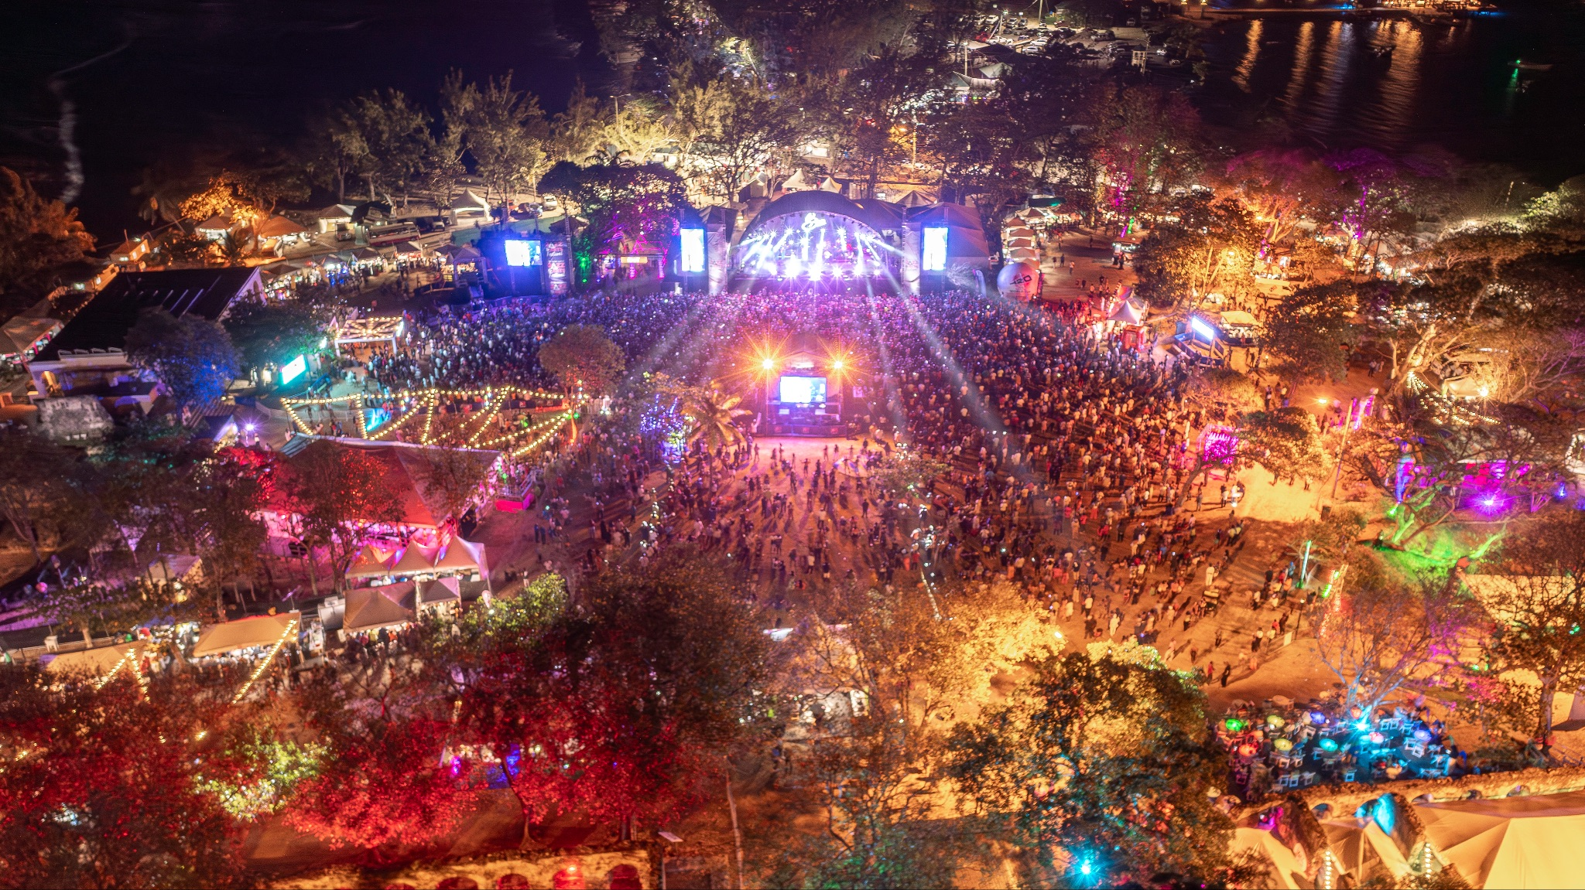
Quarter 1 & 2 Highlights
Jazz Festival 2024
Highlighted the Jazz Festival Media Launch with artist graphic lineup and countdown
Collaborated with “The Real Housewives of Atlanta” cast member Kenya Moore for Jazz Festival via a social media posts and stories
Launched early bird ticket specials and the official teaser videos
Promoted the Festival through posts/stories including a countdown to launch, and Flash Sale.
Designed custom graphics to increase awareness and promote performing artists.
Promoted Jazz Festival via Social Media ads across Canada, USA and Caribbean

Slide 47
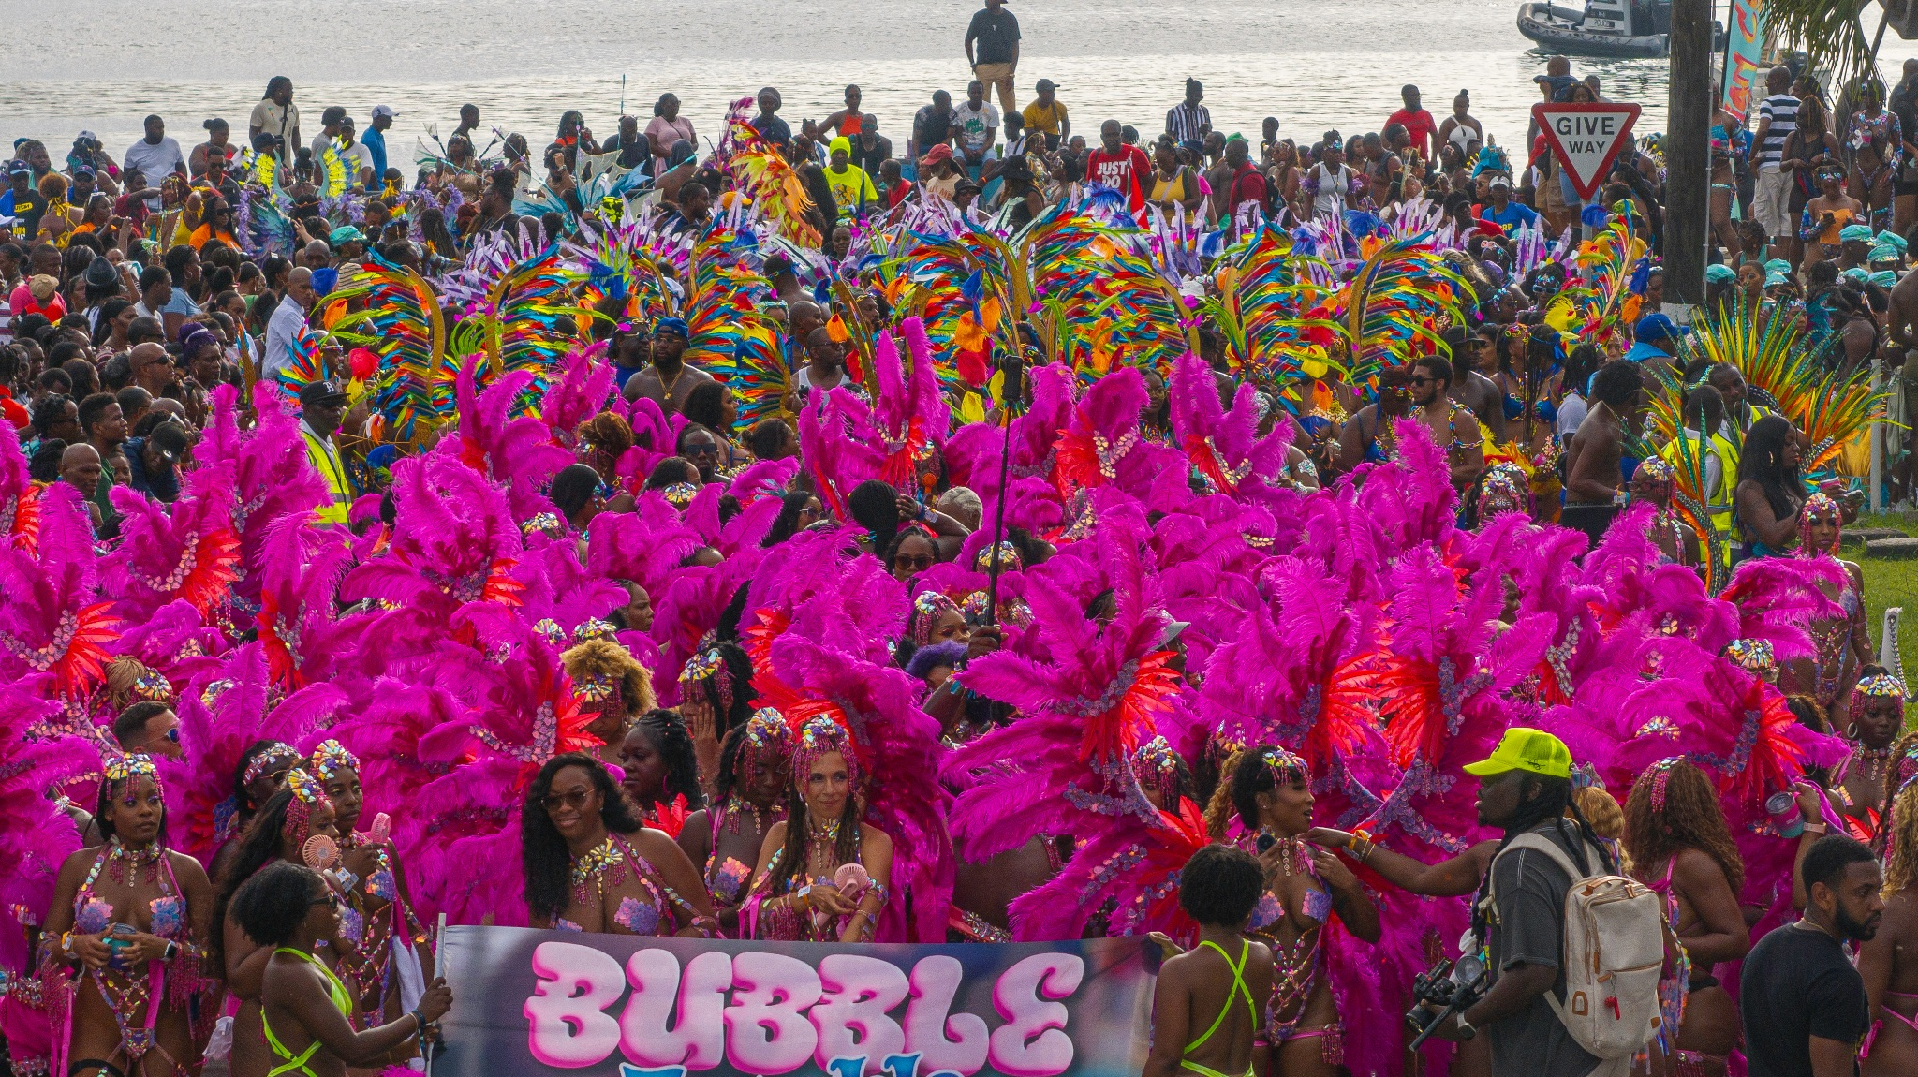
Quarter 1 & 2 Highlights
Carnival 2024
Launched the official Carnival video and promoted events throughout the month
Influencer collaboration with Korra Obidi - Singer and social media personality to experience Saint Lucia for the first time highlighting her experience to her followers with social posts and lives.
Influencer collaboration with Senior Editor, Sidnee Douyon from Black Enterprise, a premier resource for African American business.
Influencer collaboration with Jessie Woo, TV Host and Social Media Personality who highlighted her experience on social media.
Promoted Carnival via Social Media ads across Canada, USA and Caribbean

Slide 48
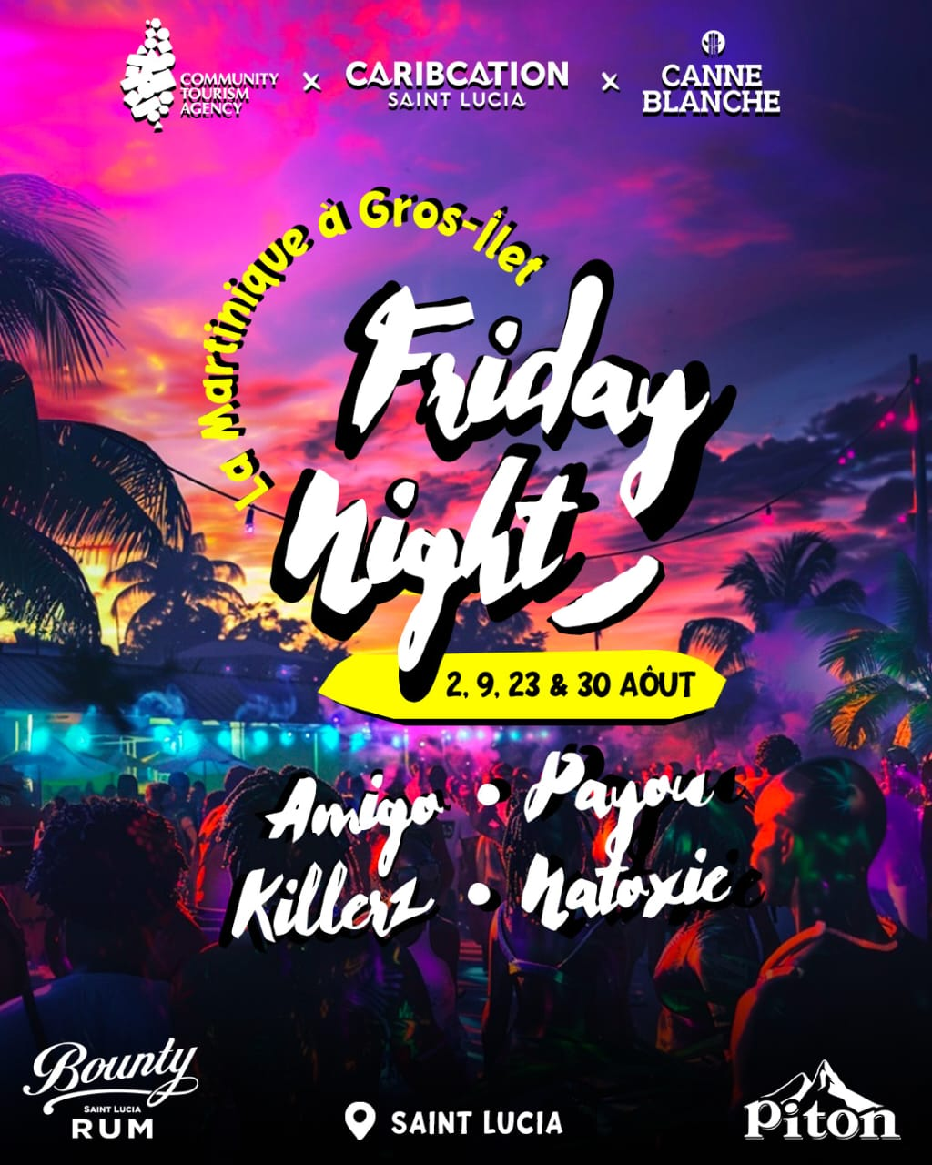
Quarter 3 Current Market Updates
August - September
Gros Islet Friday Night Street Party with exclusive Martinique DJ takeovers for the month of August
Julien Alfred Gold and Silver Olympic Win social media push and campaign planning
Highlighted the new Chloe Bailey visual album entirely inspired by and filmed in Saint Lucia across social media
Promote Saint Lucia Stories across all social platforms
Influencer collaborations
Quarter 4
October - December
Holiday Giveaway with Influencer Collaboration
Holiday Influencer PR/Social Box
Influencer Residency Campaign Planning for 2025
Ongoing influencer collaborations
Monthly custom interactive social media stories
Ongoing promotion of Staycation
Collection de Pépites highlighting villas, B&B’s and boutique hotels
Monthly Social Media Ad promoting Staycation

Slide 49
SLTA GLOBAL
HIGHLIGHTS

Slide 50
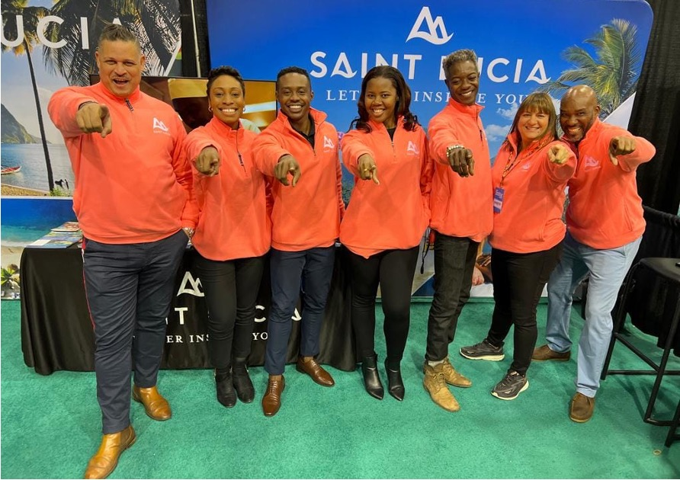
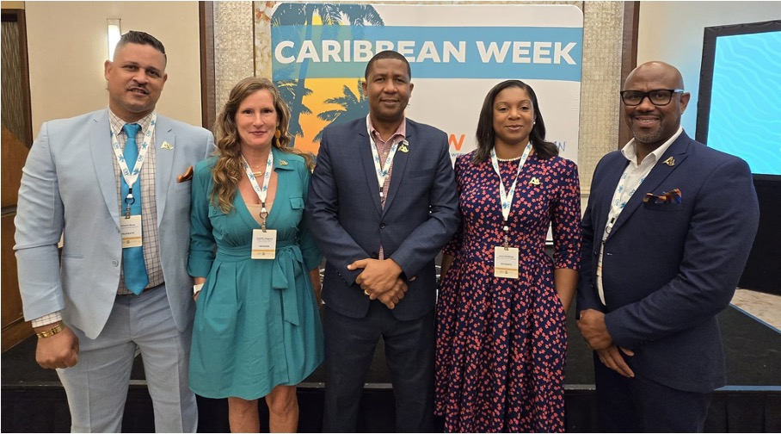
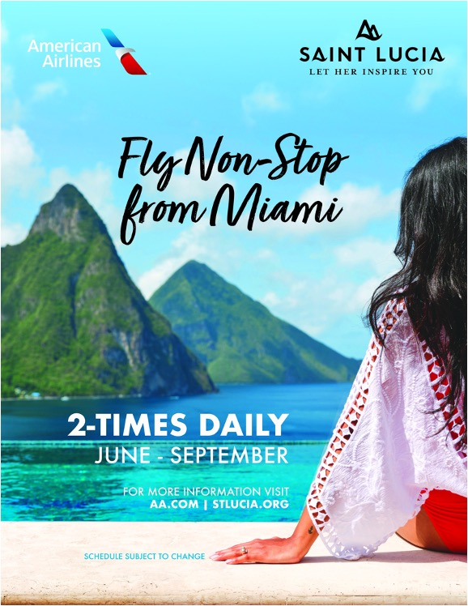
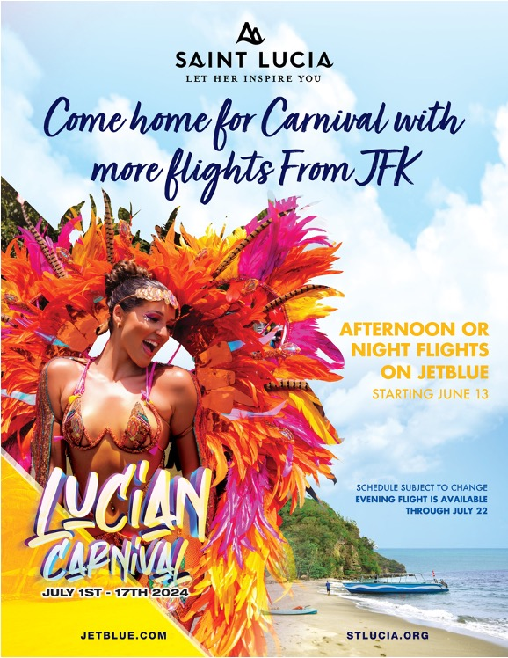
UNITED STATES

Slide 51
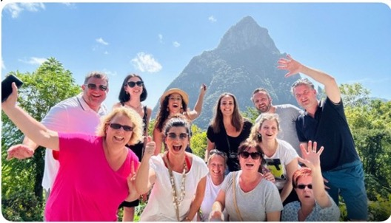
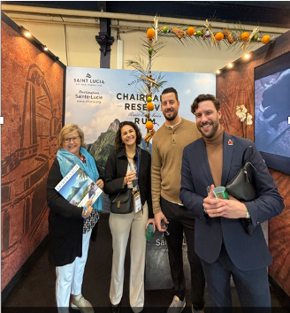
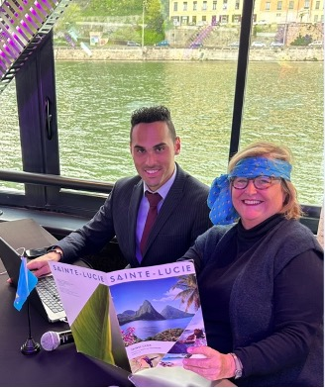
EUROPE

Slide 52
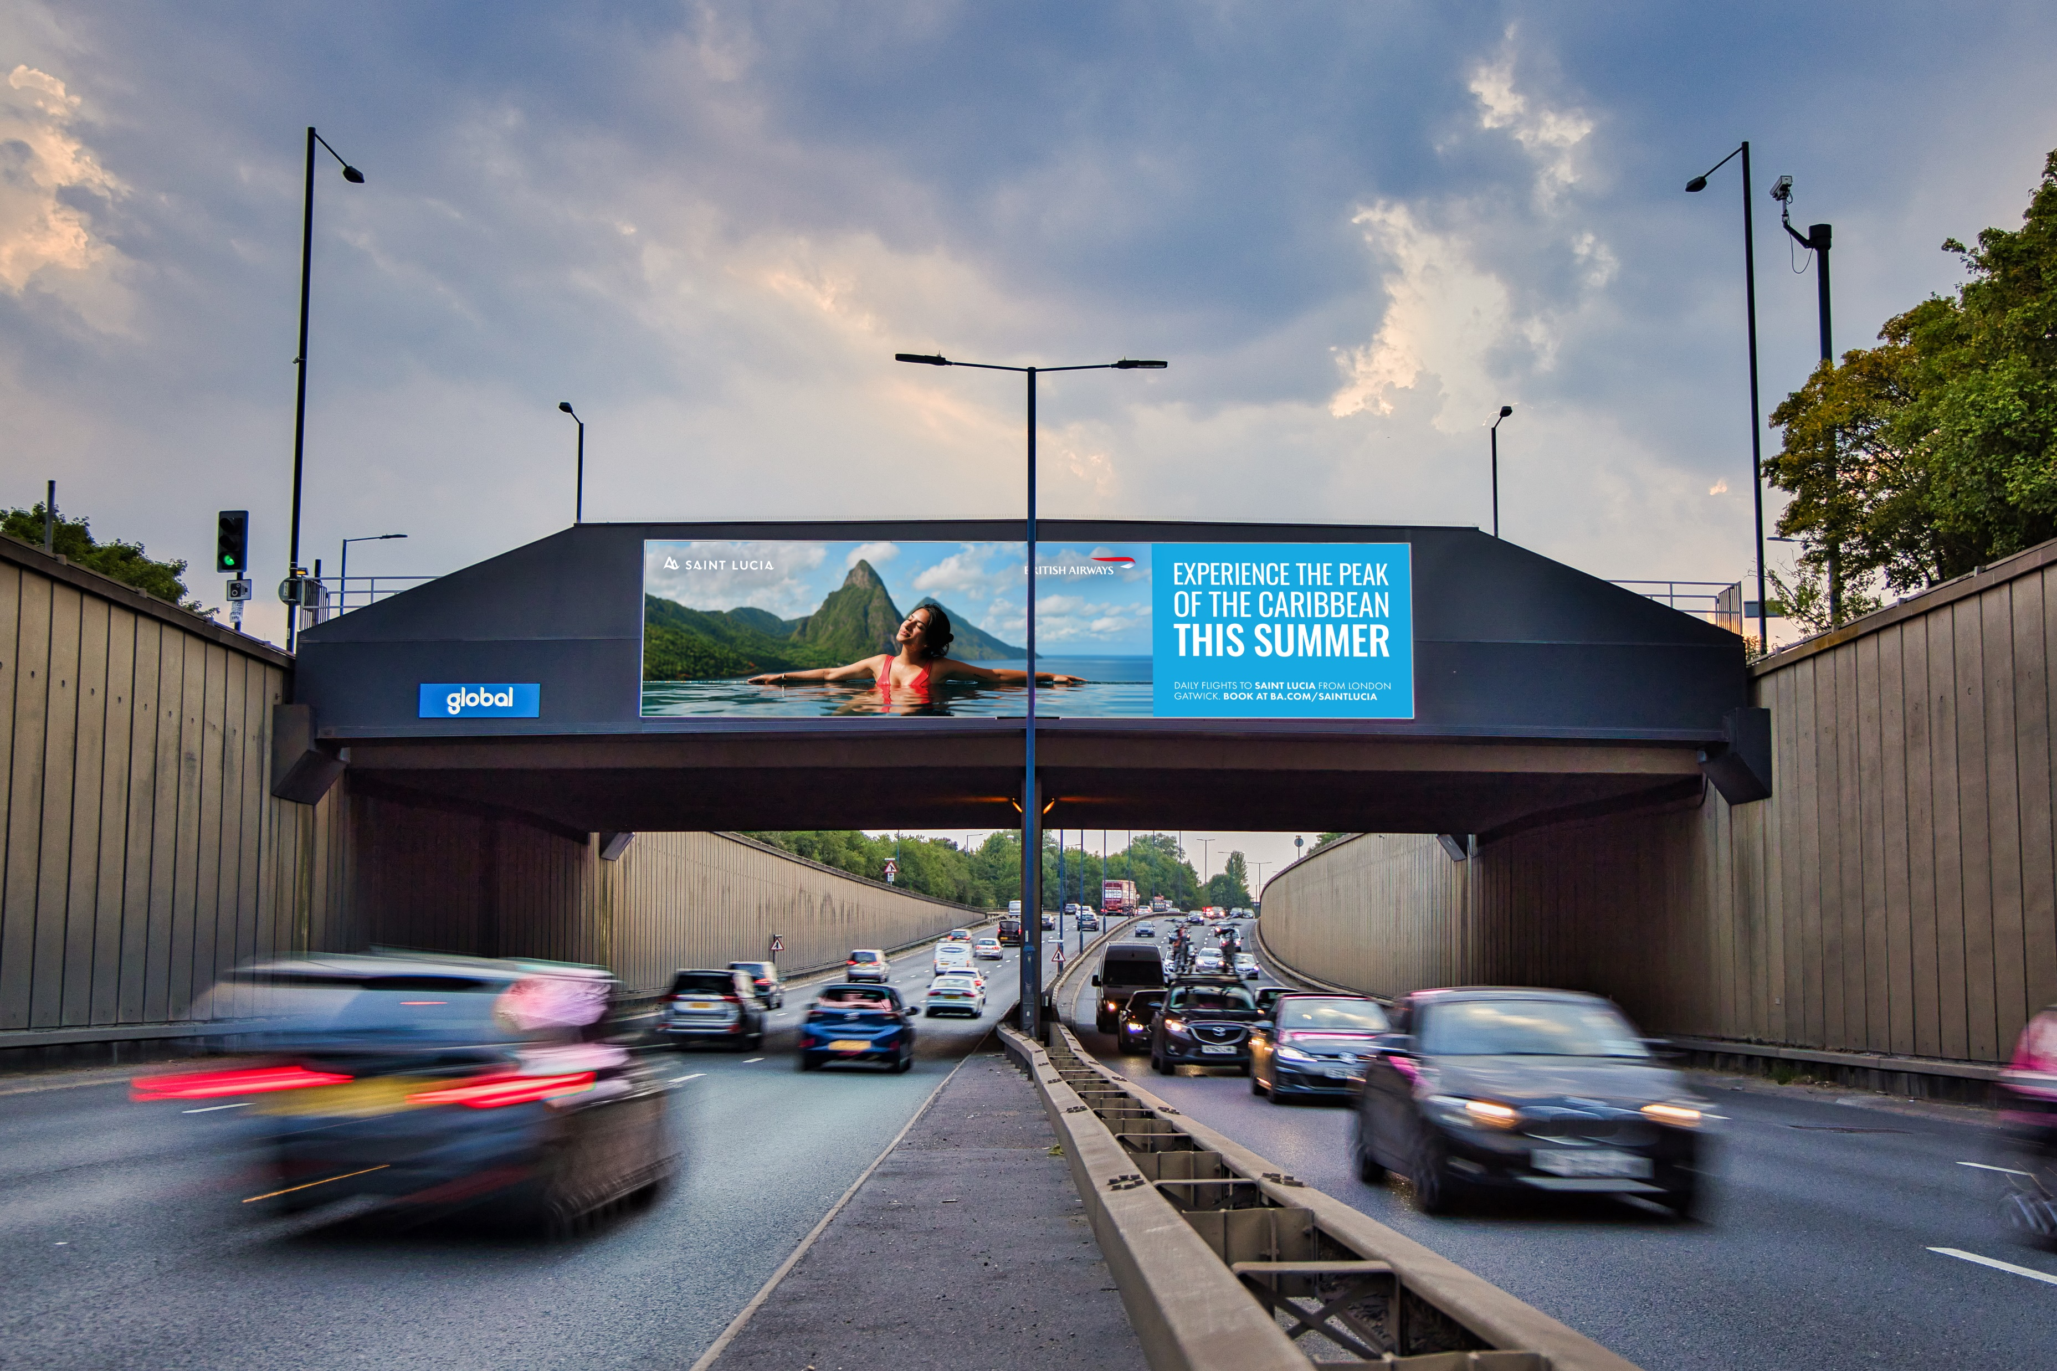
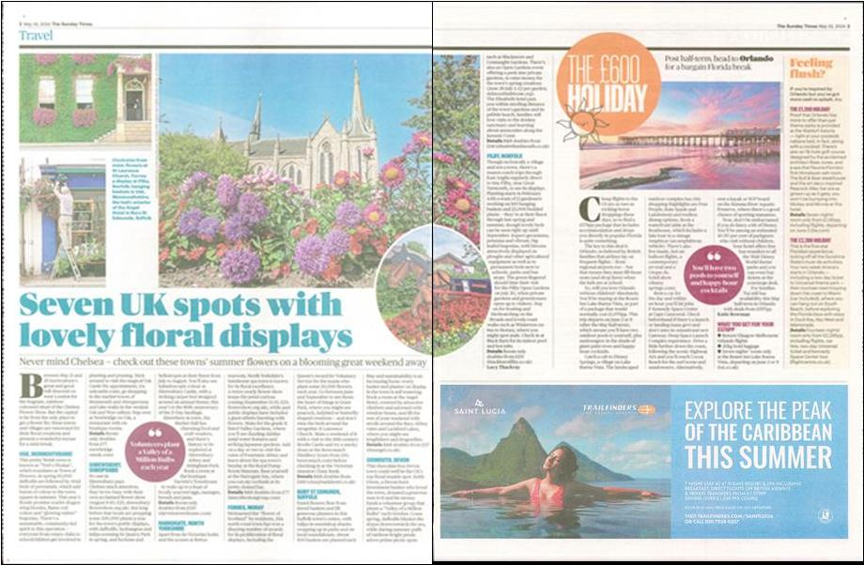
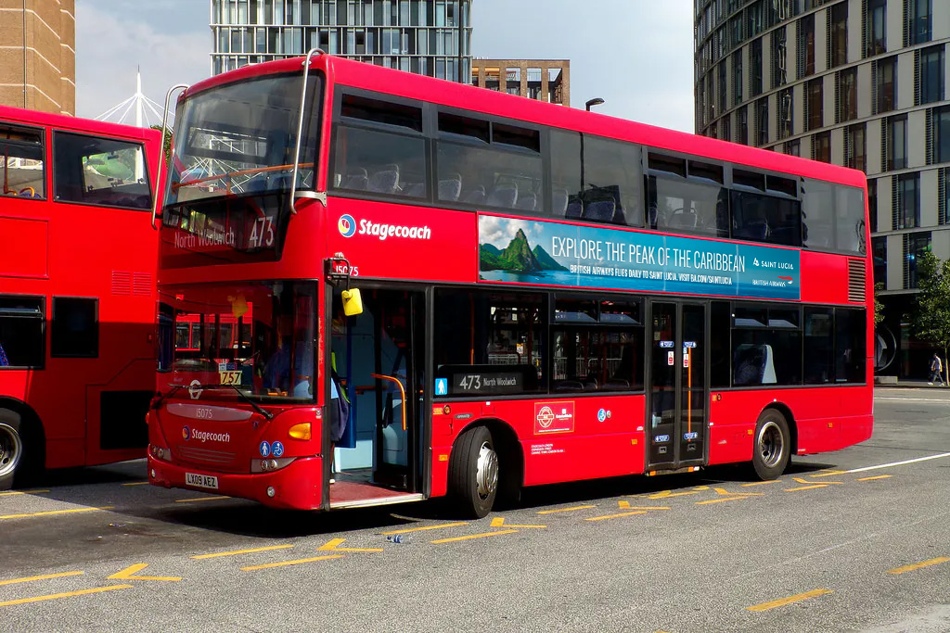
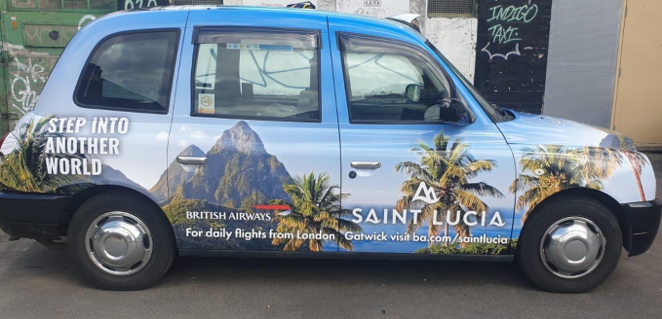
UNITED KINGDOM

Slide 53
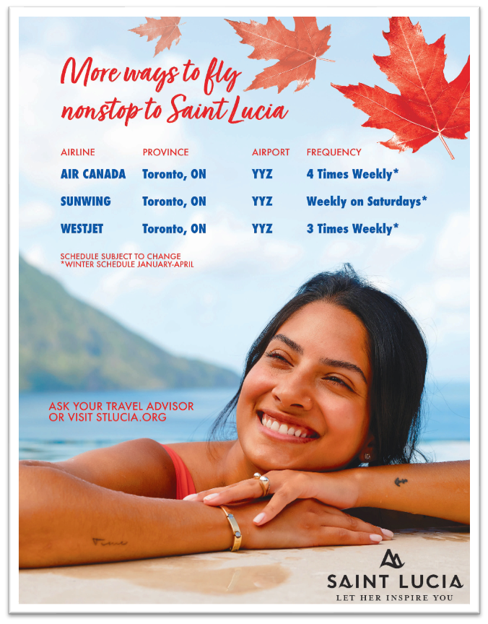
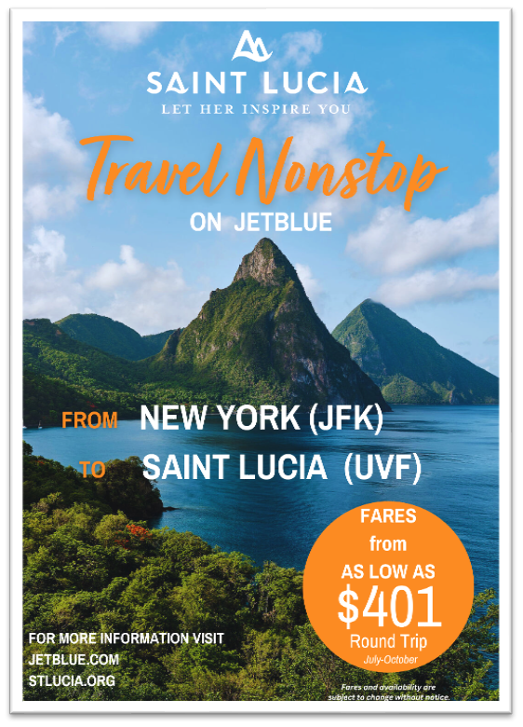
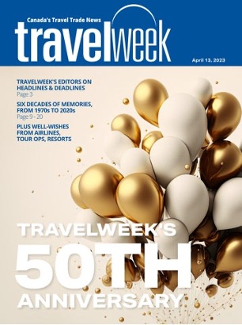
CANADA

Slide 54
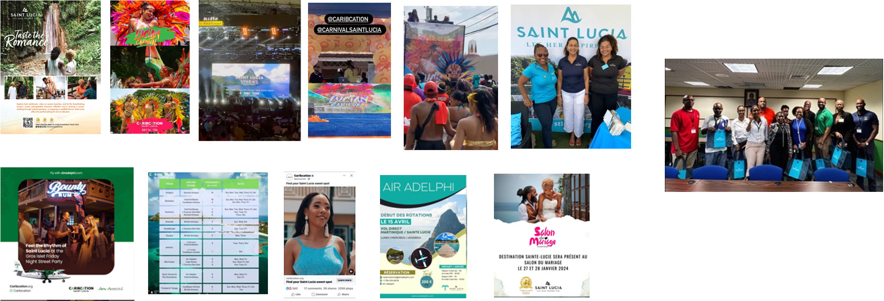
CARIBBEAN

Slide 56
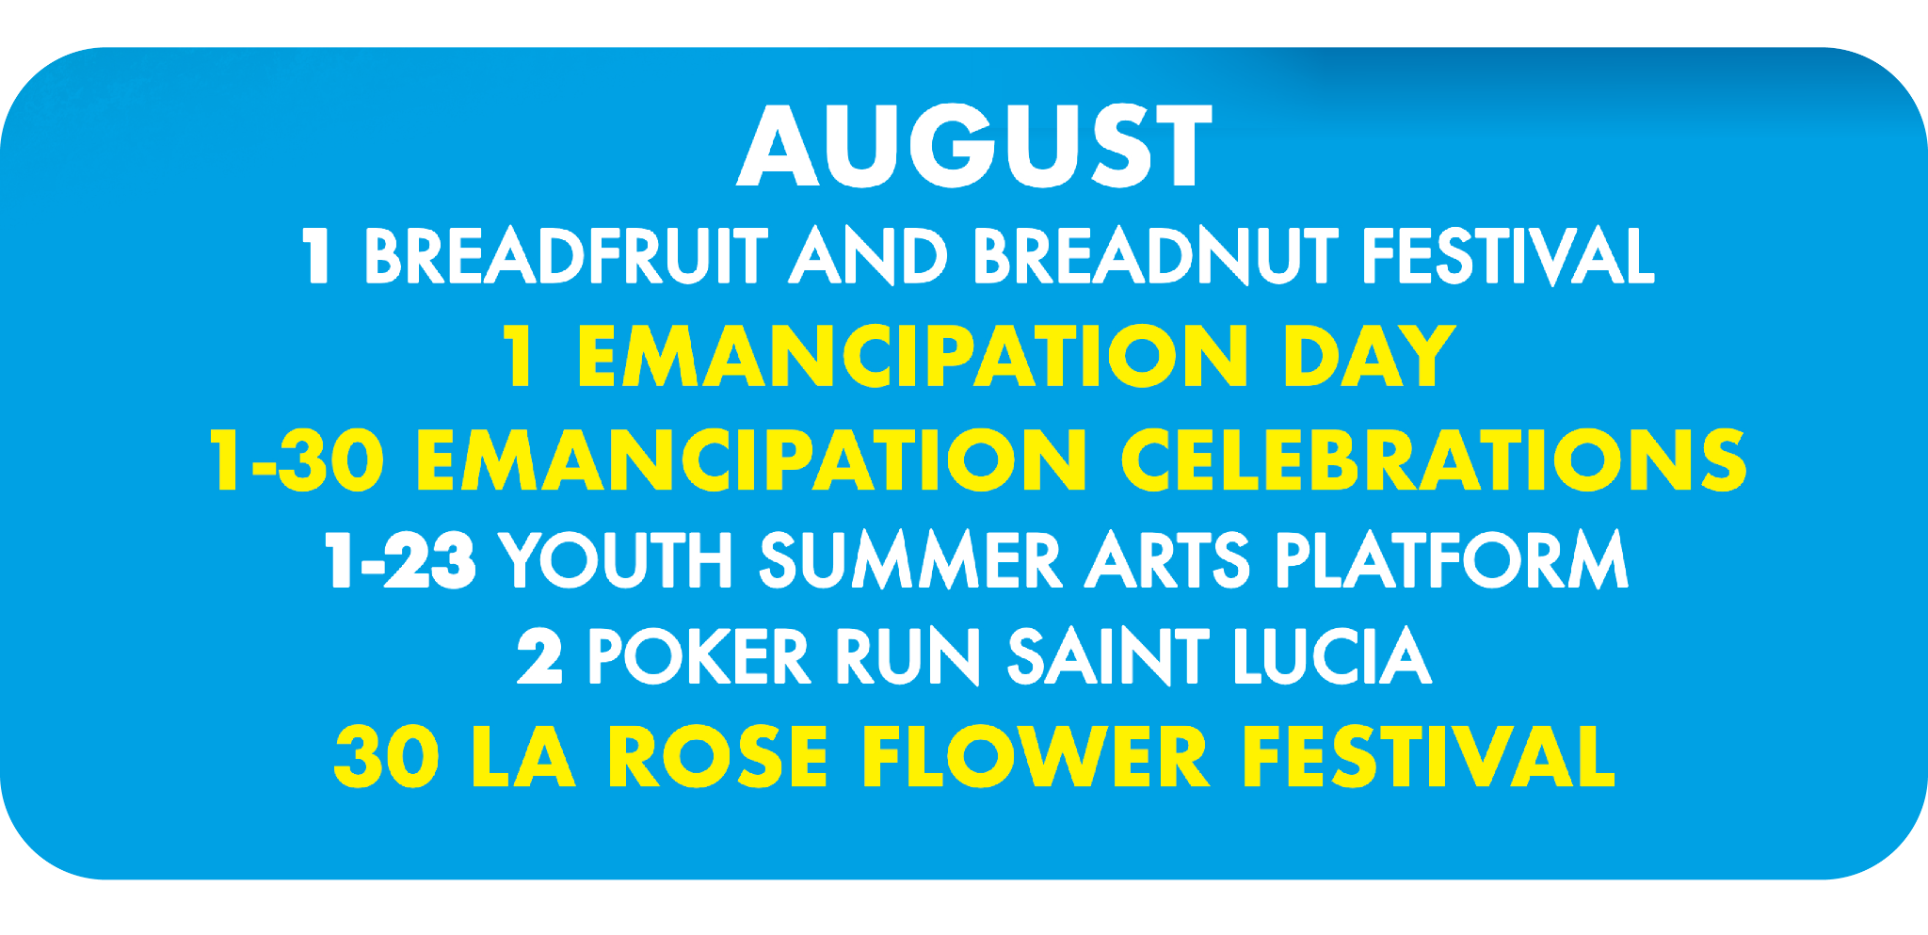
AUGUST

Slide 57
SEPTEMBER

Slide 58
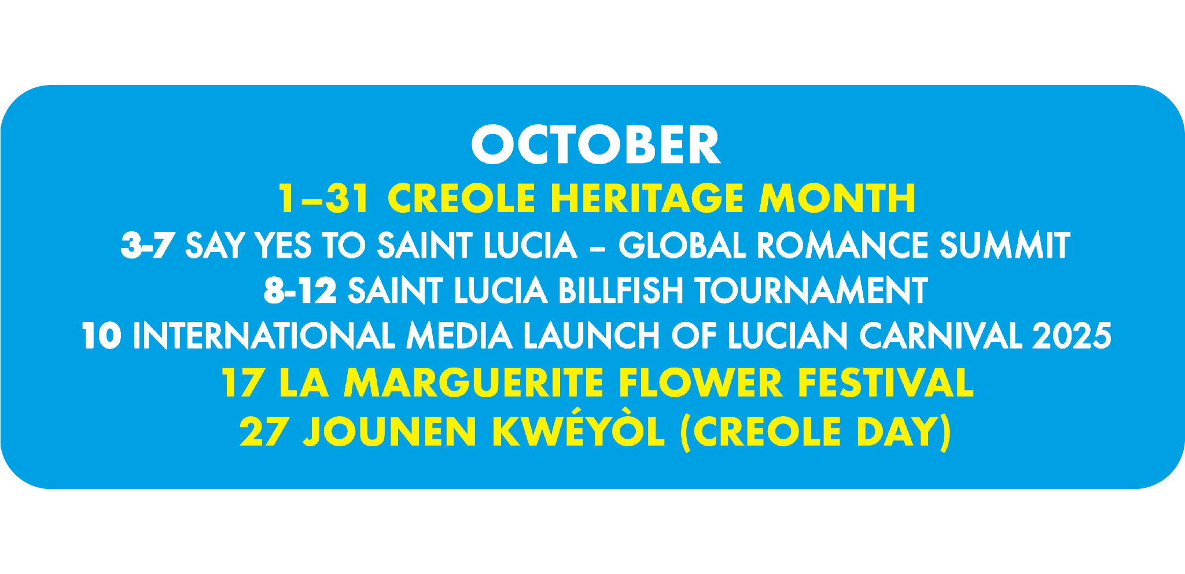
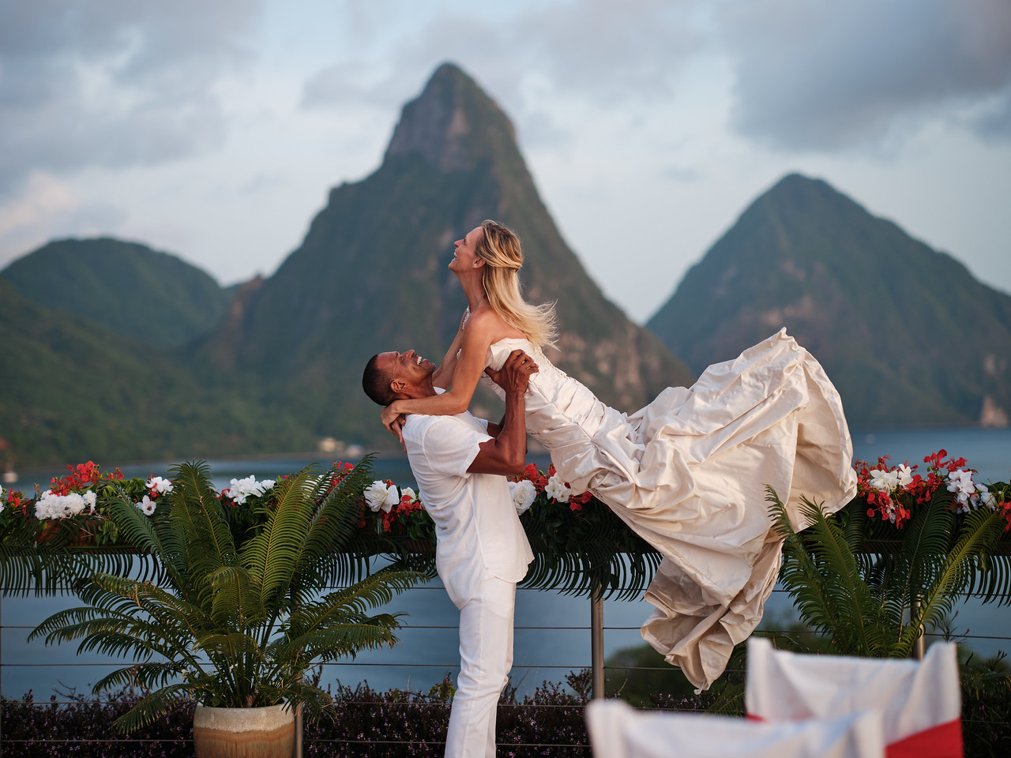
OCTOBER

Slide 59
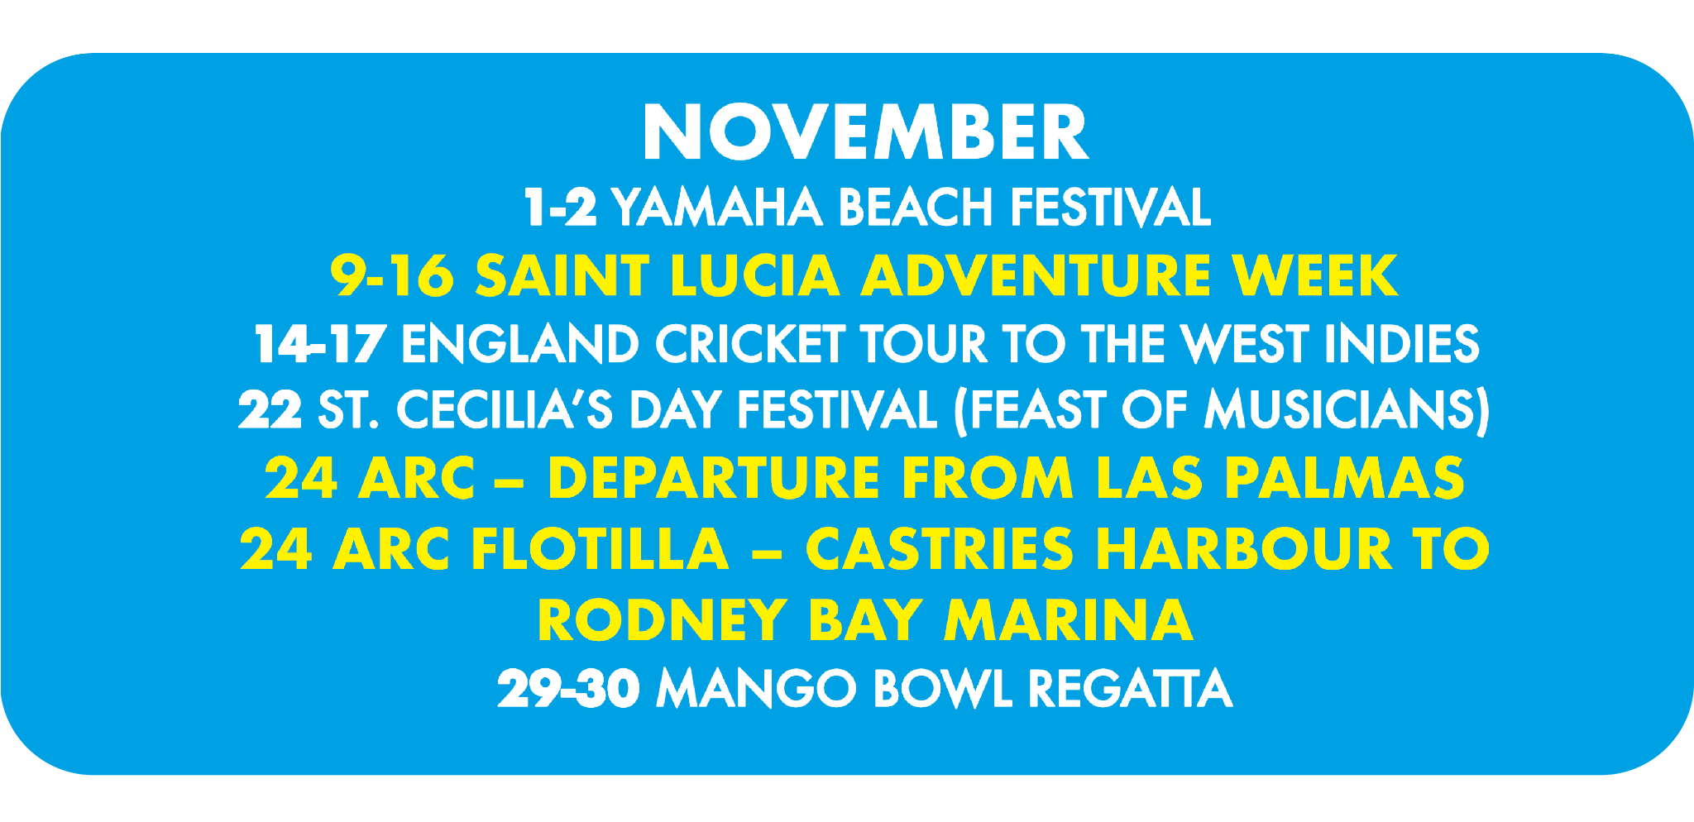
NOVEMBER & DECEMBER

Slide 60
2025
CALENDAR

Slide 61
MAY

Slide 62
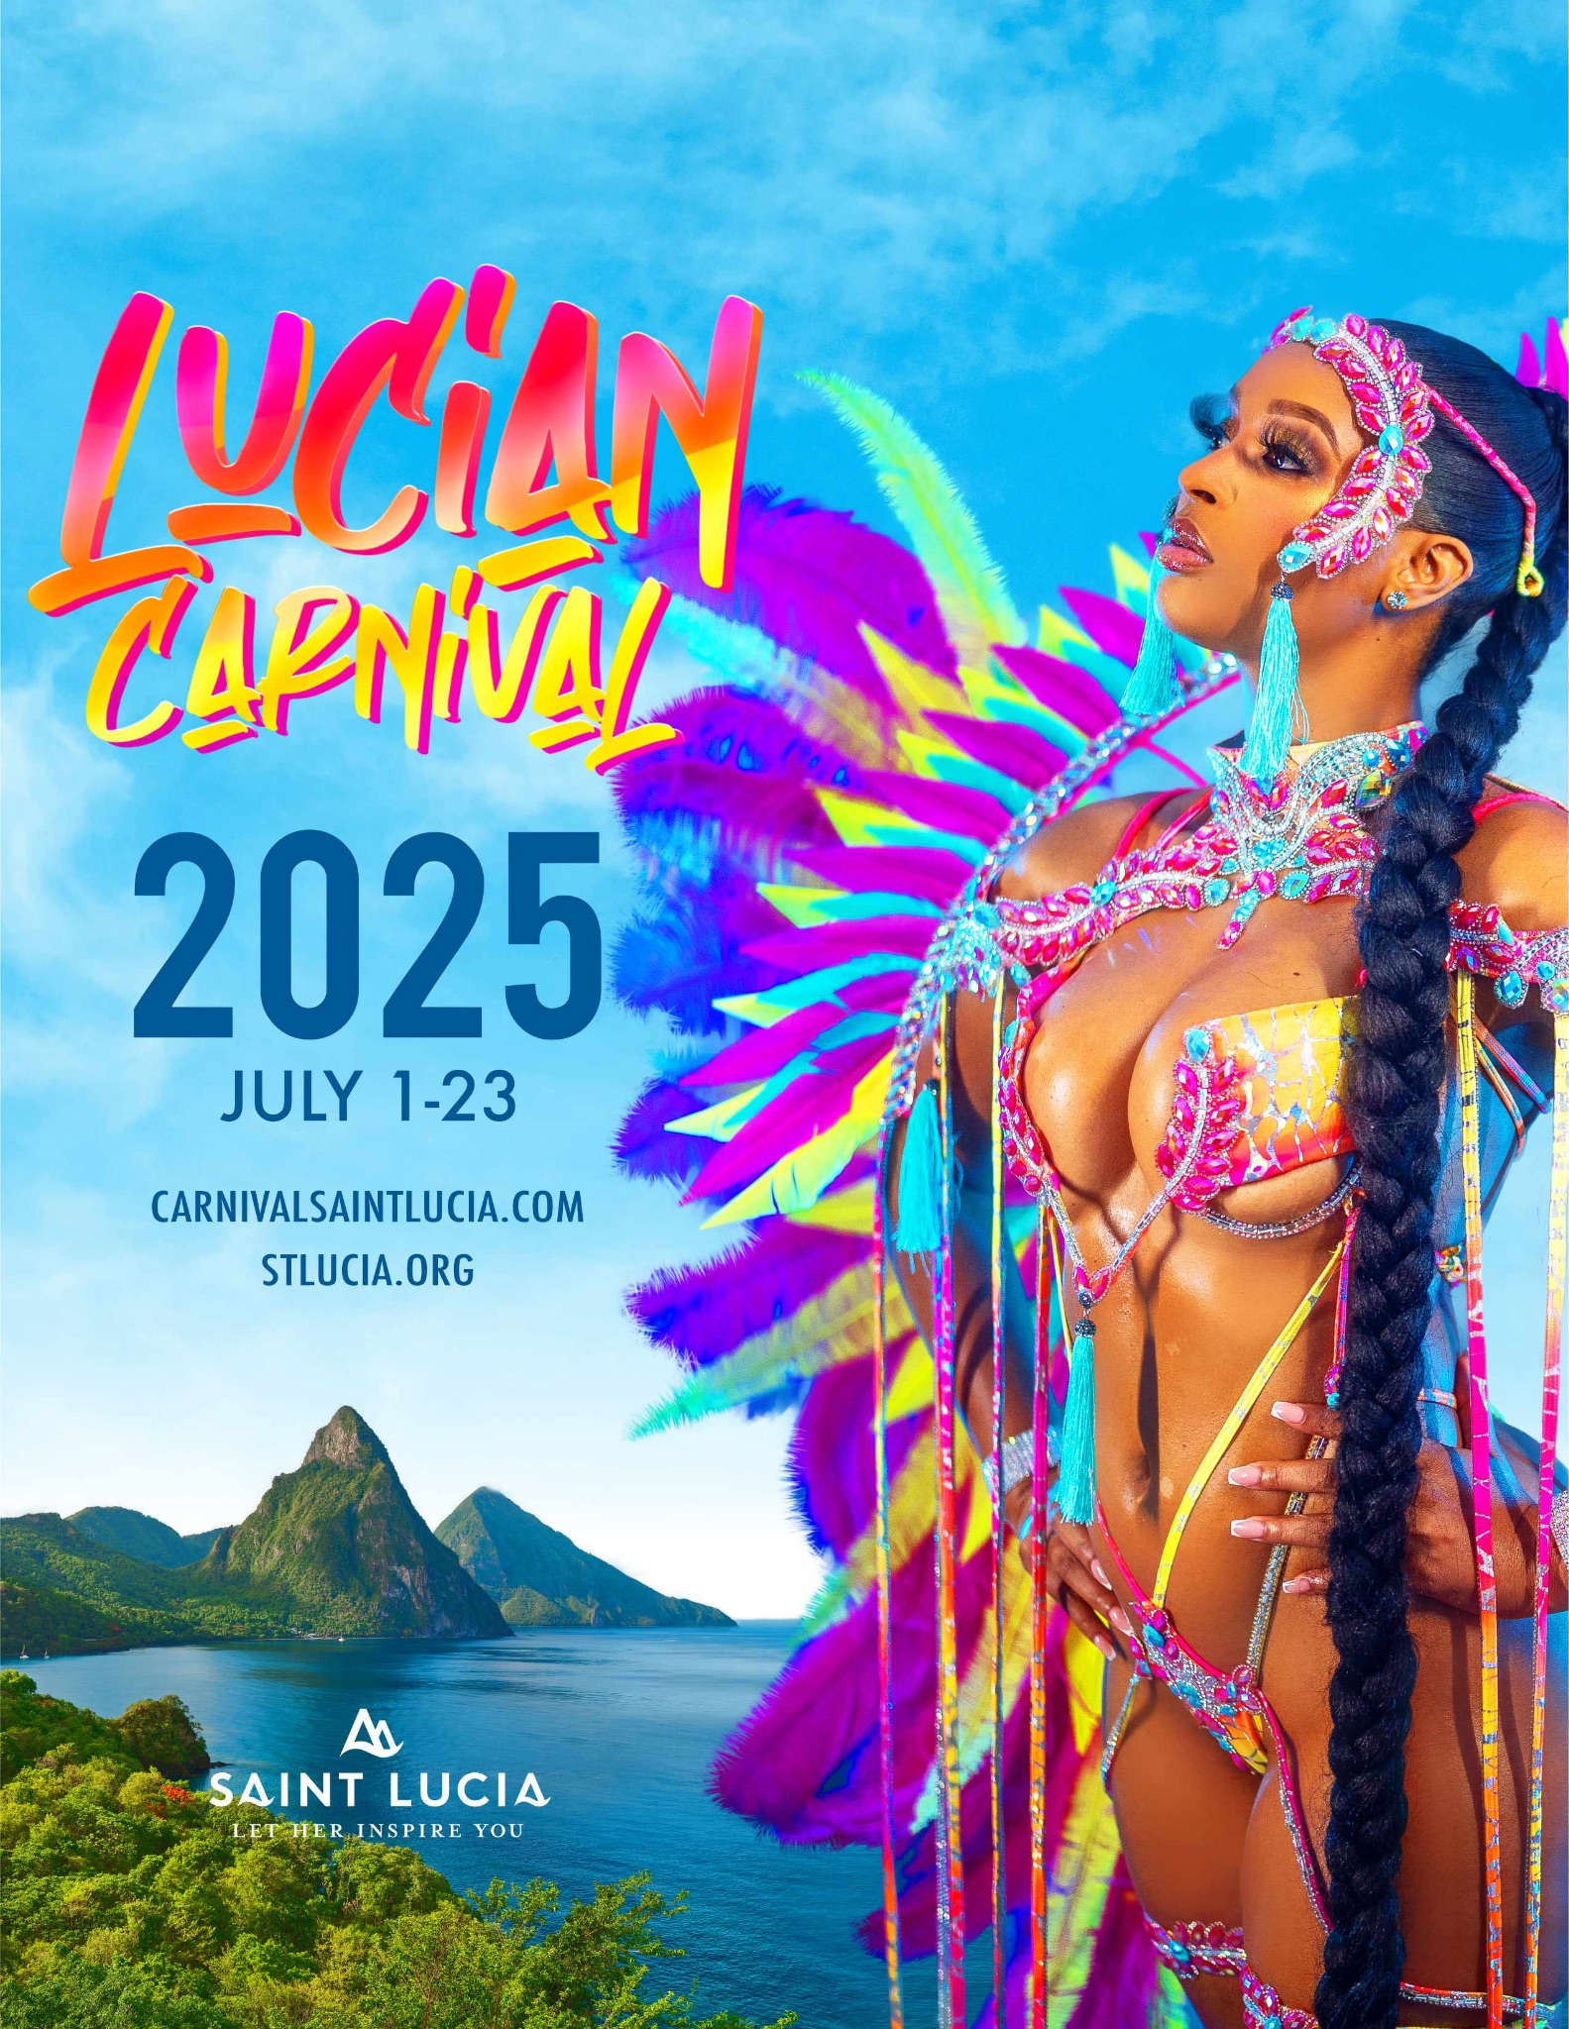
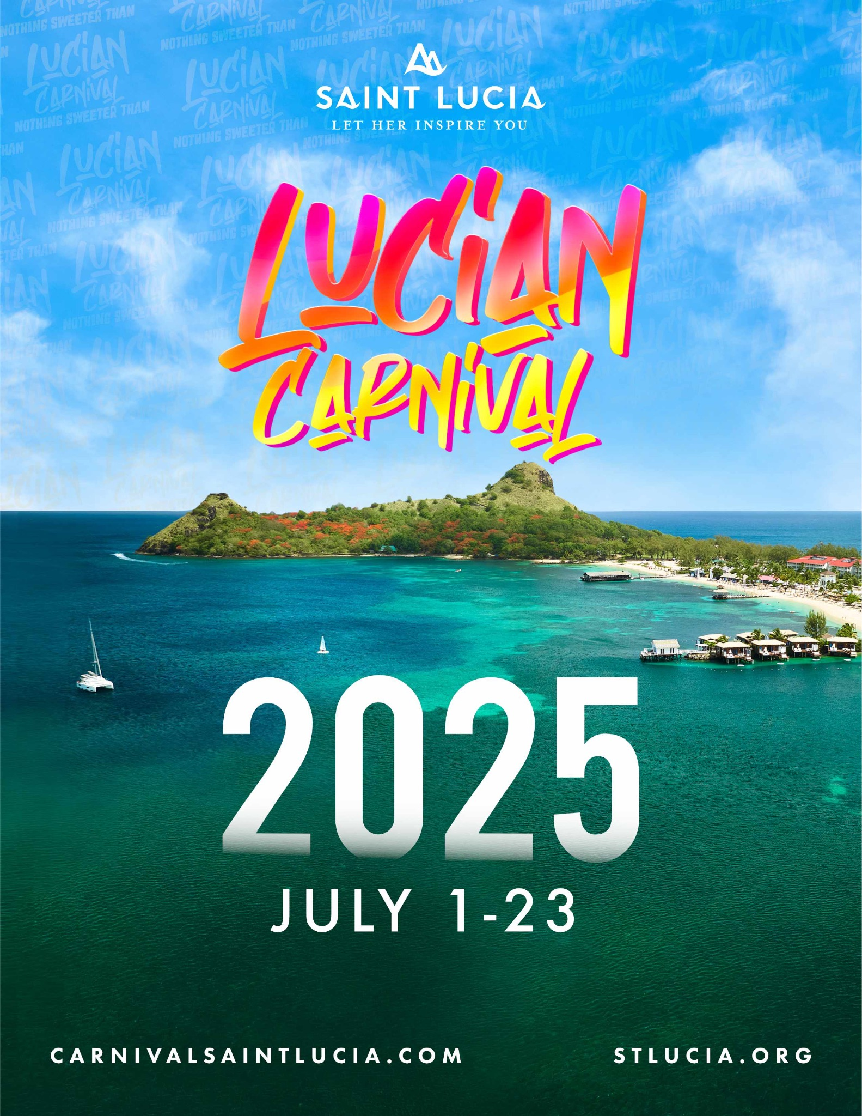
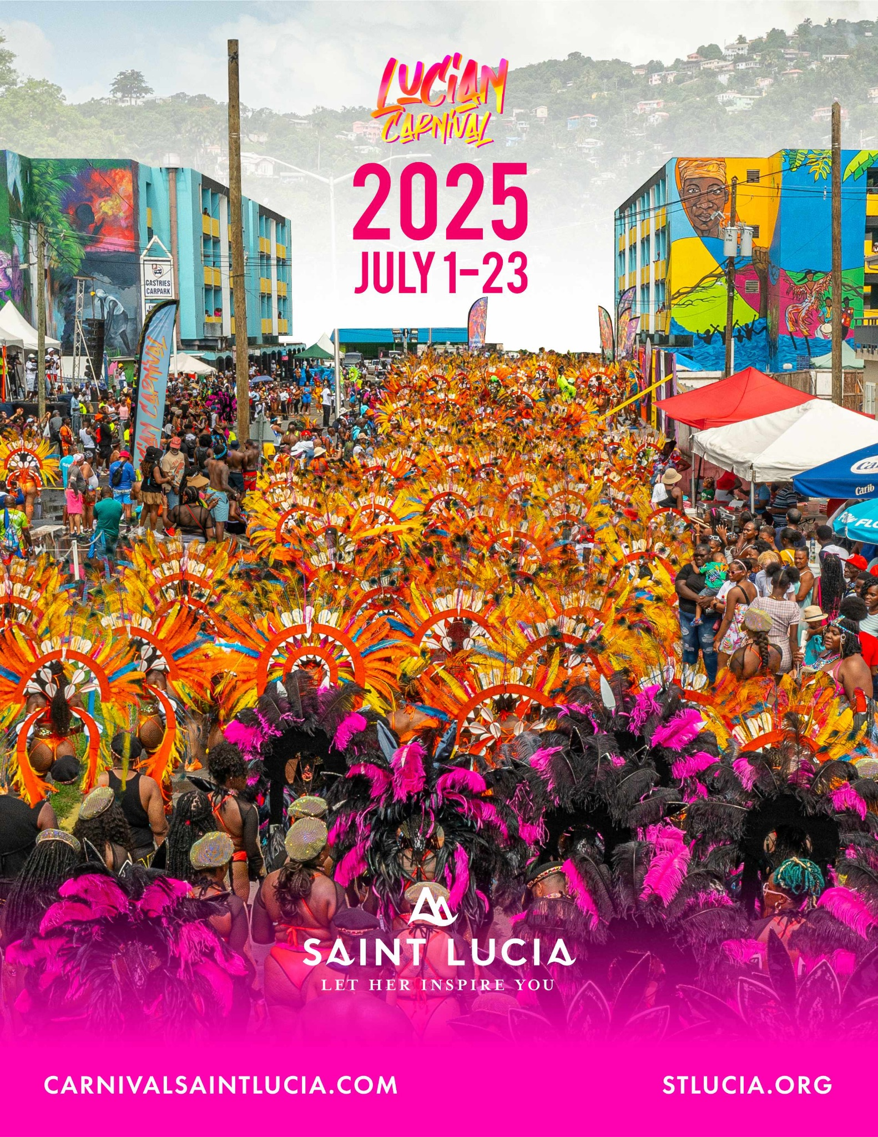
JULY

Slide 63
THANK YOU

