Slide 1
SLHTA CHEF’S FORUM PRESENTATION
Ministry of Tourism, Investment, Creative Industries, Culture and Information

Slide 2
Introduction
Presentation Team
Tourism Development Act
TDA Timeline & TDA Background
Certification
Status of Certification
Room Stock Update
Current Room Stock/Room Stock Under Construction
Room Stock by Product Classification and Geographic Location
Tourism Incentives
Requirements for Tourism Incentives
Incentives Process and Flow Chart
Incentives Tables
Government’s Investment in Tourism Development
Questions and Answers
ORDER OF PRESENTATION

Slide 3
Progress has been made so Far ...
Tourism Development Act No. 1 of 2024 was Gazetted on March 14th.
Publication of Regulations in the Week of August 19th.
2024
Jan
Feb
Mar
Apr
Aug
Nov
Dec
Tourism Development Bill was Read and Passed in the House of Parliament on February 20th .
Tourism Development Act came into Effect on April 15th.
First Phase of Certification of Accommodation Sub-Sector to be Completed.

Slide 4
TOURISM DEVELOPMENT ACT
Adiva John

Slide 5
BACKGROUND
PREVIOUS LEGAL FRAMEWORK FOR TOURISM
Key Acts:
The Tourism Incentives Act, Chapter 15.30 (1996)
The Tourism Stimulus and Investment Act, Chapter 15.03 (2014)
Cabinet Conclusions:
Cabinet Conclusion No. 717 of 2011: Yachting Sector
Cabinet Conclusion No. 504 of 2023: Incentives Regime for the Car Rental Subsector
Cabinet Conclusion No 1189 of 2020: Incentives for Tourism Transportation (extended)
Other Acts:
Saint Lucia Tourism Authority Act
Community Tourism Development Act
Tourism Levy Act

Slide 6
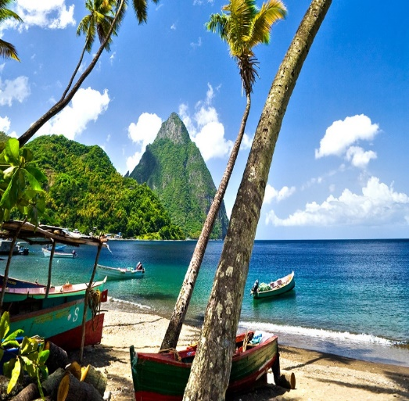
BACKGROUND
The Tourism Incentives Act, Chapter 15.30 (1996)
The Tourism Stimulus and Investment Act, Chapter 15.03 (2014)
Cabinet conclusion No. 227 of 2021
Why the need
for change ?
Cabinet via Conclusion No. 227 of 2021 endorsed the revision of the Tourism Incentives Act, Cap. 15.30, of the Revised Laws of Saint Lucia.

Slide 7
KEY ISSUES IDENTIFIED
1
Legislation is dated and does not reflect current industry environment
2
Increased local ownership
in the tourism sector
3
Improvement of quality and diversity
of tourism products on island
4
Incentives to encourage the improved sustainability and resilience of the industry
5
Collection of data and information to guide policy
within the tourism sector
6
Provision of incentives to new and emerging subsectors such as MICE, Wellness, Yachting and Marine services etc

Slide 8
LEGISLATIVE IMPLICATIONS
Acts to be repealed:
The Tourism Incentives Act, Chapter 15.30, and
The Tourism Stimulus and Investment Act, Chapter 15.03
Tourism Levy Act No. 11 of 2020
Cabinet Conclusions Superseded:
Cabinet Conclusion No. 717 of 2011: Yachting Sector
Cabinet Conclusion No. 504 of 2023: Incentives Regime for the Car Rental Subsector
Cabinet Conclusion No 1189 of 2020: Incentives for Tourism Transportation (extended)
Acts Retained & In Place:
The Saint Lucia Tourism Authority Act
Community Tourism Development Act

Slide 9
TOURISM DEVELOPMENT ACT
AIM
To establish a SINGLE but COMPREHENSIVE legal framework for encouraging and advancing tourism development in Saint Lucia.

Slide 10
TOURISM DEVELOPMENT ACT
Arrangement of Sections
PRELIMINARY
Short Title
Interpretation
PART I: ADMINISTRATION
PART II: TOURISM CERTIFICATES
PART III: SOCIAL PARTNERSHIP
PART IV: INCENTIVES, ADDITIONAL INCENTIVES, INCENTIVES FOR RESILIENCE & TAX CREDITS
PART V: TOURISM LEVY
PART VI: REVIEW COMMITTEE
PART VII: TOURISM DEVELOPMENT FUND
PART VIII: TOURISM INFORMATION DATABASE & MONITORING
PART VIII: MISCELANEOUS
SCHEDULES

Slide 11
NEW LEGISLATIVE FRAMEWORK
Core objectives of the TDA:
to facilitate inclusive, resilient and sustainable tourism development;
to provide for administration of the tourism certification programme;
to facilitate incentives for tourism investment, including, specialized support areas, additional incentives and incentives for resilience
the imposition, collection, remittance, assessment and payment of a tourism levy;
the establishment of the Tourism Development Fund and Tourism Information Database; and
To broaden the scope of eligible projects for tourism incentives.

Slide 12
CERTIFICATION UNIT UPDATE
PS Donalyn Vittet

Slide 13
TOURISM CERTIFICATION
TOURISM CERTIFICATION: THE STARTING POINT
Tourism as an export must be subject to and meet set national & international service and product quality standards.
Sections 39 and 40 of the TDA
Tourism Certifications
No person, business or entity operating in any sub-sector of Saint Lucia's tourism industry will offer any service or product for reward or otherwise unless they are an Approved Tourism Operator based on a valid Tourism Certificate issued Every 2 Years by the Government of Saint Lucia
Accessing Incentives
No person, business or entity will be entitled to access the co-financing facilities (incentives) and other provisions under this Act unless they hold a valid Tourism Certificate as an Approved Tourism Operator

Slide 14
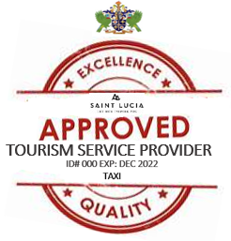
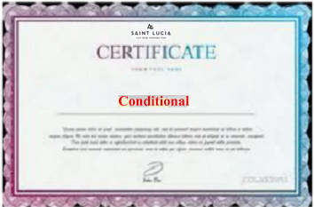
TOURISM CERTIFICATION
Types of Certification

Slide 15
TOURISM CERTIFICATION COMMITTEE
The Tourism Certification Committee shall comprises 7 key sector agencies.
The members are as follows:
The Permanent Secretary, and in his or her absence, the Deputy Permanent Secretary of the Ministry, who is the Chairperson;
a representative of the Saint Lucia Bureau of Standards;
the Chief Tourism Officer (Ex-officio Officer);
a representative of the Saint Lucia Hospitality & Tourism Association;
a representative of Saint Lucia Chamber of Commerce; and
an attorney-at-law, who is an ex officio officer with no voting rights;
A representative of the Ministry of Health.
N.B A person appointed to serve on the Tourism Committee Committee must be —
nominated by the Ministry or Department that he or she represents; and
a person who is not below the office of a director or head of an office

Slide 16
UPDATE ON THE CERTIFICATION UNIT
Submissions for the Tourism Certification Committee have been received from all members listed in the legislation
Memorandum was sent to cabinet to appoint Tourism Certification Committee
Regulations to be published the week of 19 August
Notes:
To date, submissions for the Tourism Certification Committee have been successfully received from all members listed in the legislation.
Additionally, a memorandum has been sent to the Cabinet for the official appointment of the Tourism Certification Committee. This formal appointment will allow the committee to begin its important work to consider and determine an application for a tourism certificate or sustainable tourism certificate; to issue, suspend or revoke a tourism certificate;
Regulations are scheduled to be published during the week of August 19. These regulations will provide the necessary framework for the certification processes,

Slide 17
UPDATE ON THE CERTIFICATION UNIT
Staffing and Training
Procurement of Equipment
Engagement with the Ministry of Health
Notes:
New staff members have been hired and trained, to ensure they are fully prepared to carry out their responsibilities under the TDA
To facilitate the Certification process, the MOT procured essential equipment for inspectorates and the Unit.
A meeting with the Ministry of Health was held to discuss the Public Health Licence, which is a key component of the certification requirements.

Slide 18
Implementation Plan
1
Tourism Accommodation & Transportation Certification
2
Sites and Attractions Certification
3
Food and Beverage Certification
4
Niche Markets Certification
Notes:
To effectively manage the Certification process, a phased approach will be adopted, initially focusing on the Accommodation sector. Each sector will be targeted within a 3 month period to ensure that each sector receives the attention needed to be certified.

Slide 19
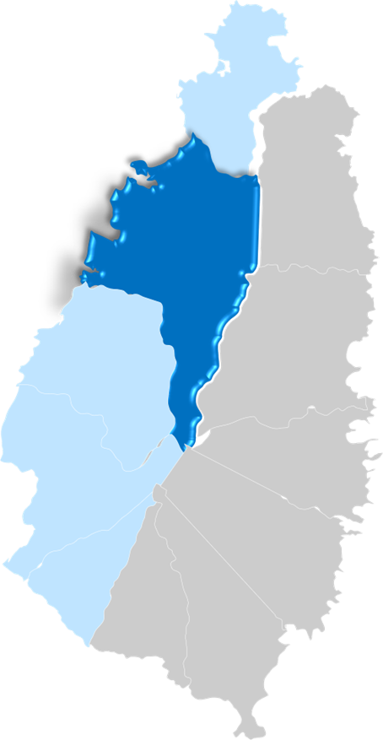
Implementation Plan
17 Accommodation Properties Inspected Thus Far
308 Tourism Accommodation Properties Pursuing Certification
Notes:
As part of Certification Unit’s efforts, approximately 308 correspondences were sent to the accommodation operators, providing information about the Certification programme and the requirements to be Certified.
To date, a total of 17 accommodations have been inspected. These inspections are essential to verify that accommodations meet the minimum requirements to operate.

Slide 20
ACCOMMODATION REQUIREMENTS FOR CERTIFICATION
Certificate of Registration of Business Name or Certification of Incorporation
Return of Allotments (where applicable)
Certificate of Good Standing (where applicable)
Proof of Registration with the Inland Revenue Department
Proof of Registration with the National Insurance Corporation
Trade Licence (where applicable)
Public Health Licence
Food Handler Certificate (where applicable)
Liquor Licence (where applicable)
Proof of Public Liability Insurance
Letter of Compliance from the Saint Lucia Tourism Authority (where applicable)
Development Control Authority Approval (at least in principle)
Land Register or Agreement for Lease
Notes:
In alignment with the TDA, these documents are essential for Certification. (go through list)
Effective April 15, 2024, all applicants seeking to advertise, offer or provide a tourism product or service to a visitor must be certified as an ‘Approved Tourism Operator’ by the Ministry.

Slide 21
UPDATE ON THE CERTIFICATION UNIT
Daily Certification Solicitation Target: 10 per day
Daily Follow-Up Target: 20 per day
Weekly Inspection Target: 20 per Week
Notes:
Specific targets are set to ensure the certification process remains on track and progresses efficiently
The unit will focus on reaching out to 10 operators each day, particularly those from COVID-19 certified accommodations who have already submitted some documents, as well as new accommodations not currently listed in the Ministry of Tourism database. The goal is to guide these operators through the remaining certification requirements and assist them in completing the certification process.
The unit will also aim to conduct 20 follow-ups per day with operators who have submitted the majority of their documents. These follow-ups are crucial for ensuring that these operators finalize their submissions and achieve certification.

Slide 22
ROOMSTOCK
Javan Lewis

Slide 23
Current Roomstook and Roomstock Under Construction
Tourism Sector Roomstock
Roomstock figures to be updated during the current certification rollout.
Hotel Properties Accommodation Roomstock Under Construction
3,343 Rooms
3,501
5,316
1815
Tourism Accommodation Projects currently under construction include; Secrets Resort, Courtyard Marriot, Cas en Bas Beach Resort, Hyatt Hotel, and Atlas Group.
Hotel Properties Accommodation
Vacation Rentals Accommodation
Total Accommodation

Slide 24
Current Roomstook By Product Classification
Alternative Accommodation
Formal Accommodation
Category | Properties | Roomstock
Villa | 186 | 780
Apartments | 154 | 551
Bed and Breakfast | 34 | 240
Condominium | 15 | 76
Cottages | 31 | 76
Other | 10 | 55
Home Sharing | 9 | 38
Total | 439 | 1816
Category | Properties | Roomstock
All Inclusive | 10 | 2165
Economy | 10 | 649
Luxury | 8 | 445
Boutique | 11 | 242
Total | 39 | 3501

Slide 25
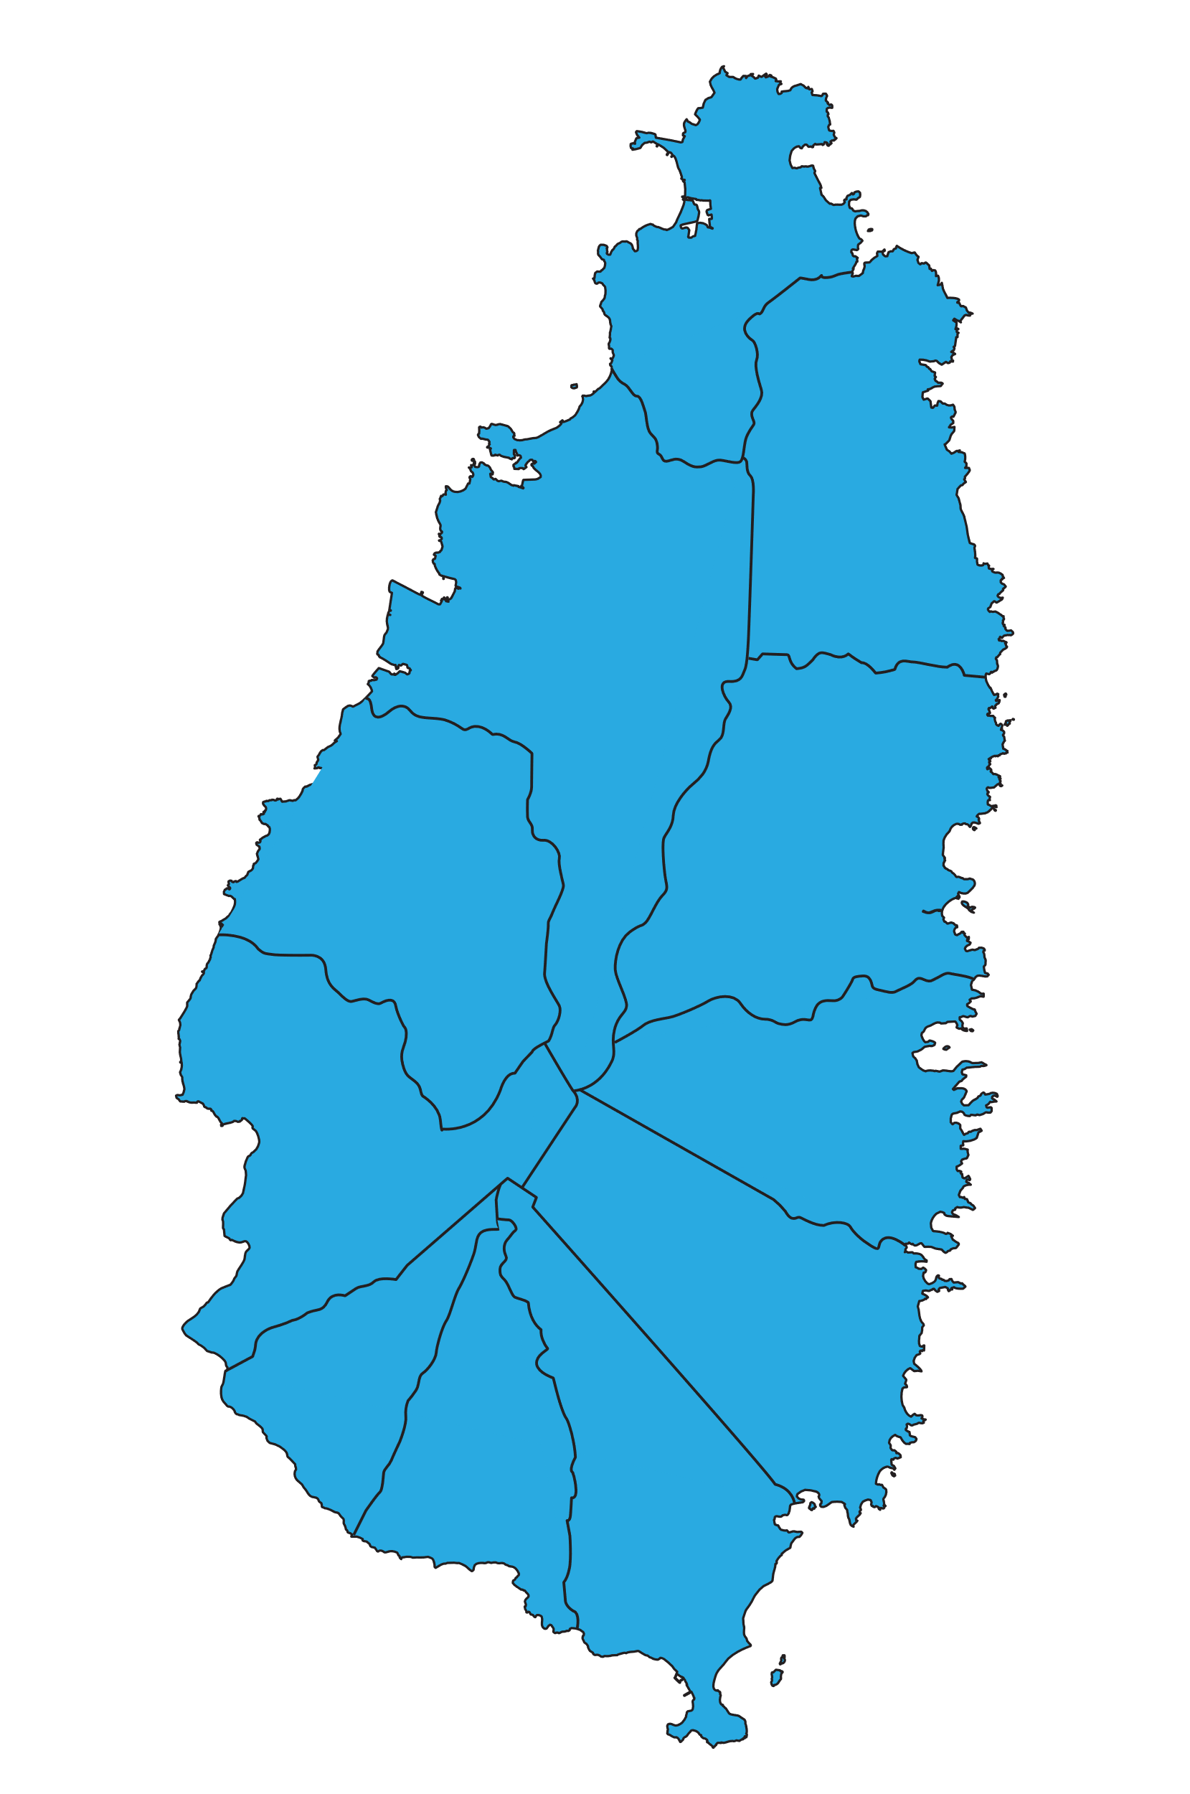
Roomstook By Geographical Location
GROS ISLET
Formal:2025
Alternative:793
Total:2,828
CASTRIES
Formal:877
Alternative:404
Total:1,281
DISTRICT | FORMAL SHARE | ALTERNATIVE SHARE | OVERALL SHARE
Gros Islet | 58% | 44% | 53%
Castries | 25% | 22% | 24%
Anse La Raye/Canaries | 1% | 3% | 10%
Soufriere | 8% | 16% | 7%
Choiseul | 0.002% | 3% | 2%
Laborie | 0% | 5% | 2%
Vieux Fort | 8% | 6% | 1%
Micoud | 0% | 2% | 1%
ANSE LA RAYE/CANARIES
Formal:33
Alternative:51
Total:84
SOUFRIERE
Formal:274
Alternative:284
Total:558
MICOUD
Formal:0
Alternative:45
Total:45
CHOISEUL
Formal:6
Alternative:46
Total:52
VIUEX FORT
Formal:286
Alternative:105
Total:391
LABORIE
Formal:0
Alternative:88
Total:88

Slide 26
TOURISM INCENTIVES
Nye Gabriel

Slide 27
PURPOSE OF INCENTIVES
The Ministry through its enabling legislation, offer a variety of fiscal incentives to touristic enterprises. The purpose of these incentives is to encourage and facilitate investment and employment in the industry so as to ensure the improvement and diversification of the Destination’s tourism product.

Slide 28
TYPES OF INCENTIVES
Tourism incentives fall under four (4) broad categories as per the Tourism Development Act. They are as follows:
Incentives for Tourism Investment;
Incentives for a Tourism Investment: Specialized Support Area;
Additional Incentives; and
Incentives for Resilience.

Slide 29
ELIGIBILITY AND NON-ELIGIBILITY REQUIREMENTS
Basic Criteria
A valid tourism operator certificate or,
A valid conditional tourism operator certificate
Specialized Support Area
Intends to undertake an investment in a specialized support area
In the case of Building Resilience
A person operates within the tourism industry or the tourism value chain and suffers loss as a result of a disaster
A person is ineligible for tourism incentives, if:
The person continues to benefit from incentives granted under another enactment
The person has obtained a benefit for a continuous period of forty (40) years under the Tourism Incentives Act, Cap 15.03 or the Tourism Stimulus and Investment Act, Cap 15.03
Has obtained a work permit for a continuous period of two (2) years and six (6) months

Slide 30
DOCUMENTS REQUIRED
Completed Tourism Development Act Incentives Application Form
Land Register
Lease Agreement –
For at least three (3) years if the value of the tourism investment is up to EC$750k; and
For at least ten (10) years if the value of the tourism investment is above EC$750k.
Proof of financing for the project
In the case of a tourism investment with a value of more than a EC$1M, financial projections for the project
Development Control Authority (DCA) approval (at least in principle)
Bill of Quantities/ List of Materials and Equipment
Business plan with information relating to the investment time frame
Letter of Compliance from the Inland Revenue Department
Letter of Compliance from the National Insurance Corporation
Certificate of Character (first time applicants); in the case of a company, a Certificate of Character must be provided for each direct of the company
Letter of Compliance form the Saint Lucia Tourism Authority (where applicable)

Slide 31
REFERRAL OF INCENTIVES APPLICATIONS
Application for Incentives
Cabinet of Ministers
Tourism Investment Committee
< EC$1 Million
> EC$1 Million

Slide 32
COMPOSITION OF THE COMMITTEE
The Tourism Investment Committee shall comprise no less than three or no more than five persons.
The members are as follows:
The Permanent Secretary, and in his or her absence, the Deputy Permanent Secretary of the Ministry, who is the Chairperson;
a representative of the Department of Finance;
the Chief Tourism Officer;
a representative of the Inland Revenue Department;
a representative of Invest Saint Lucia; and
an attorney-at-law, who is an ex officio officer with no voting rights.
Notes:
The Ministry is pleased to inform you that the representatives that will make up the Committee have all been identified and it is anticipated that the committee will be formally actioned soon.

Slide 34
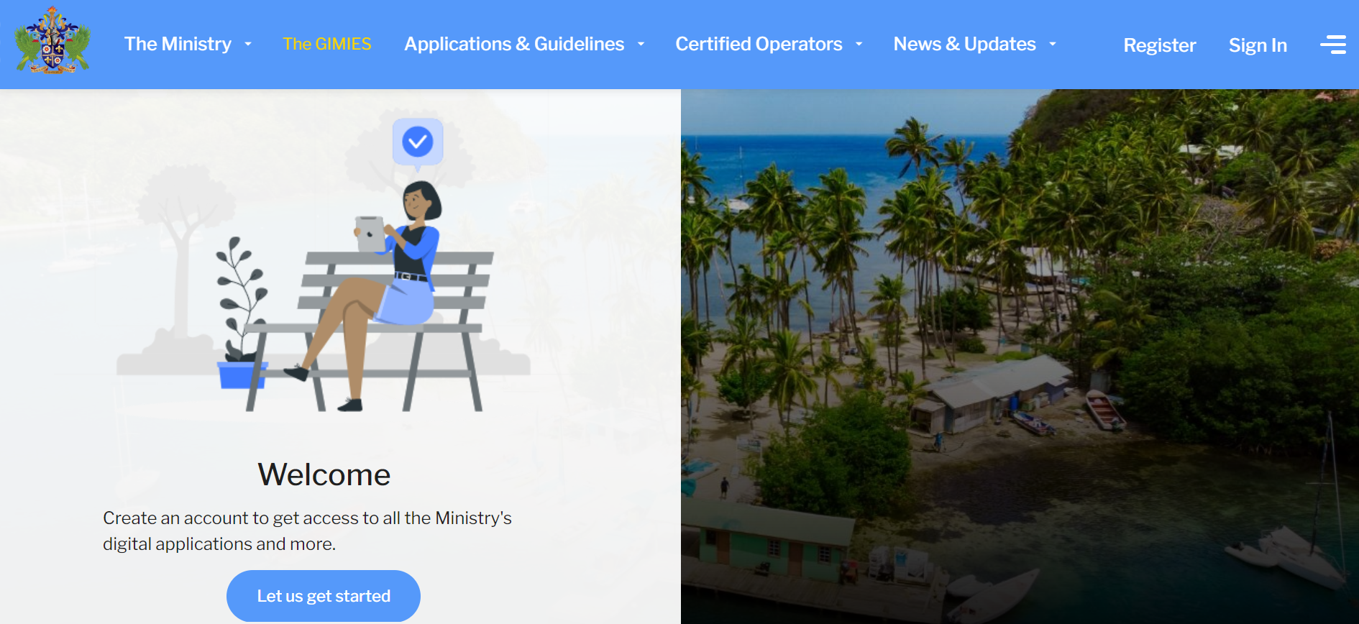
Incentives and Certification Applications Can Be Uploaded on the Ministry’s Website

Slide 35
REDRESS UNDER THE ACT
Request for review of a refused application for incentives
85.—(1) Where an application for incentives is refused under section 84, the person making the application for incentives may make a request in writing to the Minister for a review of the application.
(2) Where a request is made to the Minister under subsection (1),
the Minister shall refer the application for incentives to the Review
Committee.

Slide 36
REVIEW COMMITTEE
Appointment of the Review Committee
The Review Committee is appointed by the Minister to review applications for a tourism certificate or incentives refused by the Committee or Cabinet.
Composition of the Review Committee
The committee will comprise of five (5) persons appointed by the Minister, including an attorney-at-law, of at least fifteen (15) years’ experience
Functions of Review Committee
Review applications for tourism incentives/certification that have been refused
Make a recommendation to the minister after the review is conducted

Slide 37
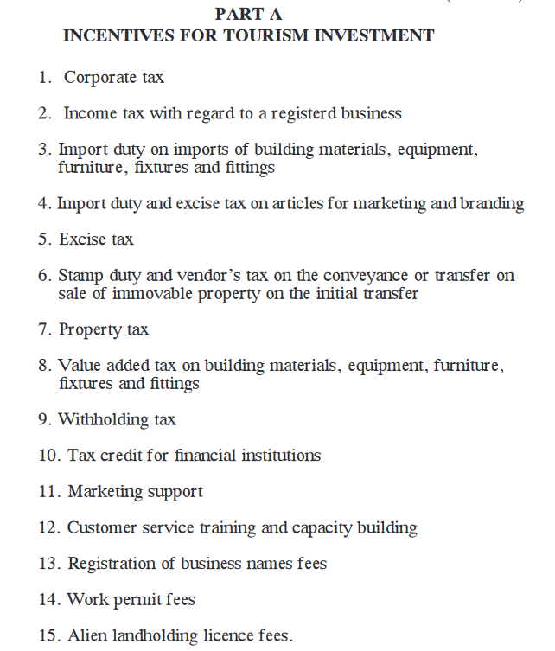
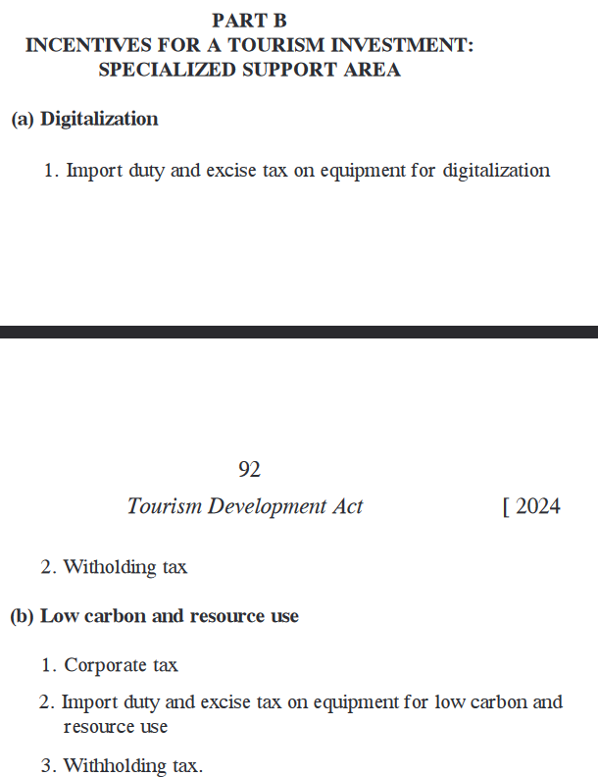
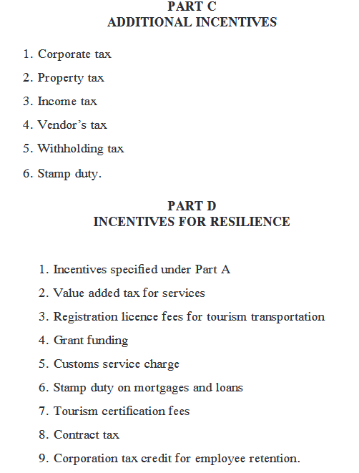
TYPES OF INCENTIVES

Slide 38
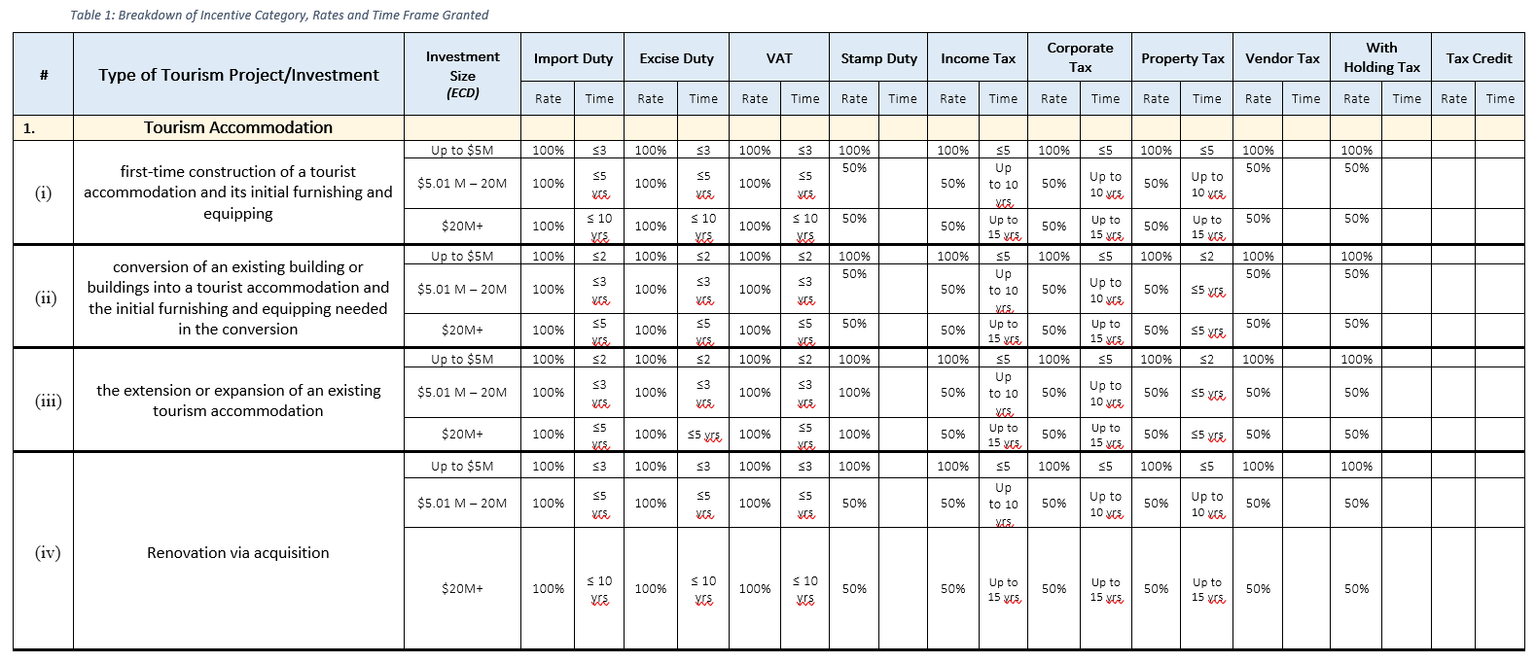
TOURISM INCENTIVES TABLE

Slide 39
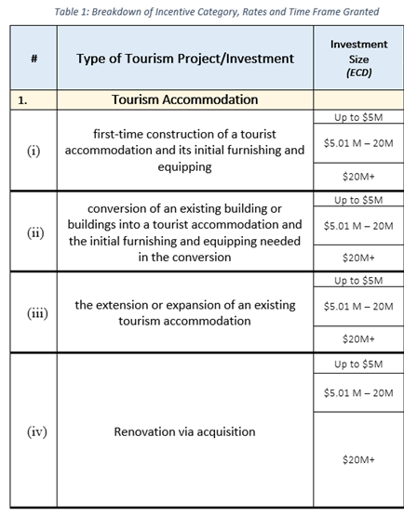
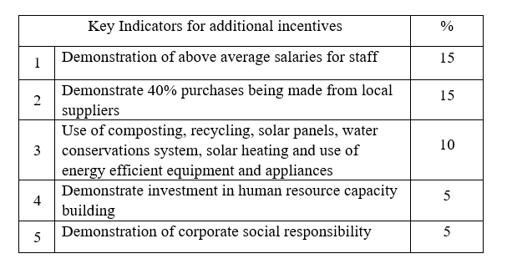
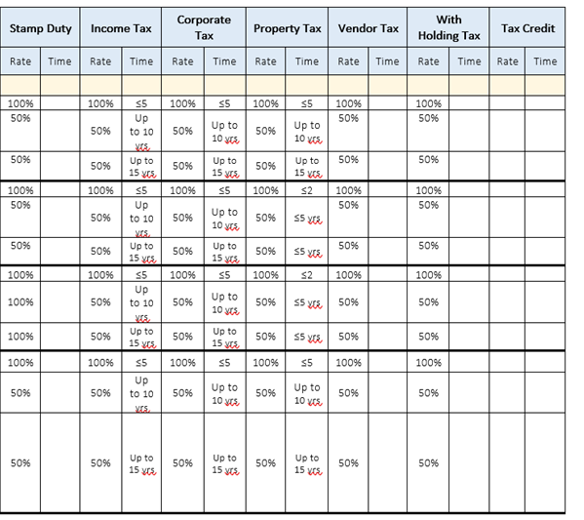
ADDITIONAL INCENTIVES

Slide 40
GOVERNMENT’S INVESTMENT IN TOURISM DEVELOPMENT
Darnica Jn.Charles

Slide 41
Tourism Developments
THE GOAL OF TOURISM DEVELOPMENTS
Enhance Saint Lucia’s Tourism Product Offering;
Strategically increase Cruise tourist spend within the local economy;
Improvement of Recreational Beach Facilities;
Improvement of Visitor Stop Centers;
Support Community Tourism;
Reduce Congestion on Beaches
Increase local community participation and involvement in tourism; and
Stimulate tourism-related economic activity.

Slide 42
TOURISM POLICY DEVELOPMENTS
National Tourism Policy
Tourism Transportation Demand Study

Slide 43
VALUE OF INVESTMENTS
Total Government Investments
Approximately XCD $64,000,000.00
Eastern Caribbean Sixty-Four Million Dollars

Slide 44
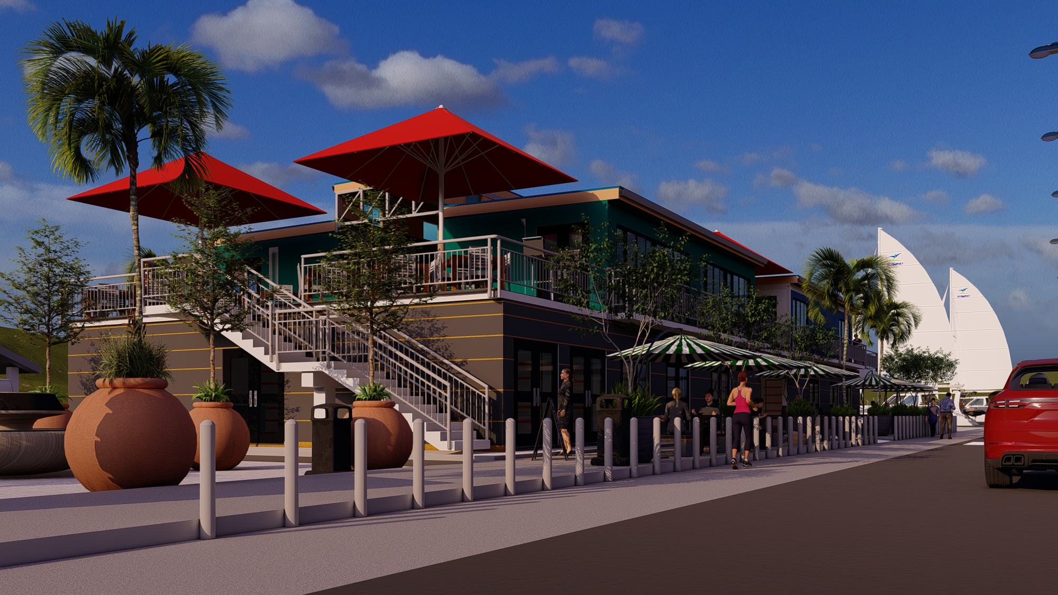
CASTRIES MARKET BOX PARK
Scope of Works:
Twenty-Two (22) Units
Two (2) Accessible toilets and a janitors’ closet
Electrical and mechanical closets
Implementation Phase:
Completed
Additional Works: Grounds & Elevator
Request for Proposals
Beneficiaries:
SLMB – Building Asset & Commercial Space
Private Retailers

Slide 45
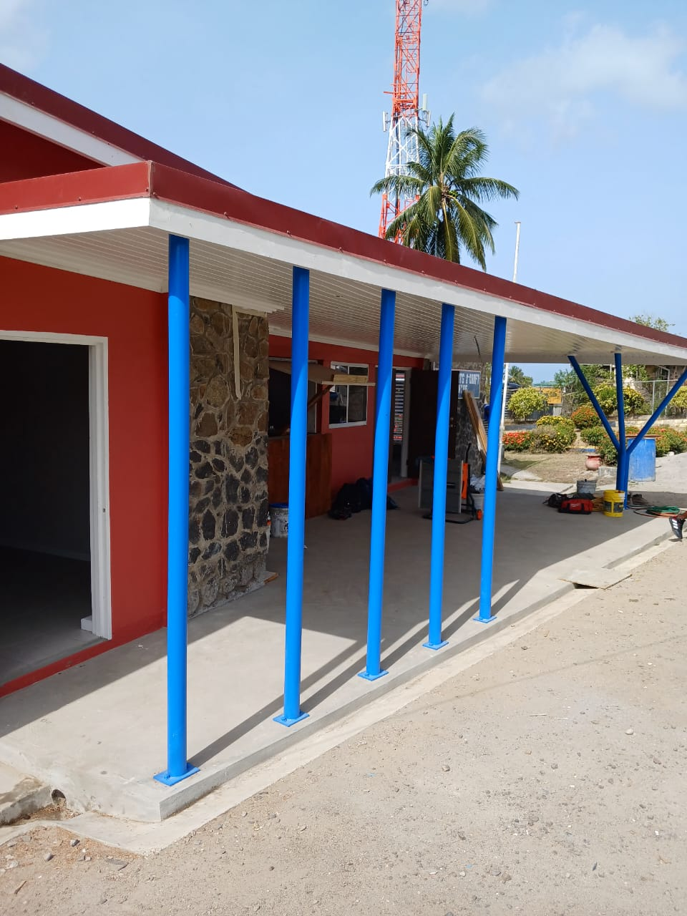
CHOISEUL ARTS AND CRAFT CENTRE
Scope of Works:
Renovation and remodeling of the interior space for display in the existing main building
Upgrading of Four (4) Training Facilities
Renovation of Restaurant
Upgrade of the Parking Area, Fencing and Main Entrance
Implementation Phase:
Completed
Conceptualization and Curation of Space - Ongoing
Beneficiaries:
CTA – Building Asset & Commercial Space
Crafters – Retail Showroom & Digital Museum
Taxi & Tour Operators
National Skills Development Center

Slide 46
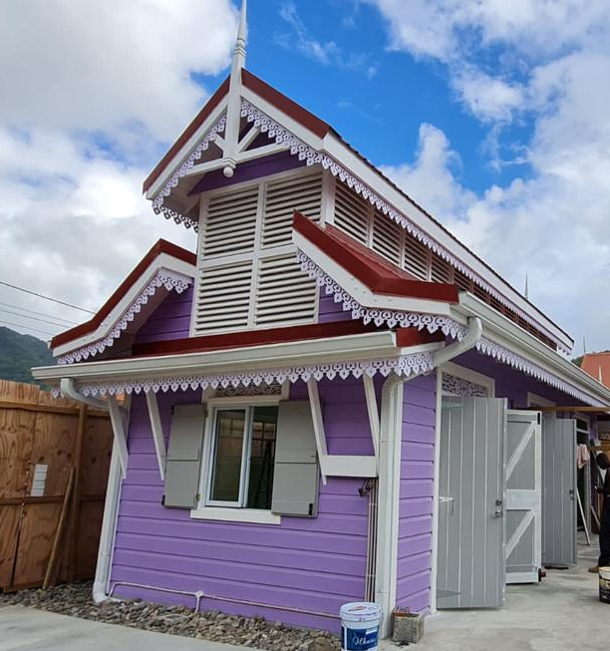
SOUFRIERE CONCESSIONAIRES BOOTH
OLD TRAFFORD
Scope of Works:
Three (3) Vending Spaces
Implementation Phase:
Completed
Beneficiaries:
Private Retailers/Vendors
Soufriere/ Fond St Jacques Constituency Council

Slide 47
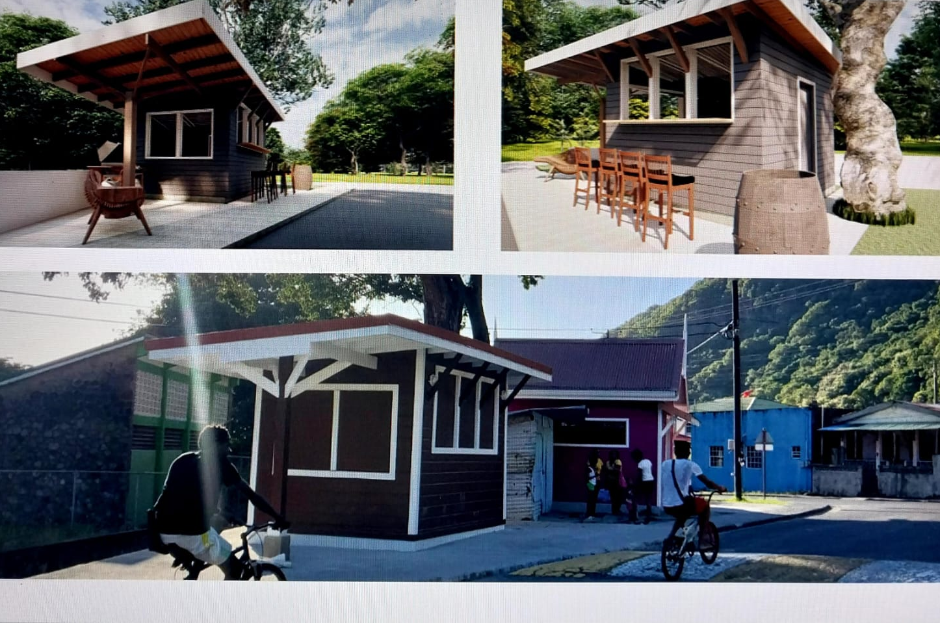
SOUFRIERE VENDING BOOTH
PALMISTE
Scope of Works:
Five (5) Vending Huts
One (1) Bar
Implementation Phase:
Ongoing
Beneficiaries:
Private Retailers/Vendors
Soufriere/ Fond St Jacques Constituency Council

Slide 48
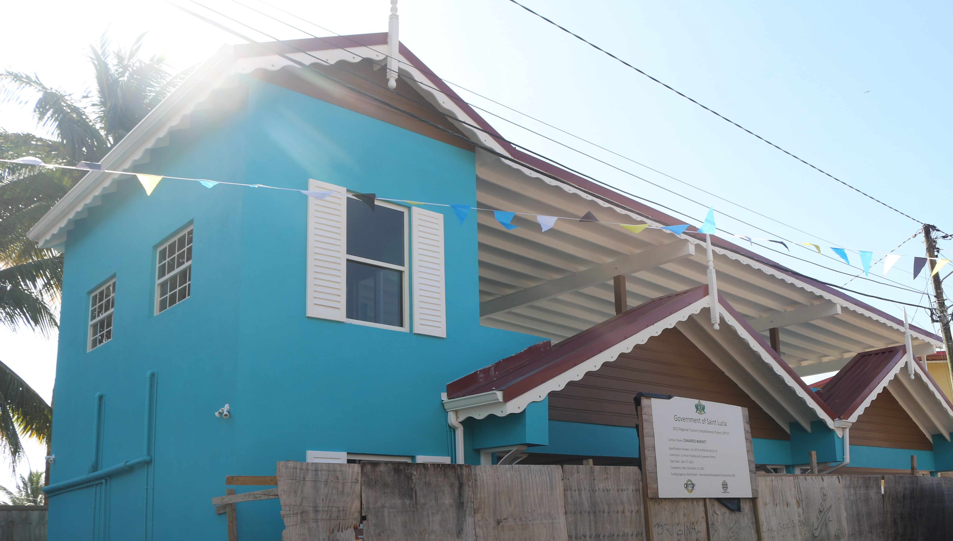
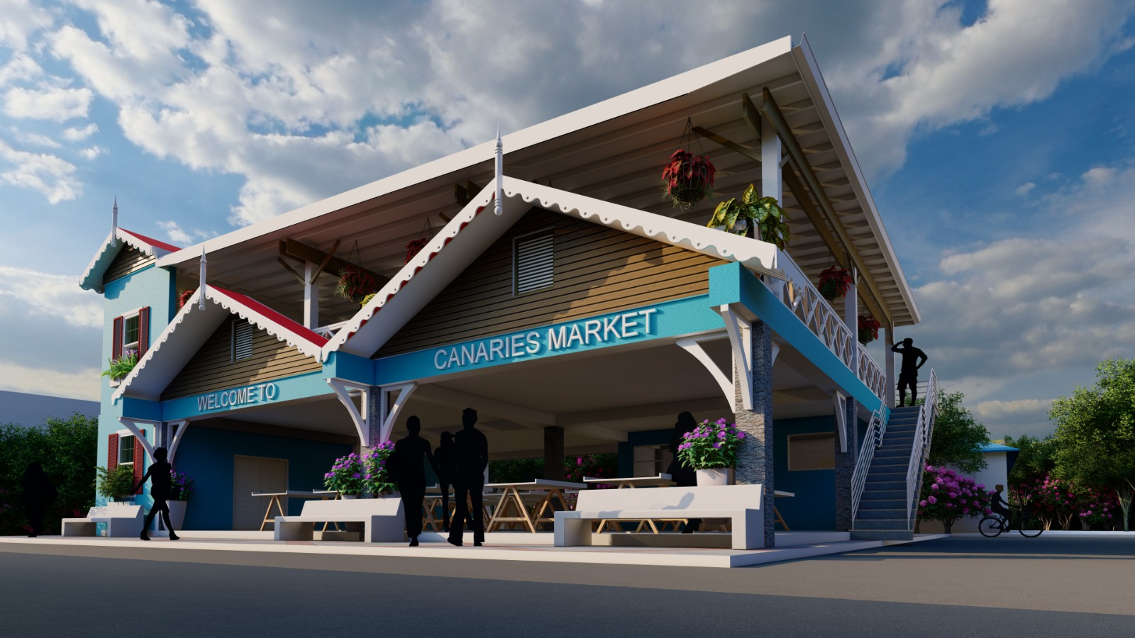
CANARIES MARKET COMPLEX
Scope of Works:
A provisions Market to accommodate Twelve (12) Vendors
Ice Vending Facilities
Terrace Restaurant
Implementation Phase:
Complete
Requires Rolling Shutter for Official Opening
Beneficiaries:
CTA – Building Asset & Commercial Space
Private Retailers
Vendors

Slide 49
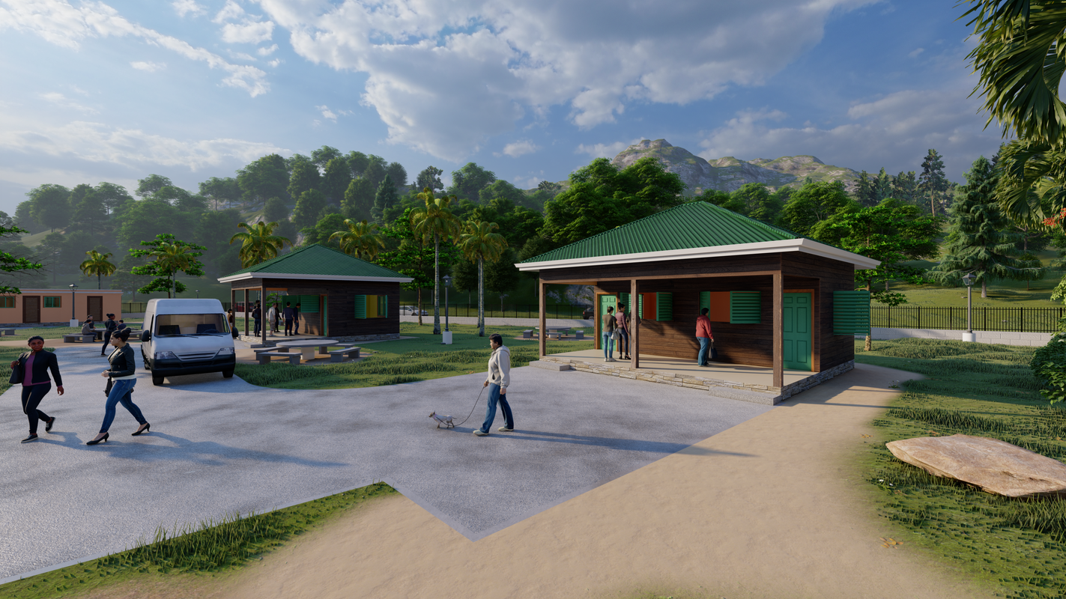
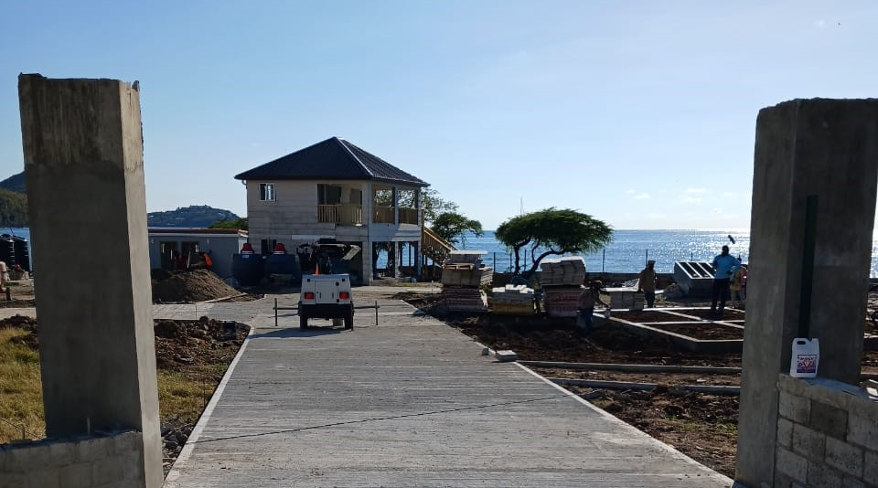
GROS ISLET RECREATIONAL PARK
Scope of Works:
Three (3) Vending Booth
Kid’s playground
Comfort stations
Entertainment Area
Administrative Building
Implementation Phase:
Complete
Retainer Wall and Repair of Damage from Hurricane Beryl
Beneficiaries:
Private Retailers/Vendors – 3 Available Units
Vendors – Hospitality & Service Training
Event Planners – Event Space
Taxi Drivers

Slide 50
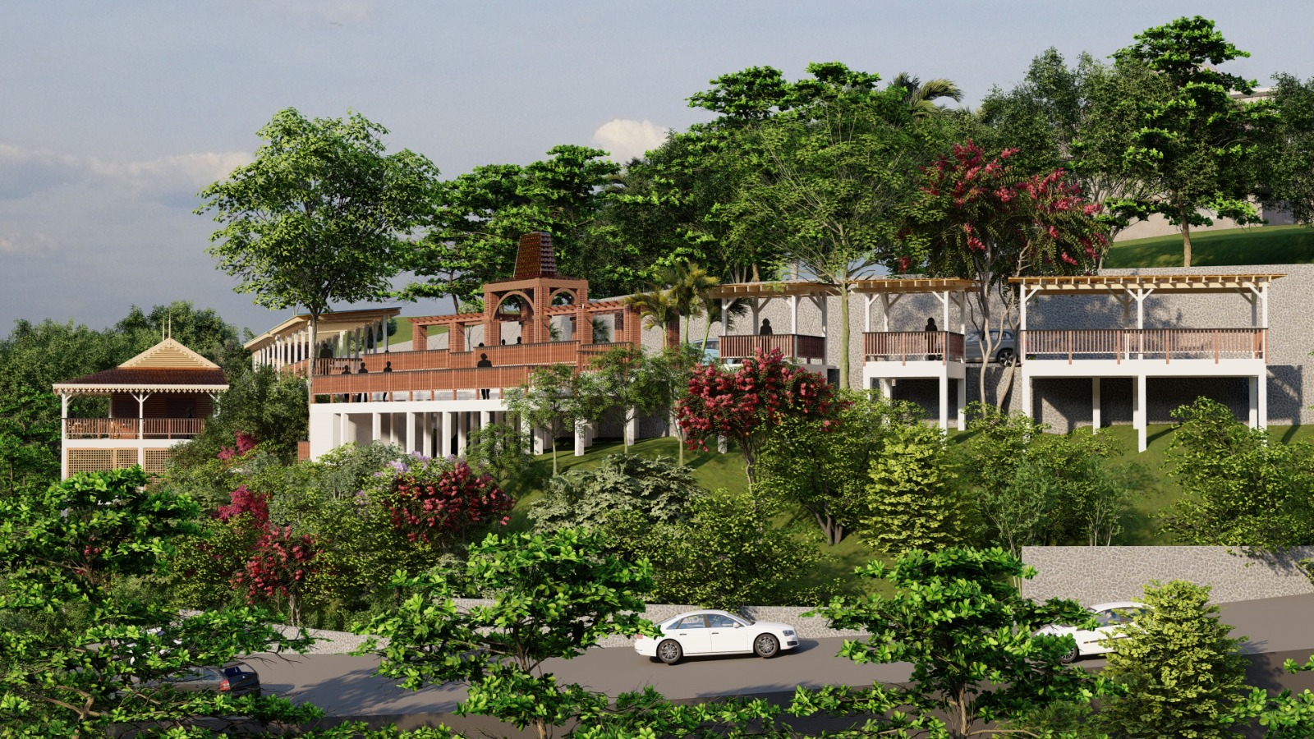
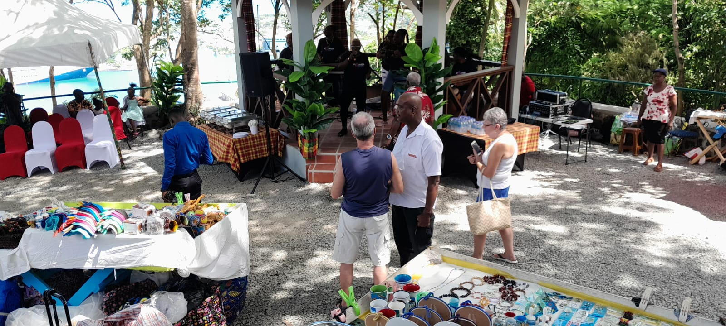
REDEVELOPMENT OF THE MORNE LAY BY
Scope of Works:
Reconstruction of the Viewing Deck
Vending Huts
Toilet Facilities
Basement Storage Area
Implementation Phase:
Construction
Beneficiaries:
CTA – Building Asset & Commercial Space
Vendors – Facility & Training
Taxi Drivers
Notes:
Phase 1 – Clearing, Debushing, Construction of Steps, Installation of Security Railings

Slide 51
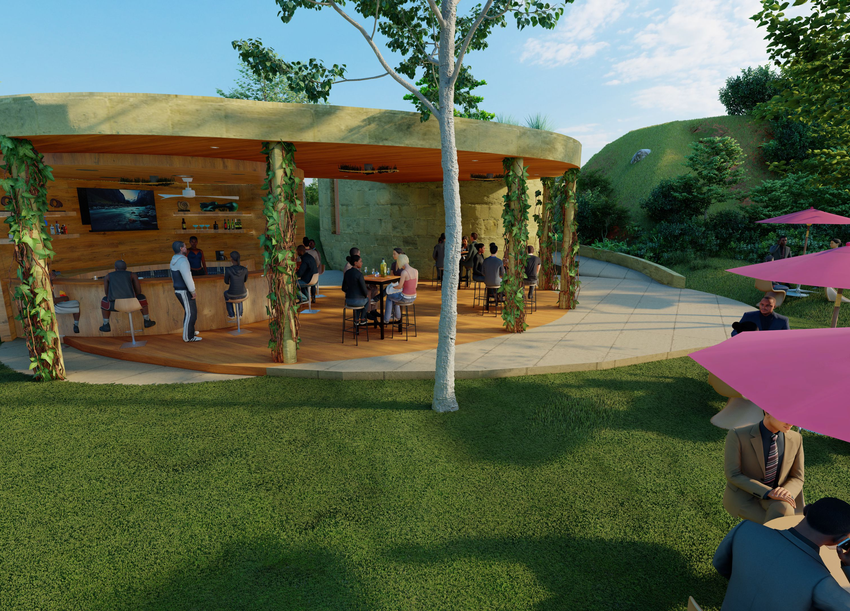
ANSE FERRE PARK AND LOOKOUT
Scope of Works:
Landscaping
Vending Areas
Car Park Hard Standing
Security/ Information Booth
Railings/ Safety Barriers
Toilet Facilities
Implementation Phase:
DCA Approvals
Beneficiaries:
Vendors – Facility & Training
Divers – Certification
Taxi Drivers

Slide 52
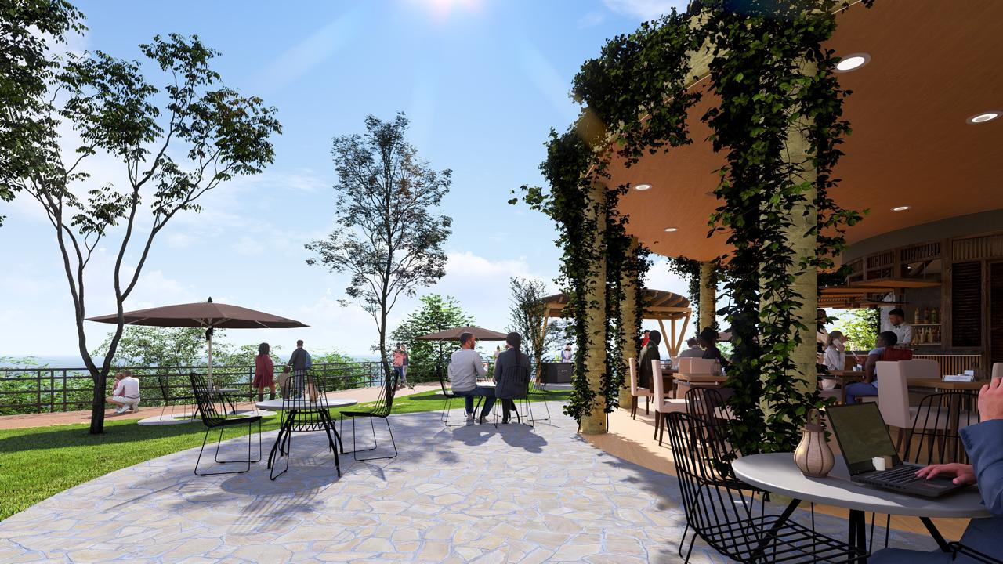
ANSE FERRE PARK AND LOOKOUT

Slide 53
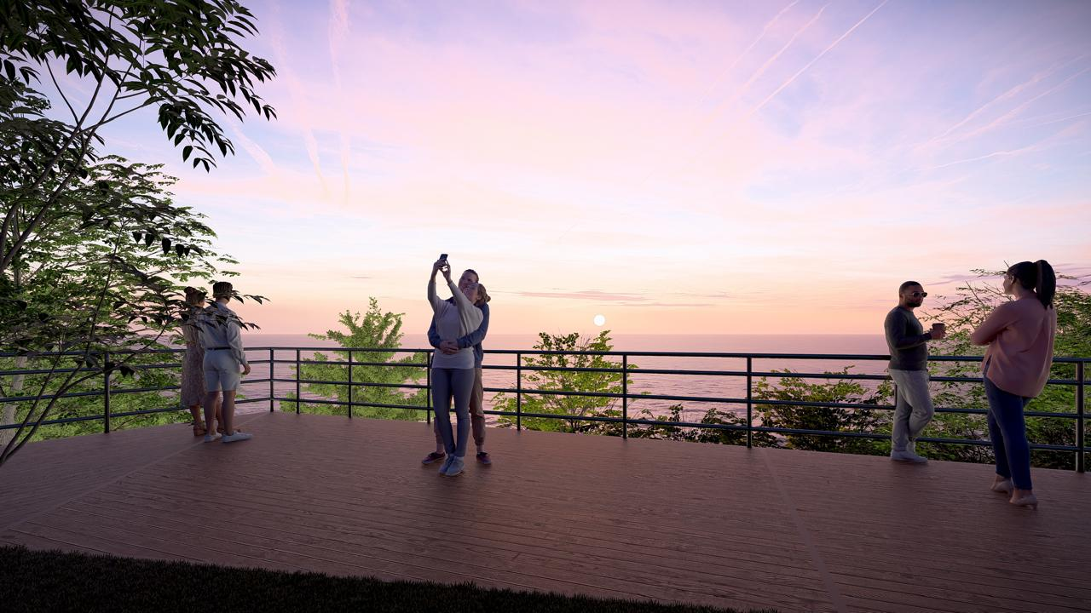
ANSE FERRE PARK AND LOOKOUT

Slide 54
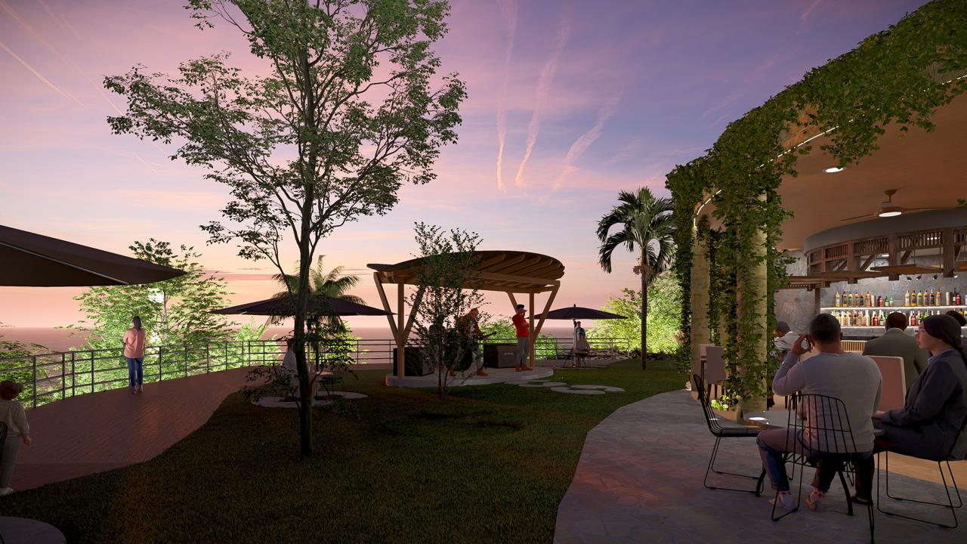
ANSE FERRE PARK AND LOOKOUT

Slide 55
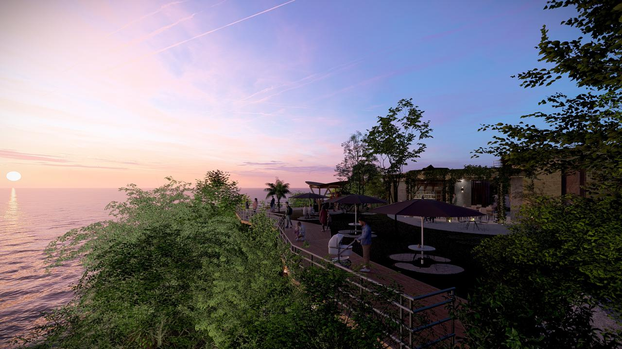
ANSE FERRE PARK AND LOOKOUT

Slide 56
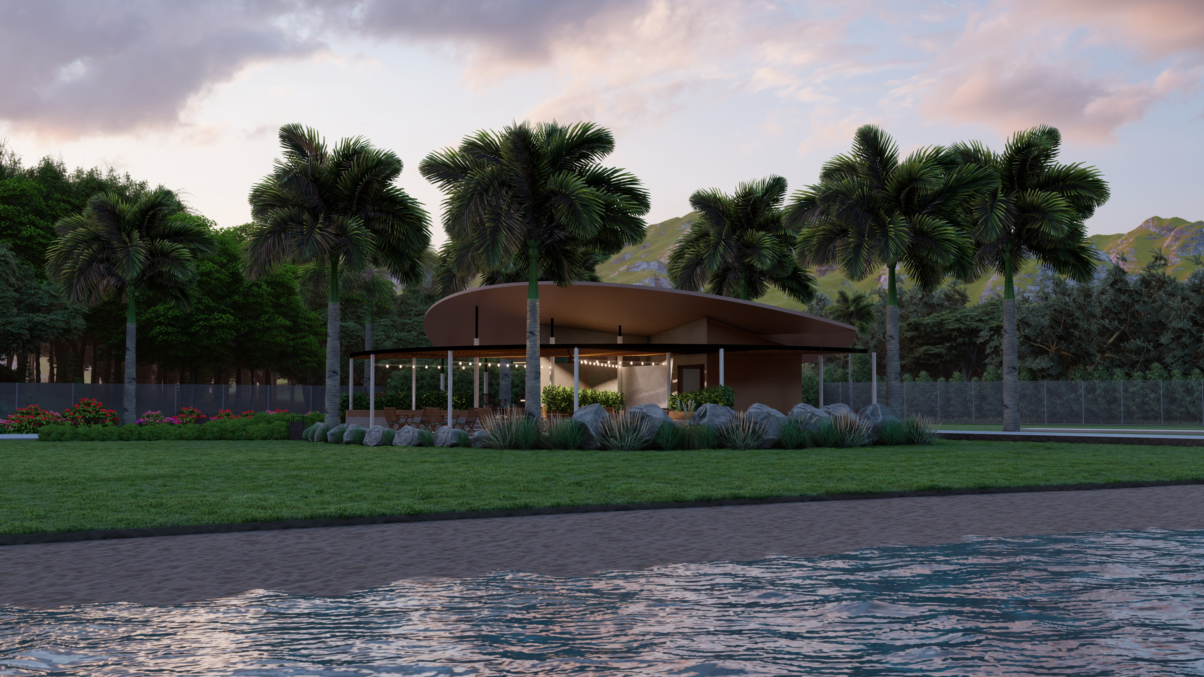
CUL DE SAC BUCKEYE BEACH PARK
Scope of Works:
Landscaping + General Cleanup
Toilet Block + Showers
Security/ Information Booth
Vending Stalls (open)
Beach Bar & Pizza Hut
Umbrella Storage Shack
Implementation Phase:
DCA Approvals
Beneficiaries:
Vendors
Taxi & Tour Operators

Slide 57
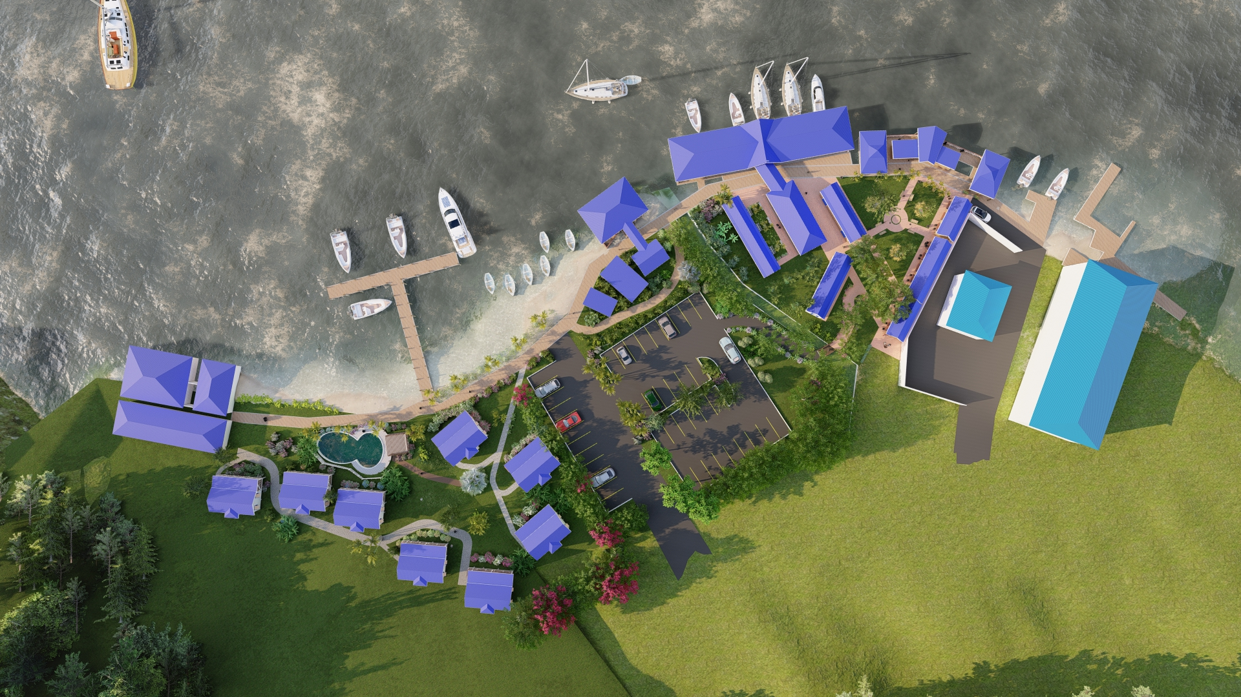
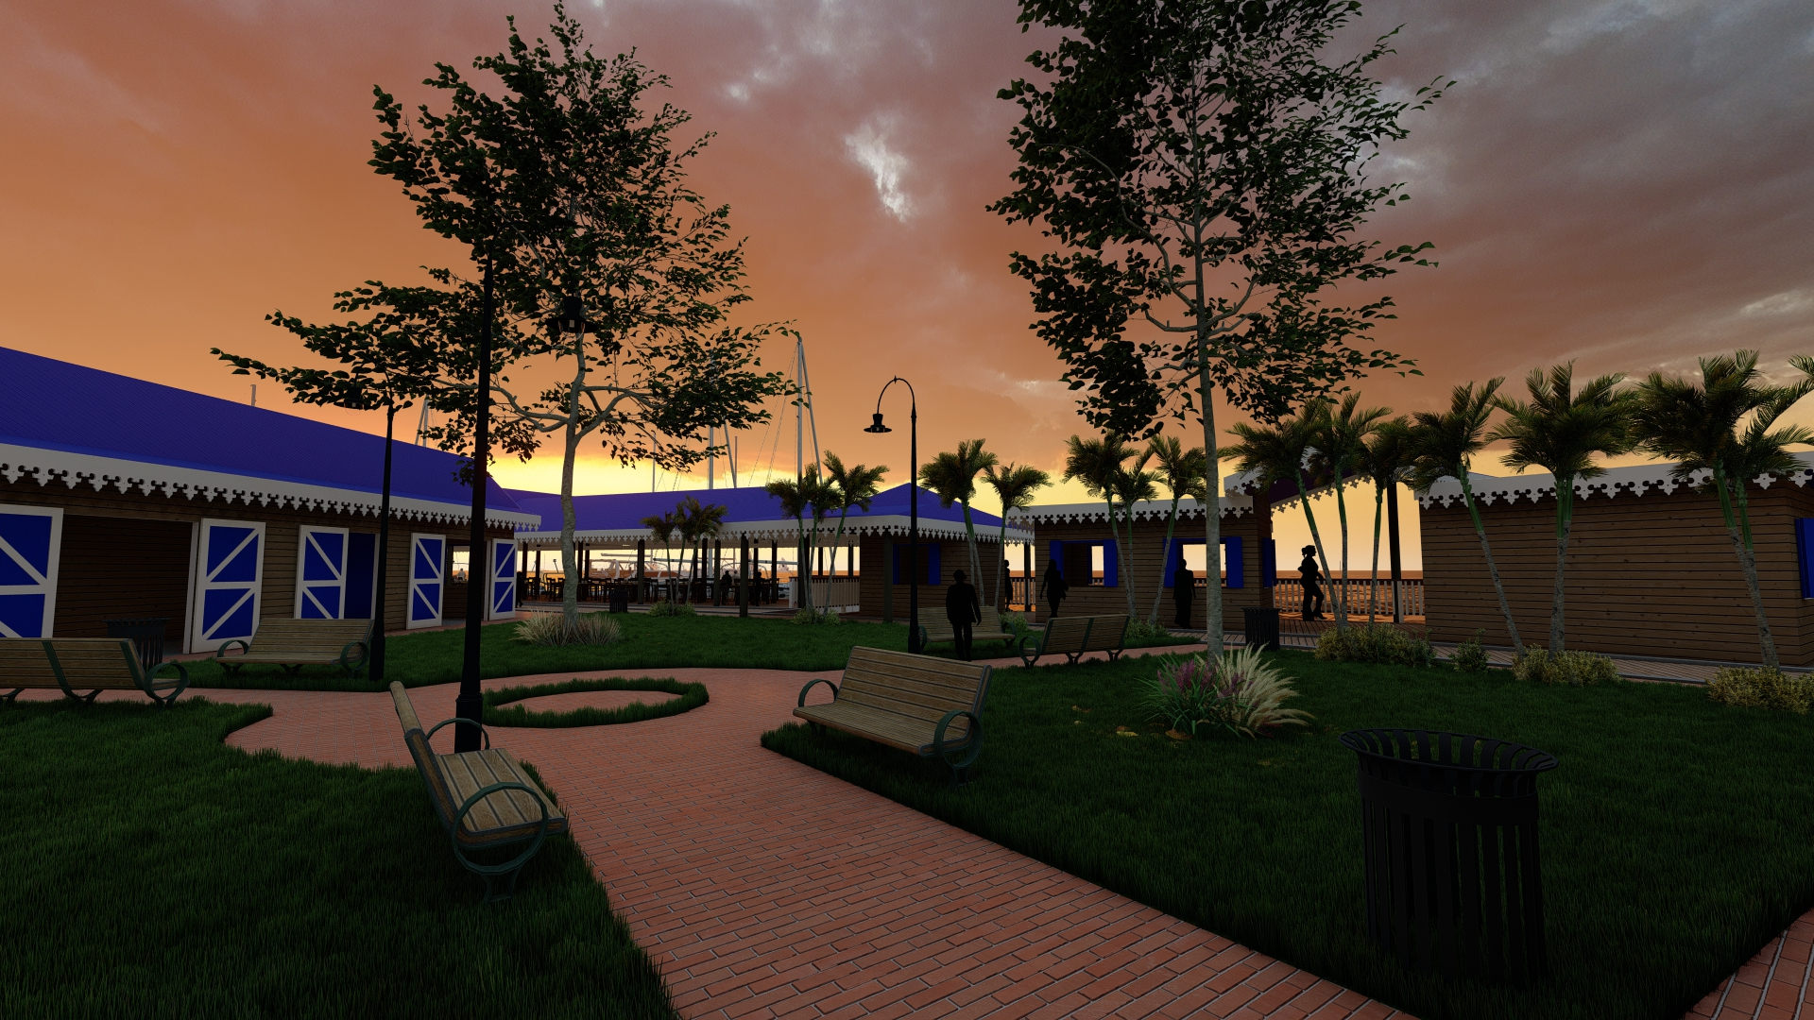
MARIGOT BAY WATERFRONT DEVELOPMENT
Scope of Works:
Open Gazebo/Recreational Area
Toilet/Shower Facilities
Jetty/Berting Point for Small Vessels
Boardwalk
Implementation Phase:
DCA Application
Beneficiaries:
Vendors
Ferry Operators/Fishermen
Taxi Drivers

Slide 58
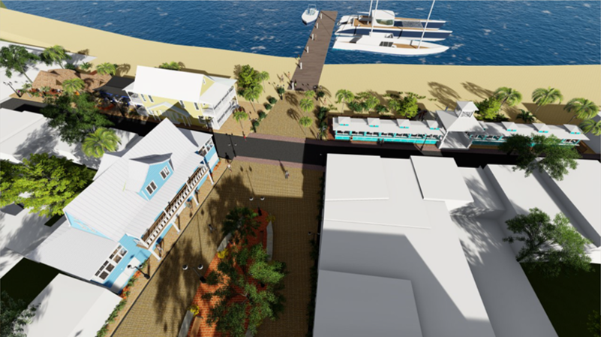
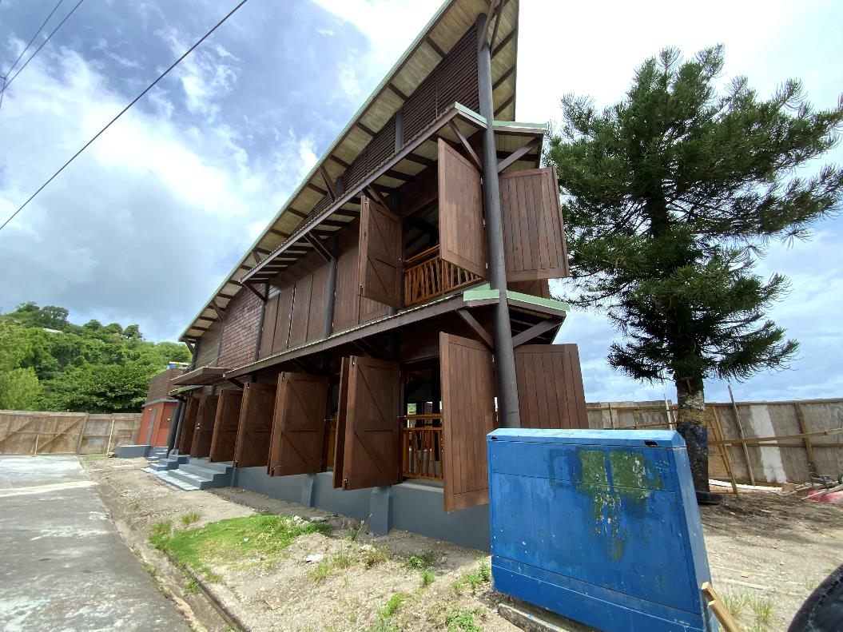
ANSE LA RAYE WATERFRONT UPGRADE
Scope of Works:
Renovated Fish Fry Building
Waterfront Restaurant
Upgrade of Jetty
Installation of Fifteen (15) Moorings
Bed & Breakfast (10 rooms)
Sewage Treatment Plant
Relocation of the Public Laundry
Ice Facilities
Enhancement of Village Square
Fishermen’s Mending Area
Additional Beach Bar & Showers
Beneficiaries:
CTA – Building Asset & Commercial Space
Vendors
Fishermen

Slide 59
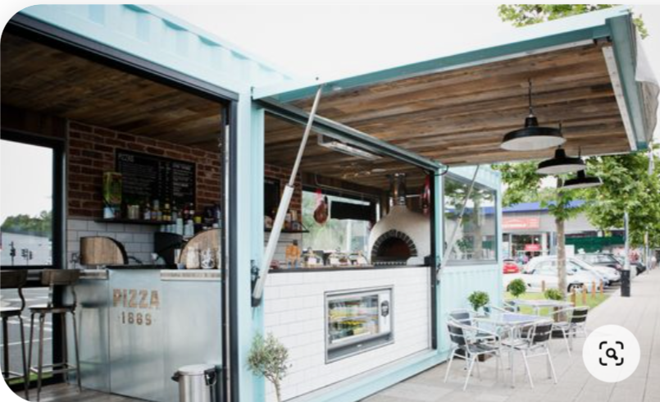
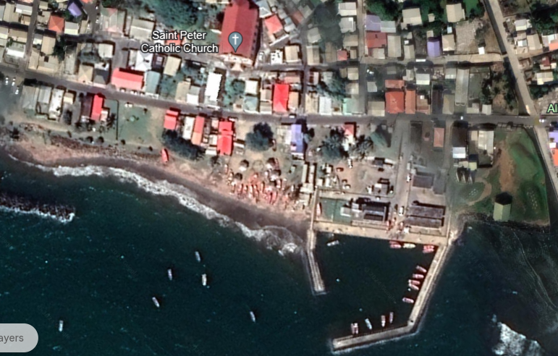
DENNERY FISH FRY REVAMP
Scope of Works:
Toilet Block
Sewage System
Movable Vending Units
Beautification
Implementation Phase:
Concept/Design
Beneficiaries:
CTA – Building Asset & Commercial Space
Vendors

Slide 60
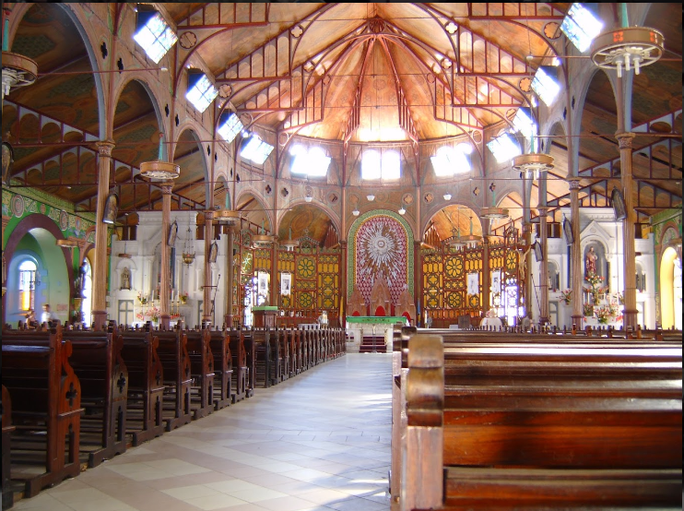
MARTYRS SHRINE
Scope of Works:
Construction of Shrine, Retail Outlets and Coffee Shop
Formulation of Tour
Implementation Phase:
Concept/Design
Beneficiaries:
CTA – Building Asset and Commercial Space
Vendors

Slide 61
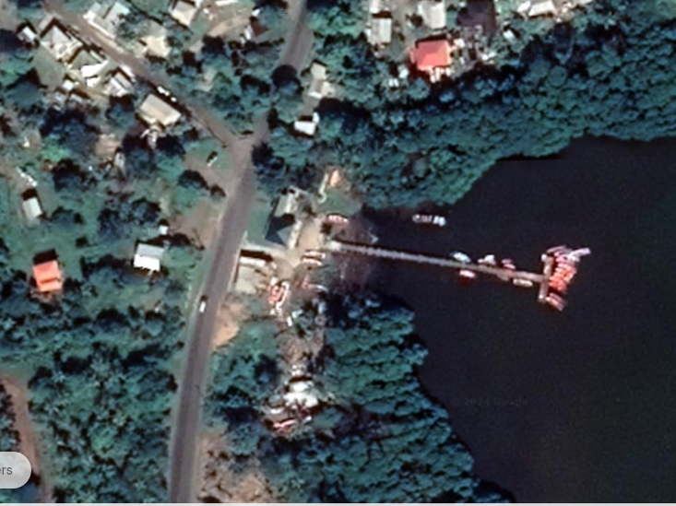
SEAMOSS EXPERIENCE – PRASLIN BAY
Scope of Works:
Mangrove Boardwalk
Construction of Vending Booths and Manufacturing Facility for Seamoss Products
Formulation of Seamoss Farm Tour
Toilet Facilities
Implementation Phase:
Concept/Design
Beneficiaries:
CTA – Building Asset & Commercial Space
Vendors

Slide 62
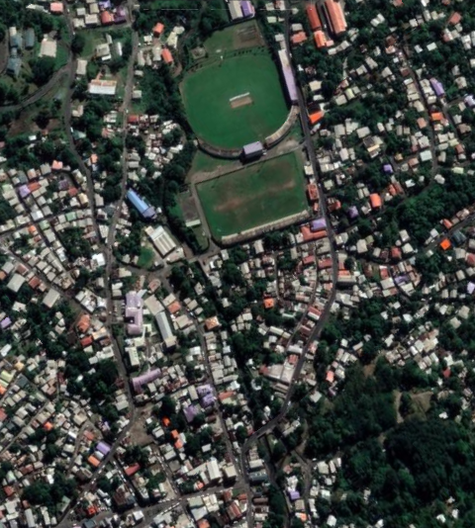
MARCHAND ARTISAN VILLAGE
Scope of Works:
Construction of Live Craft /Skills Display Area
Two (2) Restaurants
Toilet Facilities
Implementation Phase:
Concept/Design
Beneficiaries:
CTA – Building Asset & Commercial Space
Vendors

Slide 63
REDUIT BEACH VENDING AREA (THE RAMP)
Scope of Works:
Vending Stalls
Toilet Facilities
Implementation Phase:
DCA Approval
Beneficiaries:
NCA
Vendors

Slide 64
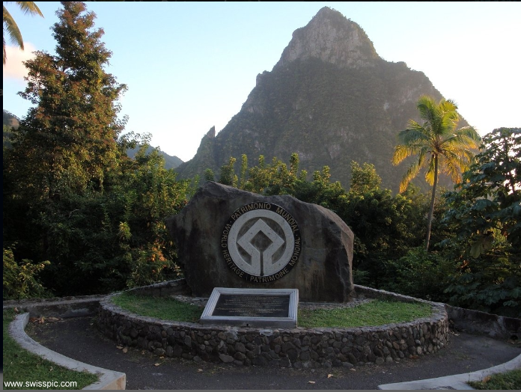
VISITOR VIEW POINTS
Scope of Works:
Vending Booths
Toilet Facilities
Locations:
Anse La Raye
Palmiste Road
Soufriere World Heritage Point
Implementation Phase:
Concepts & Designs
Beneficiaries:
CTA – Building Asset
Vendors

Slide 65
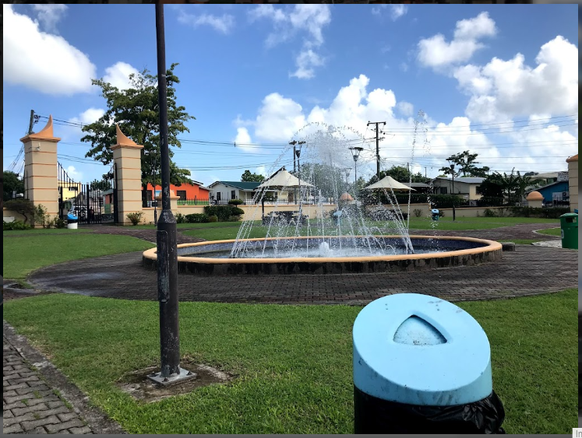
AMPITHEATRES
Scope of Works:
Open-Air Structure
Locations:
Belle Vue Community
Serenity Park
Pierrot Community
Implementation Phase:
Concepts & Designs
Beneficiaries:
CTA – Building Asset
Vendors
Artists

Slide 66
UNDERWATER SCULPTURE PARK
Scope of Works:
Underwater Structures
Implementation Phase:
Storyboard Competition and Feasibility Study
Beneficiaries:
Tour Operators
Divers

Slide 67
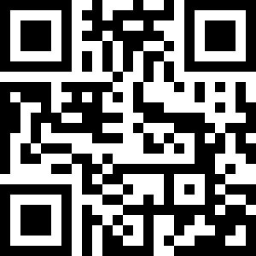
TOURISM DEVELOPMENT ACT, NO.1 OF 2024

Slide 68
THANK YOU !
QUESTION AND ANSWERS

