Slide 2
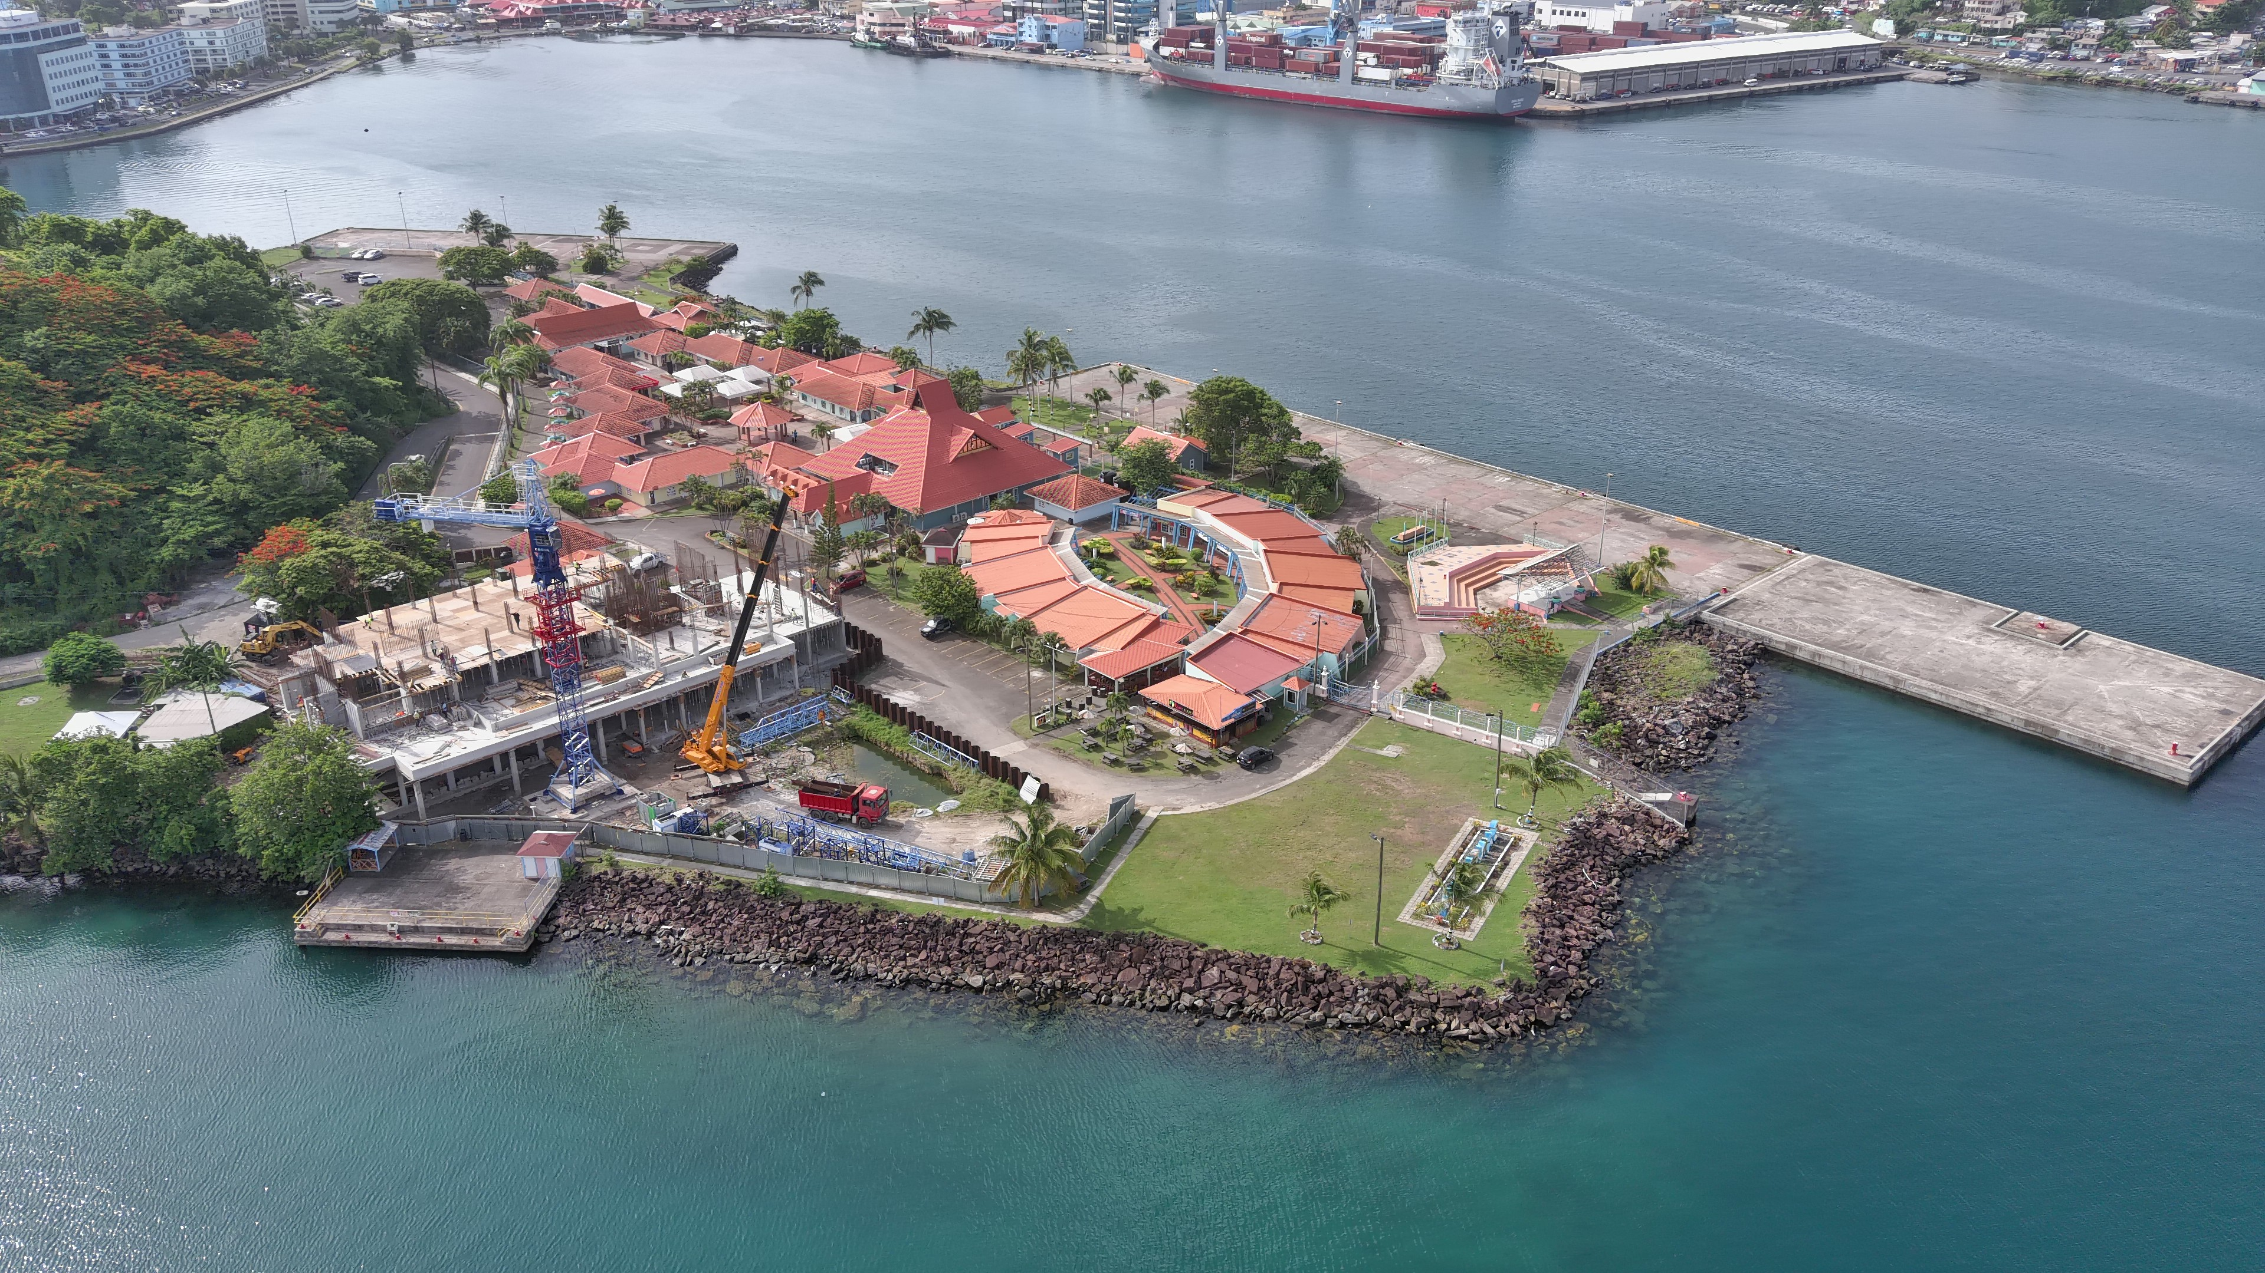
Carib Invest
A Courtyard Marriott is being constructed as a 1-storey tower and the facilities would include 140 rooms and suites, a conference center and meeting rooms, a swimming pool, a fitness center, food and beverage outlets, rooftop terraces and common facilities.
Construction is currently on the final floor and it is on track to open by Q4 2025.
Traffic management plan is underway with the construction of ring road, making the road one-way.

Slide 3
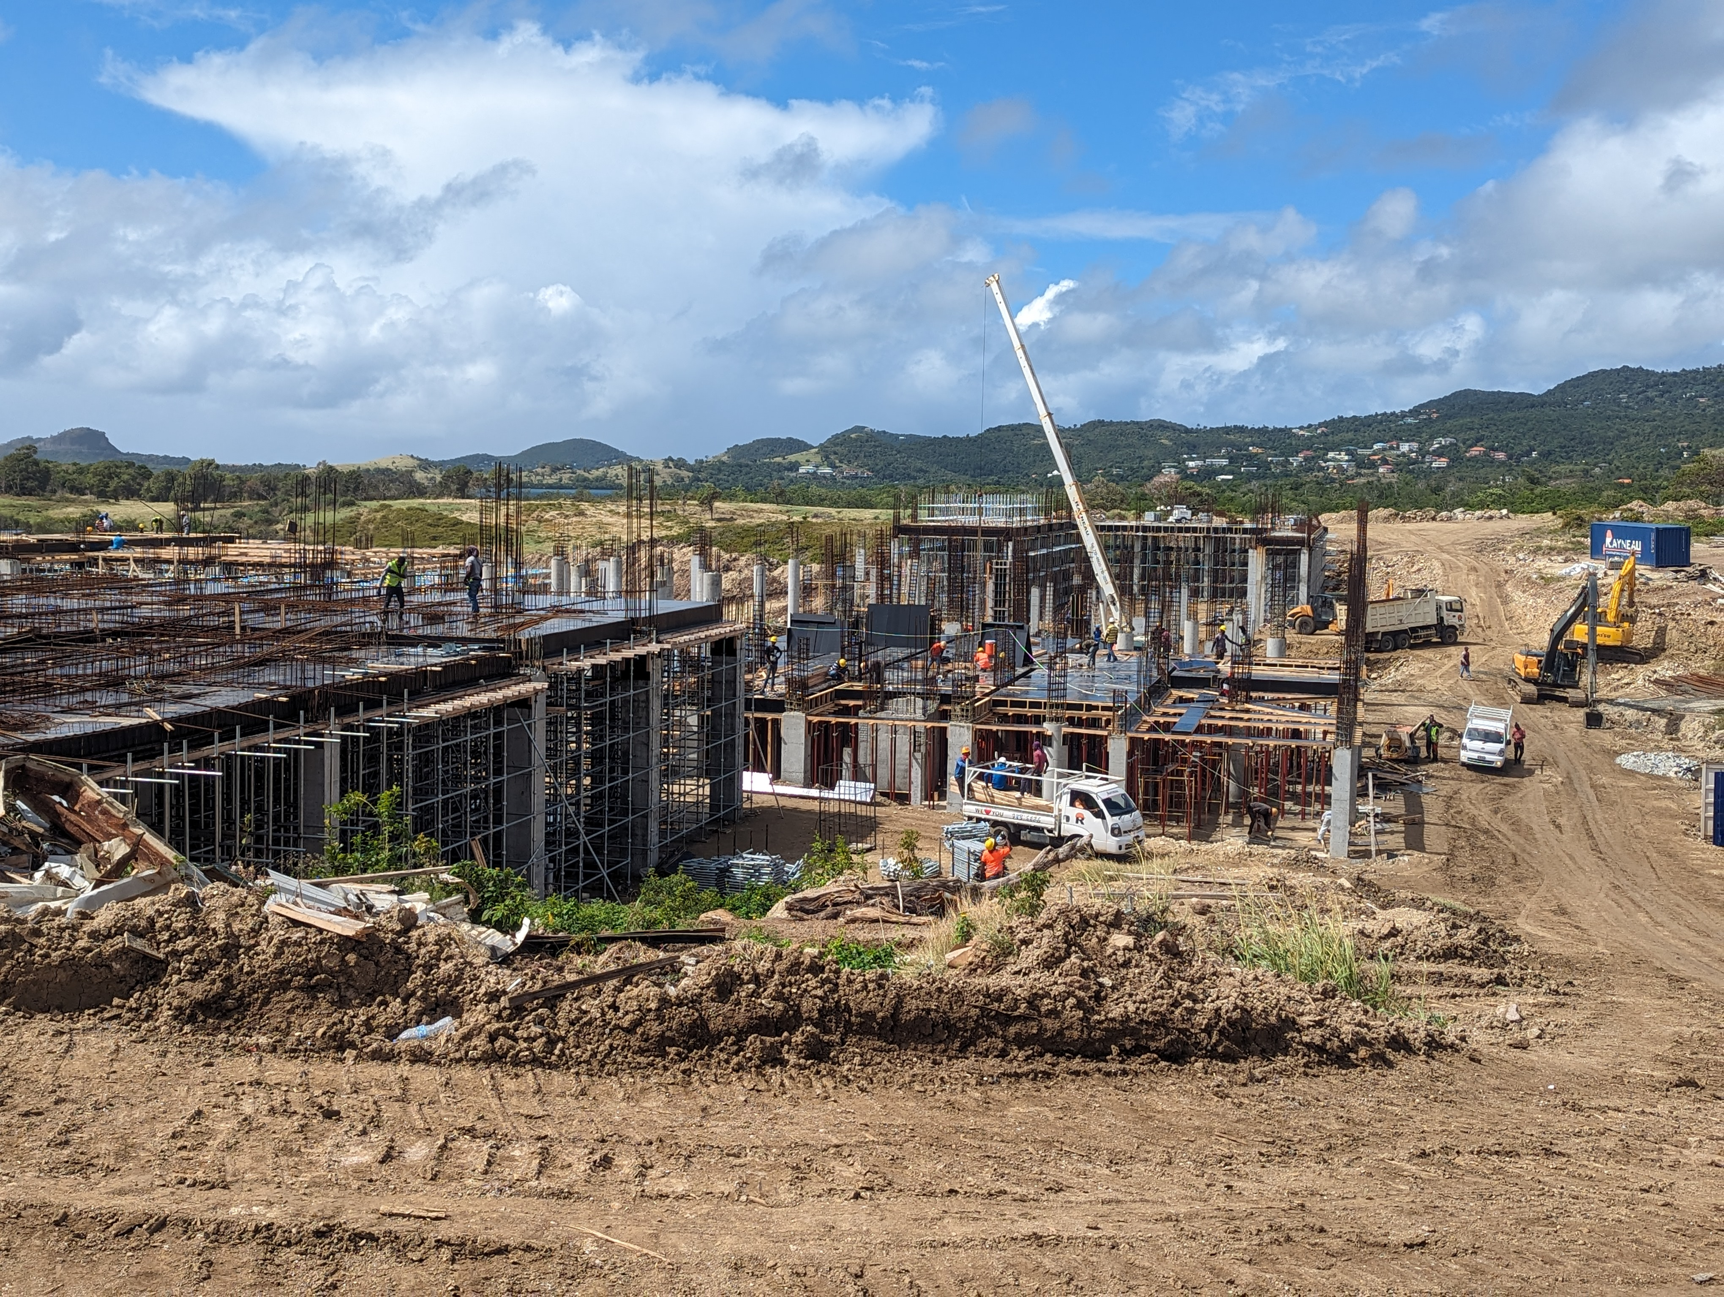
Caribbean Galaxy
The development of a 250-acre estate will see construction of a 250 room 5-star family resort, Dreams Hotel. (First Phase).
It will consist of beach bars, pools, 1 Presidential Suite, 9 guest room buildings and a main lobby/reception/dining area.
The construction of the main structure started in March 2023 and construction of 7 other buildings are underway.

Slide 4
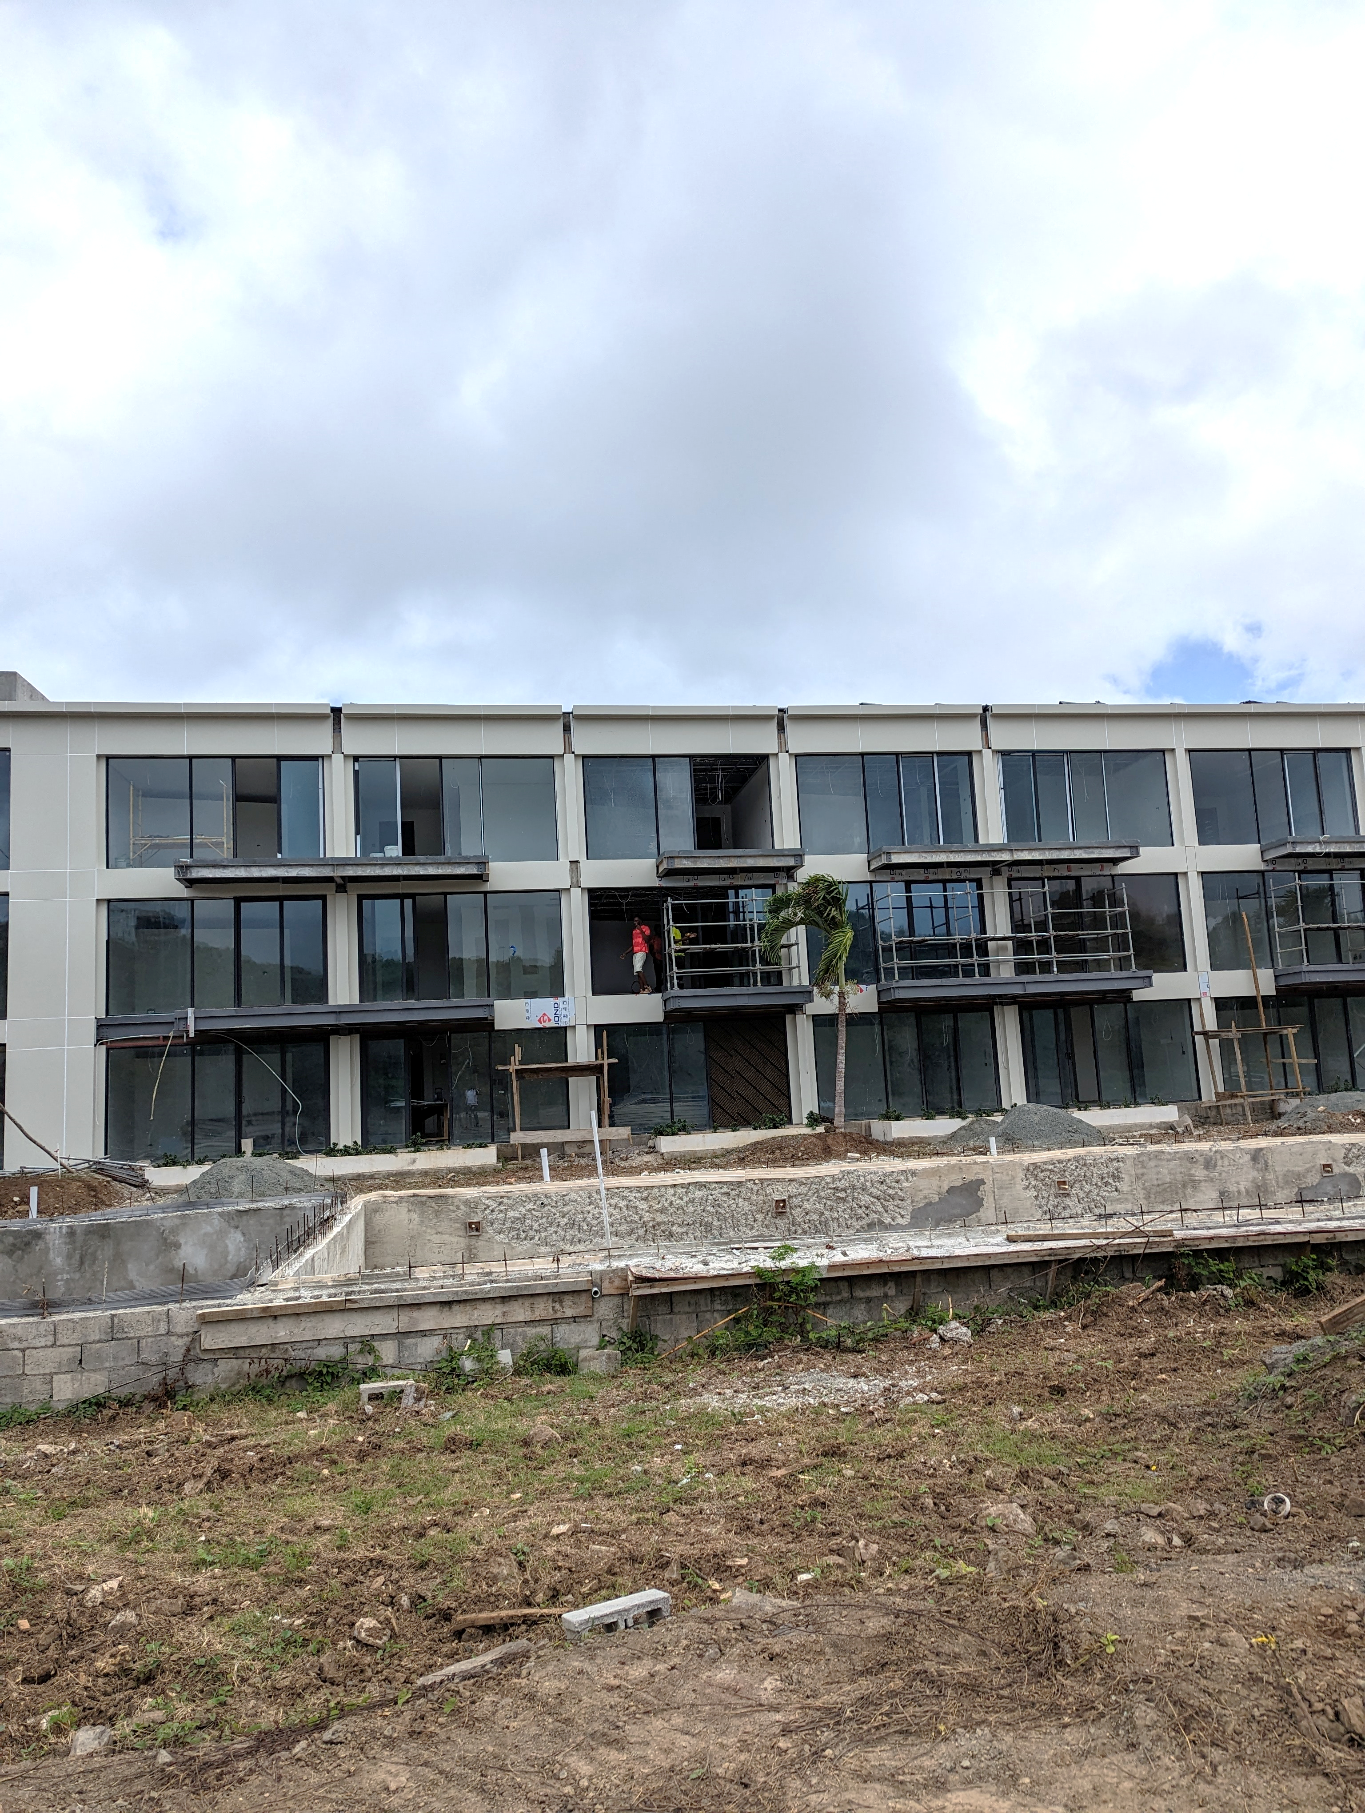
Cas En Bas Beach Resort
Cas En Bas Beach Resort comprises of two ultramodern, low-rise apartment buildings bordering one of the longest swimming pools in Saint Lucia and its surrounding sun terraces.
Facilities include 50m swimming pool, rooftop ice bar & terrace, wellness and spa treatments, sports bar, café, convenience store and business centre.
Work is progressing on building 1 with approx. 50 persons on site working on different jobs.​
Opening slated for Q1 2025 for building 1 whilst work will occur on building 2.​

Slide 5
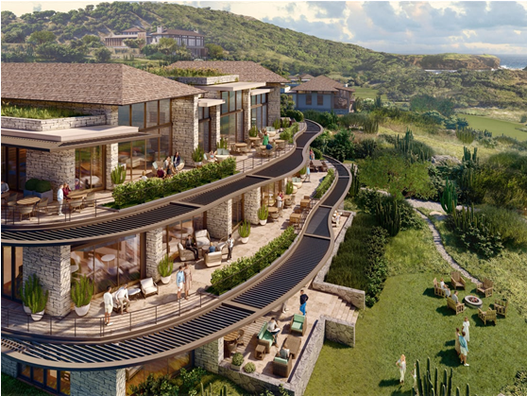
Cabot Saint Lucia
The golf course is complete and open for play.
Cabot shared the first rendering of the clubhouse. This will be a central hub of activity on the property.
The three-level structure features an array of dining options, a lively bar concept and an outdoor patio, as well as other key elements such as locker rooms, retail offerings, and the Golf Shop.
The clubhouse will also have a 4-lane bowling alley, games room and simulator, wine and poker lounge, and a cinema.

Slide 6
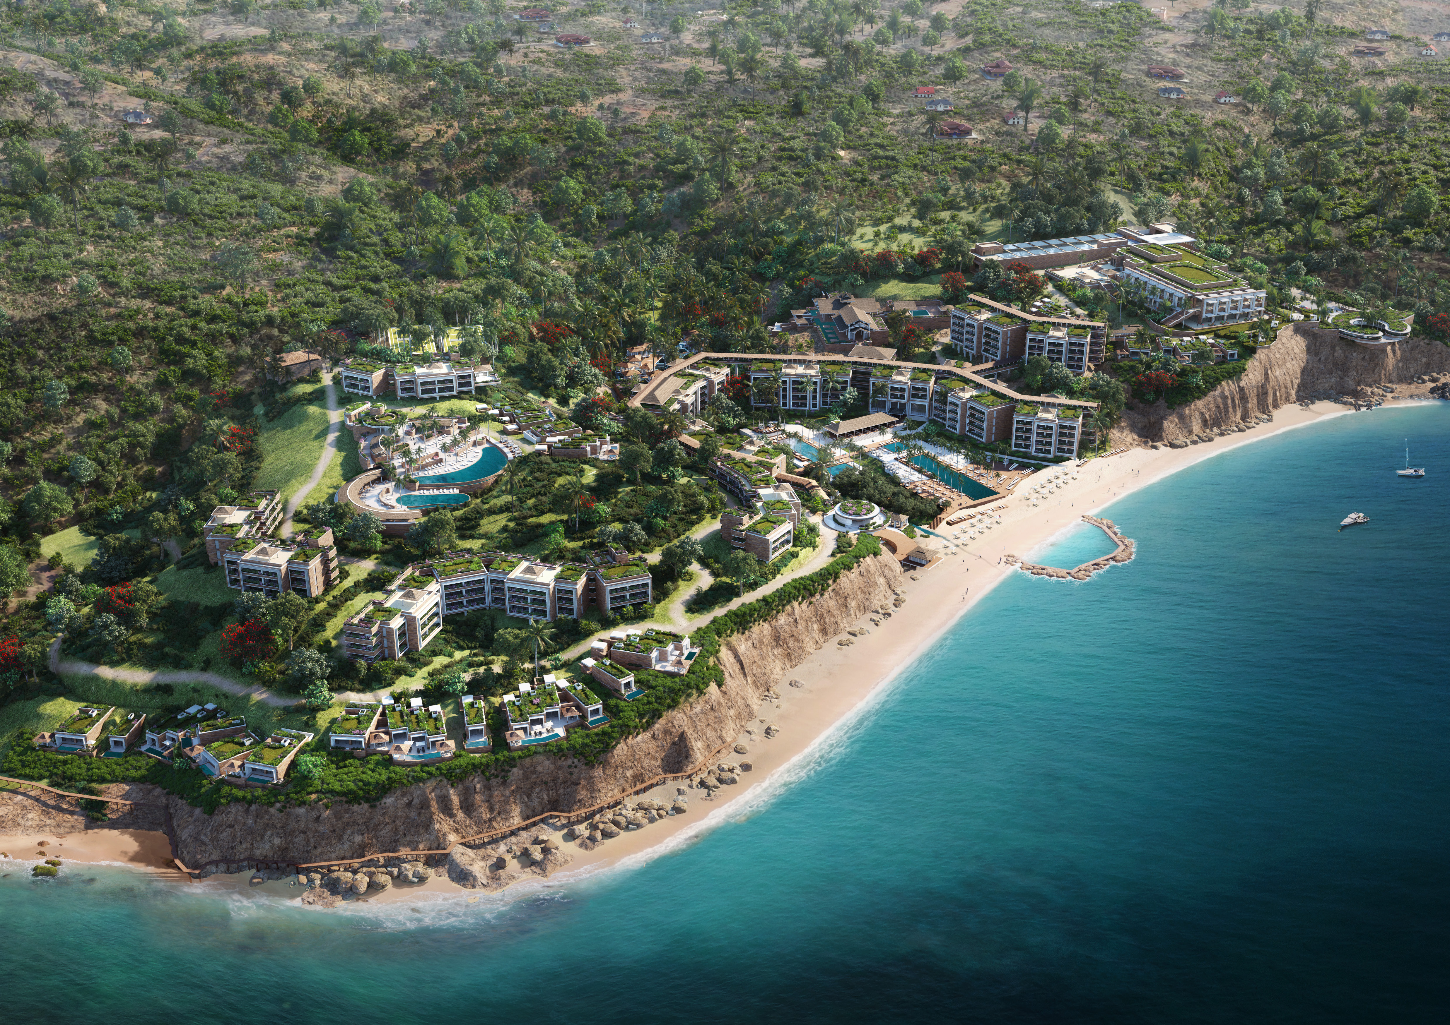
Grand Hyatt
Proposed as a 345-room luxury Grand Hyatt hotel
50+ luxury suites
3 restaurants including specialty restaurant & 3 bars
Spa and fitness center
Events space & learning activities centre
Retail shops
Sabwisha road currently cuts the property in two and as such it needs to be relocated.​
Groundbreaking for road realignment to take place in a few months.​

Slide 7
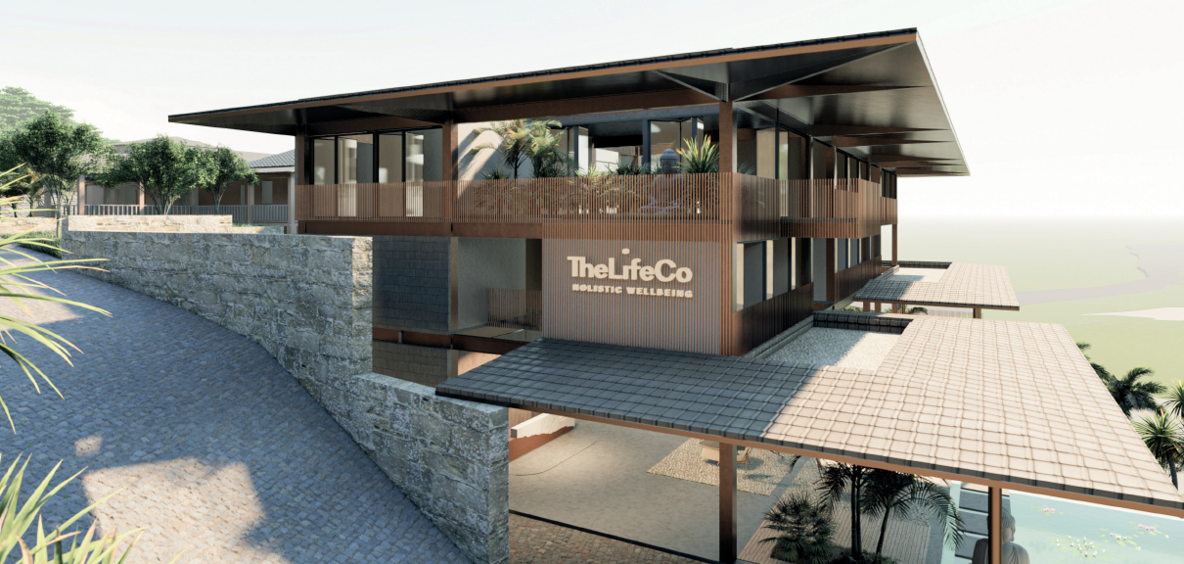
Caribbean Jewel Seven Wonders
Key spaces of the resort hotel include:
480 luxury rooms in different accommodation concepts
Themed and international restaurants
Entertainment areas-Night Club, Piano Bar, Lobby Bar
Ultimate Spa and Beauty facilities
Wedding Facility with Wedding Office
Conference Rooms and Ballrooms
Bungalows
The LifeCo is an international wellness company offering alternative solutions to improve overall quality of life with its 360 holistic wellness approach.​

Slide 8
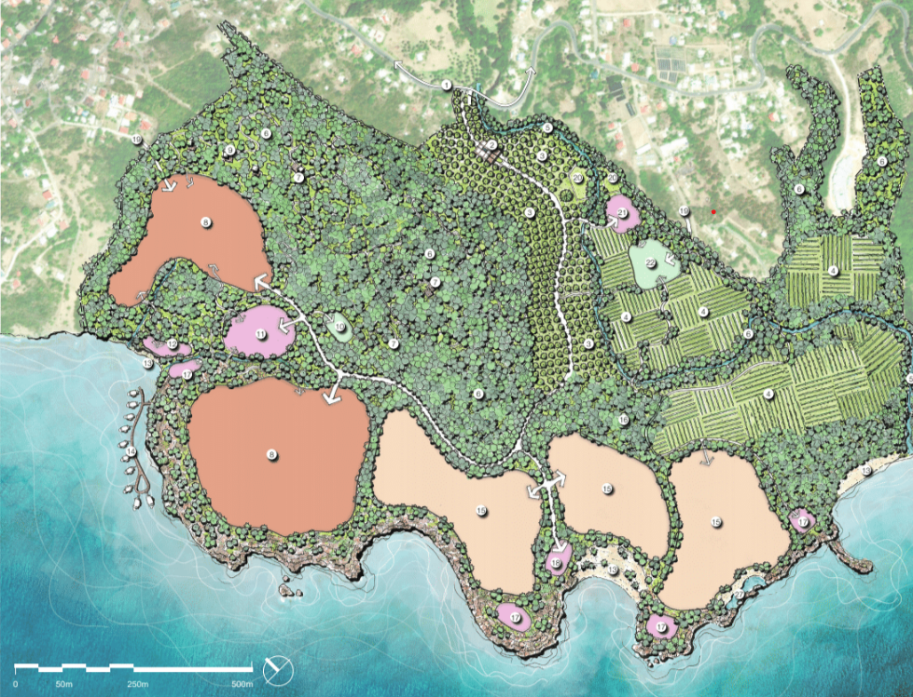
Black Bay Saint Lucia
This project is being proposed on 254 acres of land in Black Bay, Vieux Fort
It will be low ecological impact property, featuring low-density design. It will blend seamlessly with the natural surroundings and include many self-sustaining features
Phase 1: An ultra-luxury resort with 80 keys and 40 villas and residences
The resort will be equipped with amenities such as sports club, event centre, restaurants, spas, gyms, nature reserve and observatory
An international brand is being proposed as operating partner for Phase 1

Slide 9
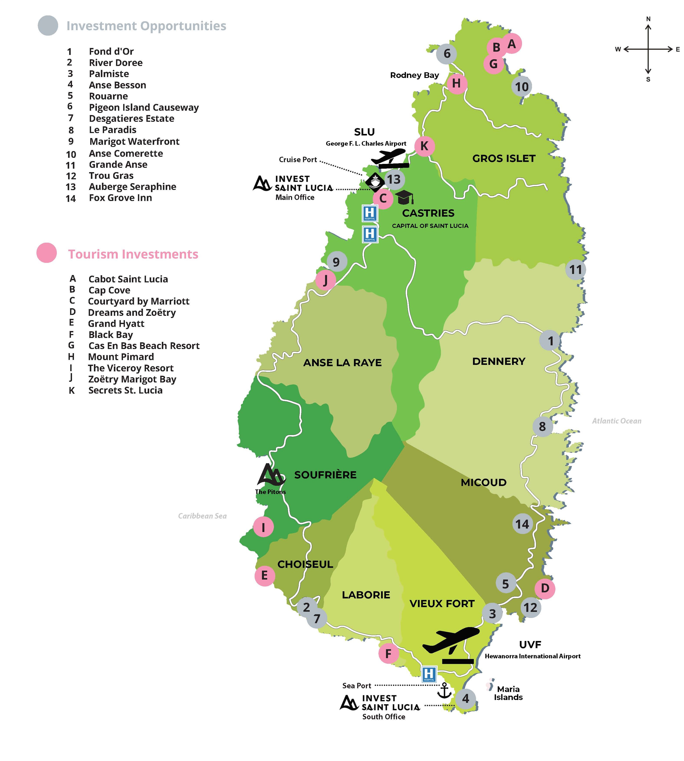

Slide 10
Upcoming Initiatives
Caribbean Hotel Investment Conference & Operations Summit (CHICOS)
Project at Ganter’s Bay
Touristic development at Beanfield, Vieux Fort
Internationally branded restaurant in the north
The American Lodging Investment Summit-Caribbean & Latin America
IGH Hotel & Resorts interested in partnership with local hotel

Slide 11
Invest Saint Lucia
info@investstlucia.com
758-457-3400

