Slide 1
HURRICANE SEASON 2023
Saint Lucia Hospitality and Tourism Association
Crisis Response Protocols
JUNE 2023
OPERATIONAL PROCEDURES

Slide 2
Contents
Introduction – NEMO
Introduction to Disaster Management System of St Lucia
NEMO Documents and Procedures
SLHTA Crisis response Protocols
Disaster preparedness
Health and Wellness Contact numbers
Emergency Shelters by District
Emergency contact information
Disaster Committee Contacts per Community
Embassy Contact details
Honorary Consuls contact information
Disaster Preparedness
Mitigation
Action

Slide 3
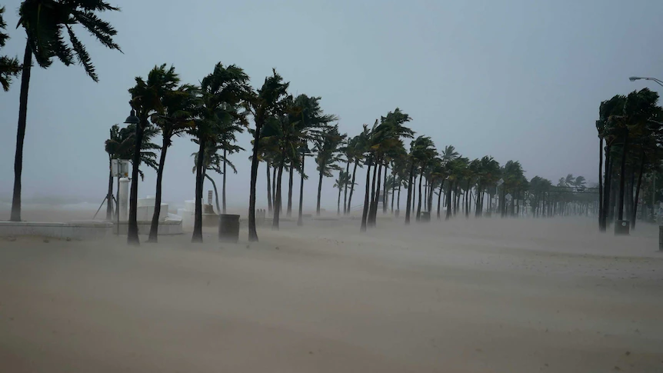
Introduction to NEMO
The role of the National Emergency Management Organization [NEMO] is to develop, test and implement adequate measures to protect the population of Saint Lucia from the physical, social, environmental and economic effects of both natural and man-made disasters.
Its responsibility is to ensure the efficient functioning of preparedness, prevention, mitigation and response actions.

Slide 4
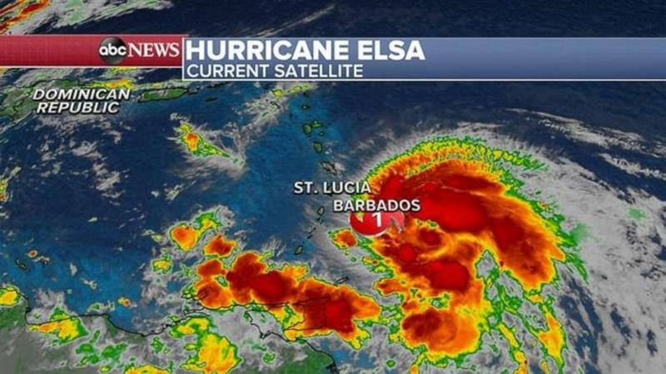
Introduction to the disaster management system
The Disaster Management System of Saint Lucia is a three
tiered one:
NATIONAL – NEMAC - National Emergency Management
Advisory Committee.
COMMITTEES - National and District Disaster Committees.
COORDINATING UNIT – NEMO Secretariat

Slide 5
NEMO documents and procedures
Standard Operating Procedures for disaster management at NEMO:
http://nemo.gov.lc/Disaster-Management/National-Emergency-Management-Plan/Standard-Operating-Procedures
General disaster documents for download:
http://nemo.gov.lc/Disaster-Management/National-Emergency-Management-Plan/General-Info
Disaster Management Policy Documents:
http://nemo.gov.lc/Disaster-Management/National-Emergency-Management-Plan/Policy-Documents
National Emergency Plans:
http://nemo.gov.lc/Disaster-Management/National-Emergency-Management-Plan/National-Plans
Ms Maria Medard– Deputy Director of NEMO - +1 758 452 3802, Email: admin@nemo/gov.lc

Slide 6
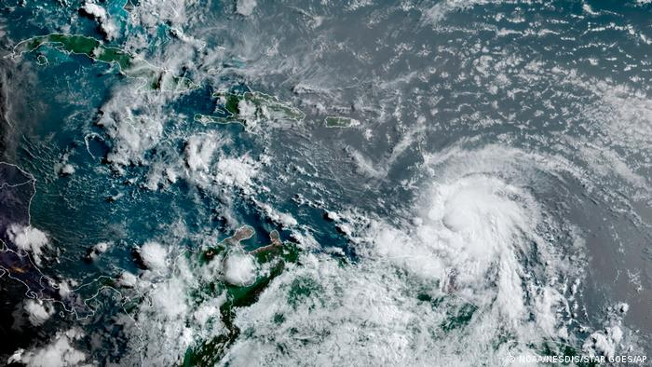
SLHTA Crisis response Protocols
The SLHTA along with other pertinent stakeholders play a pivotal role in
disaster preparedness
SLHTA are part of the NEMAC Committee
We work in conjunction with:
NEMO
GOVERNMENT OF ST LUCIA
DEPARTMENT OF HEALTH AND WELLNESS
MINISTRY OF TOURISM
METEOROLOGICAL OFFICE
SLASPA / HIA
LUCELEC
WASCO
FLOW
DIGICEL
SLTA

Slide 7
Disaster preparedness
Once a Pre-strike meeting is called by NEMO the SLHTA will implement a series of actions immediately following the announcement which is determined by the relevant authorities.
The SLHTA will provide members with updates throughout the duration of the event. This will be disseminated via the What’s App platforms.
These updates will come from various agencies – as outlined previously.
Members with guests in-house must ensure a list of guest details is easily accessible to share in the event of evacuation or accountability measures. This would include name, country of origin, arrival and departure dates.
The SLHTA would like to compile a list of emergency contacts for each member company including maintenance managers where relevant.
The following pages will give you relevant emergency contact information which would be helpful.

Slide 8
Health and Wellness Centre contacts
INSTITUTIONS TELEPHONE NUMBERS
Dennery Hospital
Respiratory Clinic
468-7650/ 468-7651/ 468-7657
468-7661/ 468-7662
Soufriere Hospital
Respiratory Clinic
468-7601/ 468-7602/ 468-7603
518-1905/ 468-7617
Gros- Islet Polyclinic
Respiratory Clinic
468 7630/ 468 7637
723-0663
Grand Riviere Wellness Centre 468-7700/ 468-7701
Monchy Wellness Centre 468-8542/ 468- 8541/ 468- 8543
Babonneau Wellness Centre 468-7720
Fond Assau Wellness Centre 4687980/ 4687981 /Mobile 285-3594
La Guerre Wellness Centre 468-7741/ 468-7742
Richfond Wellness Centre 468-7929
Micoud Wellness Centre 468-7957/ 468-7958
Ti Rocher (Micoud) Wellness Centre 468-7713/ 468-7714
Desruisseaux Wellness Centre 468-7716/ 468-7719/ 468-7717
INSTITUTIONS TELEPHONE NUMBERS
Mon Repos Wellness Centre 468-7706/ 468-7708
Vieux Fort Wellness Centre
Respiratory Clinic
468-7995/ Mobile 384-7344/
518-5881
Laborie Wellness Centre 461-6590
Saltibus Wellness Centre 468-7776/ 468-7779
Belle-Vue Wellness Centre 468-7975/ 468-7976
Grace Wellness Centre 468-7751/ 468-7752
Etangs Wellness Centre 468-7766
Fond St. Jacques Wellness Centre 468-7771/ 468-7772
Mongouge Wellness Centre 468-7786/ 468-7787
La-Fargue Wellness Centre 468-7791/ 468-7793
Delcer Wellness Centre 468-7756/ 468-7757
Jacmel Wellness Centre 468-7727/ 468-7728
La Croix Maingot Wellness Centre 468-7736/ 468-7738/ 4687737
Vanard Wellness Centre 468-7733/ 468-7734
Canaries Wellness Centre 468-7761/ 468-7762
Anse La Raye Wellness Centre 451-4225/ 4687800

Slide 9
Health and Wellness Centre contacts
INSTITUTIONS TELEPHONE NUMBERS
Castries Wellness Centre
Sexual & Reproductive Health Clinic
468-8880/ 468-8882
468-8886/ 468-8887
La Clery Wellness Centre 468-8531/ 468-8533
Mobile 723-0712
Entrepot Wellness Centre 468-7935/468-7936
Ciceron Wellness Centre 468-7704
Ti Rocher (Castries) Wellness Centre 468-7746/468-7747
Bexon Wellness Centre 468-7781/468-7783

Slide 10
Emergency Shelters by District
Gros- Islet
1.Gros Islet Roman Catholic Church
2.Gros Islet Church of the Nazarene
3.Gros Islet Infant School
4.Gros Islet Primary School
5.Gros Islet HRDC
6.Corinth Secondary School
Monchy
7.Monchy Roman Catholic Church
8.Monchy Combined School
9.Monchy Human Resource Development Centre
La Feuille
10.La Feuille Mothers’ & Fathers’ Hall
11.La Feuille Pentecostal Church
Vieux Secrieux
12.Unity Centre – Careffe Gardens
Grand Riviere (Gros Islet)
13.Grand Riviere Combined School
14.Full Gospel Deliverance Tabernacle Church
Marisule
15. Marisule Seventh Day Adventist Church – The Lighthouse on the Hill
Degazon
16. Degazon SDA Church Mount Olives
Union
17. Dame Pearlette Louisy Primary School
Babonneau
Balata
18.Balata Combined School
19.Balata SDA Church
20.Fundamental Baptist Church
Ti Morne
21.New Testament Church of God
Babonneau
22.Babonneau Resource Centre
23.Babonneau Secondary School
24.Babonneau Infant/Primary School
25.Babonneau Roman Catholic Church

Slide 11
Emergency Shelters by District
Cacoa
26.Gospel Baptist Church
27.Bethany SDA Church and Children’s Division
Fond Assau
28.Fond Assau Combined School
La Guerre
29.La Guerre Combined School
30.La Guerre Gospel Hall
Garrand
31.Garrand Mothers’ & Fathers’ Hall
Boguis
32. Boguis Combined School
33.Mother’s and Father’s Hall
Des Barras
34.Des Barras Combined School
35.Mother’s and Father’s Hall
Plateau
36.Plateau SDA Church
37.Plateau Mothers’ & Fathers’ Hall
Paix Bouche
38.Paix Bouche Kingdom Hall Jehovah Witnesses
La Croix
39. La Croix Evangelical Church
Castries North
Lanse Road
40. Camille Henry Memorial School
La Clery
41. La Clery Roman Catholic Church
42. VBCC Club House
43. Maranatha Seventh-Day Adventist Church
Vide Boutielle
44. Vide Boutielle Combined School
45. Patricia D. James Secondary School
46. Sir Ira Simmons Secondary School
Morne Du Don
47. Morne Du Don Combined School
Chase Gardens
48. Chase Gardens HRDC
CASTRIES CENTRAL

Slide 12
Emergency Shelters by District
49.Carmen René Memorial School
50.St. Aloysius RC Boy Infant School
51.St. Aloysius RC Boy Primary School
52.Ave Maria Girls Infant School
53.Ave Maria Girls Primary School
54.Anglican Infant School
55.Cannon Laurie Primary School
56.Holy Trinity Anglican Church
57.Castries SDA Church
58.Castries City Hall
59.Castries Methodist Church
60.Salvation Army Church
Castries East
Bocage
61.Bocage Combined School
62.Bocage Secondary School
63.Bocage Pentecostal Church
Marchand
64. Marchand Community Centre
65. Marchand Parish Hall
66. Bishop Gachet Combined School
67. Marchand RC Church
Entrepot
68. Entrepot Secondary School
69. Entrepot Human Resource Centre
70. Leon Hess Secondary School
Ti Rocher
71. Ti Rocher Combined School
Castries South
Ciceron
72.Ciceron R.C. Combined School
73.Deliverance Baptist Church
74.Ciceron Secondary School
75.Ciceron Methodist Church
76.Ciceron SDA Church
77.Lady Gordon Opportunity Centre
Faux A Chaux
78. Faux A Chaux Community Centre
Marigot
79.Stanley Jon Odlum Secondary School
La. Croix Maingot
80.La. Croix Maingot Combined School
Tapion
81. Tapion Private School

Slide 13
Emergency Shelters by District
Castries South East
Bexon
82.Bexon Infant School
83.Bexon Roman Catholic Church
84.Kingdom Hall of the Jehovah Witness
85.St. Benedict Roman Catholic Church
Marc
86.Marc SDA Church
Cul De Sac
87.Cul De Sac Early Childhood Development Centre
Goodlands
88.Goodlands Full Gospel Worship Centre
Ravine Poison
89.Zion SDA Church
90.Zion SDA Primary School
Sarrot
91.Sarrot Community Centre
Forestiere
92.Forestiere Methodist Church
93.Forestiere Methodist Combined School
94.Forestiere SDA Church
Ti Rocher (Castries)
95.Ti Rocher Combined School
Dierre Fort
96.Dierre Fort Seventh Day Adventist Church
Odsan
97.Odsan Combined School
98.Odsan Pentecostal Church
Trois Piton
99.Trois Piton SDA Church
Barre De Chaussee
100. Barre De Chausee Multi Purpose Court
Anse Le Raye
101.Anse La Raye Primary School
102.Anse La Raye SDA Church
103.Anse La Raye RC Church
Jacmel
104.Roseau Combined School
105.Jacmel Roman Catholic Church
Millet
106.Millet Primary School
107.Millet Infant School
Tete Chemin
108. Tete Chemin Human Resource Centre
109. Tete Chemin SDA Church

Slide 14
Emergency Shelters by District
Canaries
Canaries Village
110. Canaries Primary School
111. Canaries RC Church
112. Canaries SDA church
113. Canaries Parish Hall
114. Canaries Community Centre
Flora Villa
115. Delia’s Hideaway
Belvedere
116. Fresh Disco
Soufriere
Fond St. Jacques
117. Fond St. Jacques Roman Catholic Church
118. Fond St. Jacques Primary School
119. Fond St. Jacques Parish Centre
120. Fond St. Jacques Pre-School
Soufriere Town
121. Soufriere Roman Catholic Church
122. Soufriere Primary School
123. Soufriere Infant School
124. Soufriere Seventh-Day Adventist Church
125. Soufriere Comprehensive School
126. St. Isidore Hall
Fond Beniere
127. Christ is the Answer Church
Bouton
128. Bouton Combined School
Les Etangs
129. Les Etangs Combined School

Slide 15
Emergency Shelters by District
Choiseul
Piaye
130. Piaye Secondary School
131. Piaye Combined School
Saltibus
132. Saltibus Combined School
133. Saltibus Roman Catholic Church
134. Darban Mothers’ and Fathers’ Hall
River Doree
135. River Dorée Anglican Church
136. River Dorée Combined School
137. River Dorée Mothers’ and Fathers’ Hall
La Fague
138. La Fargue Mission Evangelical Church
139. Choiseul Secondary School
140. Roblot Combined School
Choiseul Village
141. Choiseul Roman Catholic Church
Reunion
142. Reunion Primary School
143. Enrichment Centre
144. Reunion Pentecostal Church
Mongouge
145. Mongouge Combined School
Dugard
146. Dugard Combined School
Victoria
147. Victoria Roman Catholic Church
148. Victoria Seventh Day Adventist Church
Delcer
149. Delcer Combined School
La Maze
150. La Maze Community Resource Centre
La Pointe
151. La Pointe Pentecostal Apostalic Church

Slide 16
Emergency Shelters by District
Laborie
Laborie Village
152. Laborie Boys Primary School
153. Laborie Girls Primary School
154. Laborie Roman Catholic Church
155. New Life Pentecostal Church (La Croix Road)
Augier
156. Augier Pre School (St. Francis Xavier)
157. Augier Combined School
158. Augier Roman Catholic Church (St. Francis Xavier)
159. Augier Evangelical Church
Banse/La Grace
160. Banse La Grace Combined School
161. Banse La Grace Evangelical Church
162. Banse La Grace Pre School
163. Banse La Grace Pentecostal Church
Vieux Fort South
164. Vieux Fort Comprehensive School Campus A
165. Vieux Fort Comprehensive School Campus B
166. Plain View Combined School
167. Vieux Fort Primary School
168. Victory Pentecostal Church
169. Beanfield Secondary School
Vieux Fort North
Pierrot
170. Pierrot Combined School
171. Pierrot RC Church
Morne Cayenne
172. Morne Cayenne Evangelical Church
Vigier
173. Vigier Combined School

Slide 17
Emergency Shelters by District
Belle Vue
174. Belle Vue Human Resource Centre
175. Harvest Pentecostal Church (new inspection)
176. Belle Vue Combined School
177. Belle Vue RC Church
Grace
178. Grace Combined School
179. Grace Community Centre
180. Grace RC Church
181. Grace Fair Trade Centre
Micoud South
Ti Rocher
182. Ti Rocher Multi Purpose Centre
183. Liberty Baptist Church
184. Seventh Day Adventist Church - Ti Rocher
185. Ti Rocher Combined School
Desruisseaux
186. Fond Desruisseaux Mothers’ and Fathers’ Hall
187. Desruisseaux Combined School
188. Desruisseaux Seventh-Day Adventist Church
189. Desruisseaux Roman Catholic Church
190. Desruisseaux Multi Purpose Centre
191. Desruisseaux Evangelical Church
Blanchard
192. Blanchard Pentecostal Church - Solid Rocks
193. Blanchard Combined School
194. Redeem Christian Fellowship Church - Blanchard
Dugard
195. Dugard Community Centre

Slide 18
Emergency Shelters by District
Mon Repos
206. Mon Repos RC Church
207. Mon Repos Seventh Day Adventist Church
208. Praslin Community Centre
209. Bible Baptist Church
210. Born Again Revival Pentecostal Church
211. Malgretoute Baptiste Church
Dennery North
La Resource
212. La Resource Day Care Center
213. La Resource Roman Catholic
214. La Resource Parish Centre
215. La Resource Combined school
Grande Riviere
216. Grande Riviere Secondary School
217. Grande Riviere Seventh Day Adventist Church
218. Grande Riviere Human Resource Center
Anse Ger
196.Anse Ger Secondary School
La Couville
197.La Couville Evangelical Church
Micoud North
Micoud Village
198. Lime Light Disco
199. Faith Tabernacle Church
200. Micoud Multi Purpose Centre
201. Micoud Primary School
202. Micoud Secondary School
203. Micoud RC Church
204. Ebenezer Seventh Day Adventist Church
Patience
205.Patience Combined School

Slide 19
Emergency Shelters by District
Gadette
219. Gadette Day Care
Richfond
220. Richfond Combined School
Aux Lyon
221. Aux Lyon Combined school
Derniere Riviere
222. Derniere Riviere Apostolic Faith Church
223. Derniere Riviere Combined School
Dennery South
Dennery Village
224. Dennery Infant
225. Dennery Seventh Day Adventist Church
226. Clendon Mason Memorial School
La Caye
227. St. Mary’s Anglican Church

Slide 20
Emergency contact information
Download the CAP CAP app to your mobile phone:
CAP CAP Google Play:
https://play.google.com/store/apps/details?id=hr.optimit.capcap.mobile&hl=en&gl=US
CAP CAP Apple: https://apps.apple.com/us/app/capcap/id1176568291
NEMO: http://nemo.gov.lc/
Tel: +1 758-452-3802, Ms Maria Medard – Acting Director
Email: admin@nemo.gov.lc
St Lucia Meteorological Services: https://met.gov.lc/
Hewannora Intl Airport Tel: +1 758 454 6550
Fax: +1 758 454 9705
George FL Charles Airport +1 758 452-5860
Hotline: +1 758 454-3452
E-mail: slumet@yahoo.com
Twitter: @stluciaweather
Facebook: StLuciaMet
SLASPA Flight status: https://www.slaspa.com/hia/index.php/en/hia-arrivals
Tel: +1 758 457 6100
Email: info@slaspa.com

Slide 21
Emergency contact information
LUCELEC: https://www.lucelec.com/
Tel: +1 758 457‐4761
Mobile: +1 758 519-9613 – Omari Frederick – Corporate Communications Officer, External Communications
Email: Omari Frederick - ofrederick@lucelec.com
Customers can call the following numbers to report localized faults: 452-2165 for the north of the island and 454-6617 for the south of the island (from Praslin to Bouton).
Send fault reports via WhatsApp: 285-6796, 285-7859, 285-3593, 285-3329, 728-9754, 728-9755, 728-9756. Please provide your name, a contact number, the location of the fault and the type of fault.
Email: customersupport@lucelec.com
WASCO: https://wascosaintlucia.com/
Control Room North Tel: +1 758 457 3958/60
Control Room South Tel: +1 758 457 3984
Vieux Fort Tel: +1 758 457 3980
Soufriere Tel: +1 758 457 3987
Email: wasco@candw.lc
Email: wascocontrol@gmail.com / control@wascosaintlucia.com

Slide 22
Emergency contact information
MINISTRY OF TOURISM: https://slutourism.govt.lc/
DIGICEL: http://www.digicelstlucia.com/
Tel: +1 758 728 3400
Roaming Tel: +1 758 716 7626
Email: customercarestlucia@digicelgroup.com
Twitter: @digicelStLucia
Instagram: @digicelstlucia
SLHTA – Noorani Azeez: +1 758 721 4444 ceo@slhta.info / Juliet Sutherland: +1 758 726 4680 bdo@slhta.info
Saint Lucia Tourism Authority: https://www.stlucia.org/en/
Tel: +1 758 458 7101
Email: information@stlucia.org

Slide 23
Disaster Committee Chairpersons
1. Marcelina Newton
Micoud North
730-2513/722-3413
2. Paul Francis
Micoud South
730-2506/717-3989
3. Allister Phillip
Castries East
730-2694/384-9254
4. Phillip Leon
Castries South East
730-2711/714-8033/
285-8176
17. Sarah Jules
Babonneau
730 2685/713-9817
18. Claudine Louison
Dennery North
730-2508/725-4641
5. Ulric Alphonse
Laborie
730-2505/730-0134
4875929
6. Ian Frederick
Canaries
730-2689/722-6510
730-0160
7. Jeny Gillard
Choiseul
730-2491/486-0829
8. Lindy Eristhee
Vieux Fort
730-2699/721-9799
9. Ausbert Regis
Dennery South
730-2501/485-3048
10. Elisha Clarke-Malaykhan
Castries North
730-2740/286-9133
11.Mervin S Joseph
Castries South
730-2503/519 6270
12. Placide Lascaris
Soufriere
730-2493/2853193
13. Davis Paul
Castries Central
730-2517/720-8414
14. Stephen Griffith
Anse-la-Raye
730-2709/519-6270
15. Dwain Edward
Vieux Fort North
730-2688/714-8520
16. Vance Pilgrim
Gros Islet
730-2514/720-5037

Slide 24
Embassy Contact Details
Ambassador Bernard Toscano
Ambassador of Cuba
Tel: 758 458 4665/ 285 3383
Email: embacubasantalucia@candw.lc
Ambassador Peter Chen
Ambassador of the Republic of China (Taiwan)
Tel: 758 452 8105
Email: taiwanembassyslu@gmail.com
Ambassador Maigualida Aponte Ambassador of Venezuela to Saint Lucia
Tel: 758 452 4033
Email: embavenezslu@gmail.com / vembassy@candw.lc
Acting head of Mission Mr Marrc Mertillo
France to St Lucia
Tel: 758 455 6060
Email: embassy@ambafrance-lc.org
Ambassador Abderrahim Kadmiri
Ambassador to the Embassy of the Kingdom of Morocco
Tel: 758 452 0925 / 758 458 4924
Email: embmorslu@candw.lc
Ambassador Luis Manuel Lopez Moreno
Ambassador of Mexico
Tel: 758 451-4254
Email: mexicanembassy@candw.lc / llopezm@embmexslu.com

Slide 25
Embassy Contact Details
Lesley Saunderson
Resident British Commissioner
British High Commission
Tel: 758 452 2484 / Zinna Zimbanni 520 1969
Email: zinna.zimbanni@fco.gov.uk
Ambassador Mr Hisham Tayeb
Ambassador of Libya to St Lucia
Tel: 758 452-0196 / 458-0152 / 488 0108
Email: libyanembassy.saintlucia@yahoo.com
Ambassador Anuar Nahes
Ambassador of Brazil to St Lucia
Tel: +1 758 450 1671
Email: brasemb.castries@itamaraty.gov.br

Slide 26
HONORARY CONSULAR REPRESENTATIVES IN SAINT LUCIA
AUSTRIA
Mr. Konrad Wagner
C/o Calabash Cove
Tel: (758) (C) 484-9813/ 456-3500
Email: konradinstlucia@hotmail.com
BARBADOS
Mr. Timothy Chaderton
Tel: (758) 452-8219 / Cell: (758) 485-3058
Email: chadertont@gmail.com
CANADA
Ms. Paule Turmel-John
Tel: (758) 453 6431 (H) / Cell: (758) 484-6610
(758) 724-6431 (C)
Email:pauleturmel@gmail.com / stlucia-stelucie@international.gc.ca
CHILE
Mrs. Brenda Floissac-Flemming
Tel: (758) 452-2887 / 452-3250
Email: brenda.floissac@floissaclawyers.com
DENMARK
Ms. Jasmine Kouly
Tel: (758) 285-2112
E-mail: royalknight@candw.lc/ Jasminekouly@gmail.com
FINLAND
Mrs. Berthia Monica Parle
Tel:(758) 452-0700 (h) / (758) 716-1301 (c)
Email: bp@baygardensbeachresort.com

Slide 27
HONORARY CONSULAR REPRESENTATIVES IN SAINT LUCIA
GERMANY
Ms. Karolin Güler Troubetzkoy
Cell: (758) 727-7002
Email: soufriere@hk-diplo.de
hcgermany@candw.lc
GUYANA
Mr. Lokesh Singh
Tel: (758) 453-1149
Mobile: 484-6168
Email: lokesh@amsstlucia.com
ISRAEL
Dr. Charmaine Gadner
Tel.: (758) 452-2153/484-6004
Email: gardnerc@carascoslu.com
ITALY
Mrs. Maria Thom
Tel: (758) 452 0866/5/ 712-1244
Email: mpt@casalucia.com
JAMAICA
Mr. Tyrone Chong
Tel: (758) 452 3040
Email: chongco@candw.lc
THE NETHERLANDS
Mr. Rhory Mc Namara
Tel: (758) 518-1530
Email: rhorymac@gmail.com / stlucia@nlconsulate.com

Slide 28
HONORARY CONSULAR REPRESENTATIVES IN SAINT LUCIA
KINGDOM OF NORWAY
Mr. Albert Daniels
Tel: (758) 451-8198 / 716-7171
Email: albert@daniel.lc / norway@consulate.lc
SPAIN
Mr Richard Peterkin
Tel: (758) 456-2626/4508 (H)/716-9797 (C)
Email: richard.peterkin@lc.gt.com
SOUTH KOREA
Mr. Randall Bain
Tel: (758) 452-7742 / Cell: (758) 720-5491
Email: bain61@gmail.com
SWITZERLAND
Mr. Konrad Wagner
Tel: (758) 484-9813
Email: saintlucia@honrep.ch
SWEDEN
Ms. Michel Anthony-Desir
Tel: (758) 452-5111/5112
Cell: (758) 484-6305
E-mail: mdesir@athenalawslu.com info@athenalawslu.com
TURKEY
Mr. Victor Poyotte
Tel: (758) 450-5347 / Cell: (758) 485-1638
Email: victor.poyotte@gmail.com

