Slide 1
Energy Awareness Training
Objective
To educate your team members on the power they use at home so they can better control what they use and save $$$
Notes:
24, 29, 32, 1.00, 1.17, 1.29, 1.31, 2.64

Slide 2
Energy Awareness Training
Secondary Objective
With the provision if information our team members can become energy proactive in their homes which in turn will engender habits that will spill over into the work place
Notes:
24, 29, 32, 1.00, 1.17, 1.29, 1.31, 2.64

Slide 3
Energy Awareness Training
Using only knowledge and getting buy-in from employees to be as proactive with energy as they are at home, an organization can reduce power and water consumption up to 15% without the need for any capital investment
Notes:
24, 29, 32, 1.00, 1.17, 1.29, 1.31, 2.64

Slide 4
Energy Awareness Training
Your Commitment!
To pass on this information and nurture the use of knowledge to reduce your overall consumption of power and water.
ASK QUESTIONS
Notes:
24, 29, 32, 1.00, 1.17, 1.29, 1.31, 2.64

Slide 5
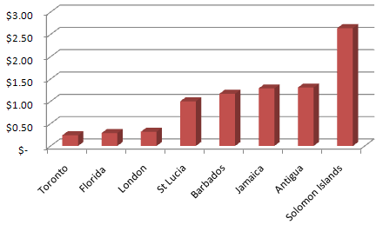
Cost of Energy - Electricity
What is the cost of power?
Charges us $1.00EC for each kW/H (Kilowatt-hour)
Compare
to:
How much power is a kW/H?
1 kW/H is the use of 1000 watts for 1 hour
Notes:
24, 29, 32, 1.00, 1.17, 1.29, 1.31, 2.64

Slide 6
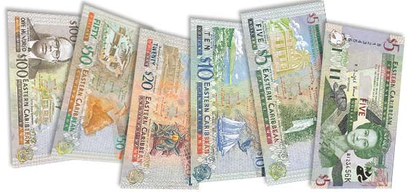
At home where do you spend your electricity dollars?

Slide 7
Old Light Bulbs V’s LED Lighting
A 60W Brightness LED Lamp uses only 7W of power
A GOOD QUALITY LED Lamp lasts 50,000 hours
An incandescent lamp lasts 1000 hours
You would need to buy 50 traditional bulbs over time to equal 1 LED bulb
1 X LED Bulb = EC $60 - 50 X incandescent bulbs = EC$200
60W incandescent operating for 50,000 hours = $3,000.00 + $200 Total $3,200
7W LED operating for 50,000 hours = $350.00 + $60 Total $410

Slide 8
Old Light Bulbs V’s LED Bulbs
60W incandescent operating for 50,000 hours = $3,000.00 + $200 Total $3,200
7W LED operating for 50,000 hours = $350.00 + $60 Total $410
DO NOT BUY!
Incandescents!

Slide 9
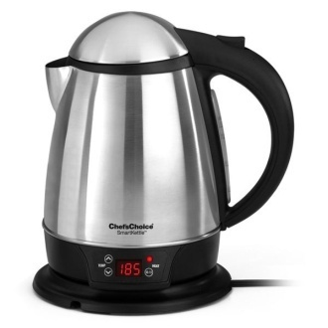
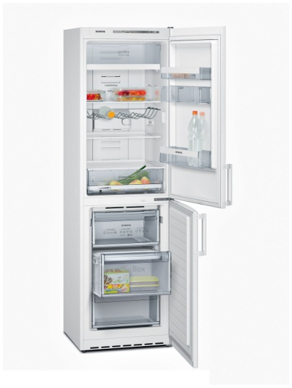
General Appliances
Curling Iron 120W 8.5 Hours for EC$1.00
Kettle 1800W 45 minutes for EC$1.00
15 Cu Ft Fridge freezer 5 Hours for EC$1.00
TV 200W 5 Hours for EC$1.00

Slide 10
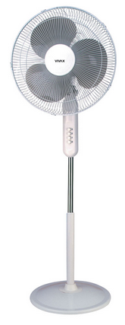
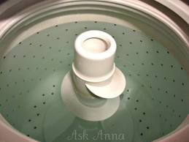
Standing Fan Desktop PC Washing Machine
PC uses 400W
You get 2.5 hours
for $1.00
Fan uses 100W
You get 10 hours
for $1.00
Washing machine uses 300W
You get 3.3 hours
for $1.00
NOTE: Cold Wash Only

Slide 11
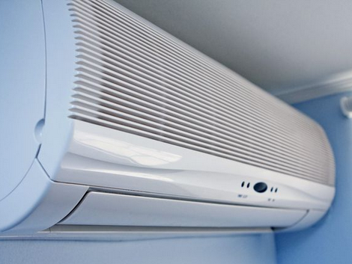
12,000 Btu (Small)
1000W
You get 1 hour cooling for $1.00
18,000 Btu (Med)
1500W
You get 45 minutes cooling for $1.00
24,000 Btu (Large)
2000W
You get 30 minutes cooling for $1.00
ROOM
PRICES

Slide 12
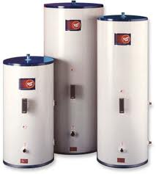
Electric Hot Water Heaters
Hot water heaters carry a 2500W element
For each hour the element is heating your water it costs you EC$2.50
NOTE : On Average a 4 person family will use 2 hours water heating per day totaling EC$5.00
Alternatives: Solar Hot Water Systems
Hot Water for FREE
Did you know that the St Lucia IRS Gives 100% tax rebate on the purchase of a Solar Heater?

Slide 13
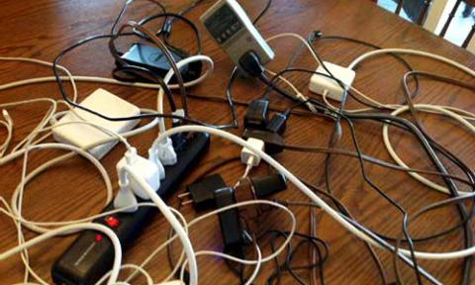
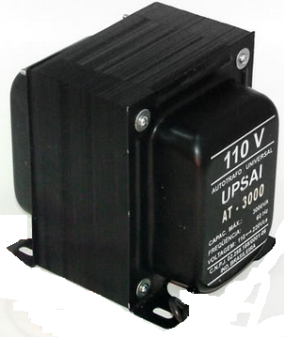
Phantom Power
Phantom power is what is used without you getting any benefit from the power consumption.
A transformer that is plugged in even though there is nothing connected to is consumes power.
Your TV, DVD, Computer & Phone Chargers all consume power when plugged in even when NOT in use.
Up to EC$2.00
A Day!

Slide 14
How to save electricity
Only buy and use Compact Fluorescent or LED lighting SAVE 75-80%
Use a fan instead of an Air Conditioner SAVE 90% Or use Solar assisted A/C units and save 40%
Install a solar Hot Water Heater SAVE 100%
Unplug all transformers when not in use SAVE Phantom Power use
Open your fridge / Freezer door for as short a time as possible to either load it or take something. NOTE 30% of the cooling is lost in just 5 seconds of the door being open.
Boil only the water you need when you use a kettle or are cooking
Never leave an Iron on when not in use – Even if you answer the phone you save dollars by turning off then back on again
Always turn off lights in areas where they are not in use

Slide 15
Cost of Energy - Water
What is the cost of water?
Charges us
EC$18.15 for each 1000 Gallons of water used at HOME
EC$36.40 for each 1000 Gallons of water used at the RESORT
What is the cost of wasting water?

Slide 16
Cost of Wasting Water
LEAKING TOILETS
High volume water leaks often come from toilets.
They are hard to detect and are usually caused by
worn or misaligned parts. A toilet that continues
to run after flushing could be wasting 5-10
gallons per hour - that’s 46,000 to 92,000 gallons
or between EC$851.00- EC$1,702.00 per year
A LITTLE DRIP CAN MEAN A LOT!
An intermittent drip from your faucet or showerhead can waste more than 9,400 gallons of water a year, costing up to EC$173.90 This amount of wasted water would fill a bathtub 184 times! The costs can add up quickly!

Slide 17
Cost of Wasting Water
LEAKING PIPES
A leaking service line or pipe in your home can add up to serious water waste. A small hole in a pipe (1/8th inch) wastes 74,000 Gallons of water in a three-month period. Continual leaking from this size hole could cost you about EC$1,369.00 in that
three month time period. This is enough water to do about 900 loads of laundry!
Remember if dripping water is hot water your
energy dollars are also going down the drain!

Slide 18
What we do at work!
We leave walk-in coolers & freezer doors open!
WHY?
WHAT CAN WE DO DIFFERENTLY?

Slide 19
What we do at work!
We leave taps running for NO reason!
WHY?
WHAT CAN WE DO DIFFERENTLY?

Slide 20
What we do at work!
We don’t care for our equipment!
WHY?
WHAT CAN WE DO DIFFERENTLY?

Slide 21
What we do at work!
We do not turn off when not in use!
WHY?
WHAT CAN WE DO DIFFERENTLY?

Slide 22
Cost of Utilities
How much does YOUR HOTEL pay monthly to LUCELEC for our electrical consumption?
GUESS?

Slide 23
Cost of Utilities
LUCELEC
EC$??,000 -Month

Slide 24
Cost of Utilities
How much does YOUR HOTEL pay monthly to WASCO for our water consumption?
GUESS?

Slide 25
Cost of Utilities
WASCO
EC$??,000 - Month

Slide 26
Cost of Utilities
How much does YOUR HOTEL pay monthly to TEXACO for our LPG consumption?
GUESS?

Slide 27
Cost of Utilities
TEXACO/SOL
EC$??,500 - Month

Slide 28
Total Cost of Utilities
PER MONTH EC$??,000.00
PER YEAR EC$?,000,000

Slide 29
Best Practice Target
Target % Savings
5% $172,500
10% $345,000
15% $517,500
20% $690,000
25% $862,500
30% $1,035,000

Slide 30
What can you do?
Be Responsible
Think Train Talk
Support Share
Educate
Emulate Best Practice Do!

